Slide 1
AMINO ACID SEQUENCING KHUSHBAKHT KHALID 2016-mphil-1376

Slide 2
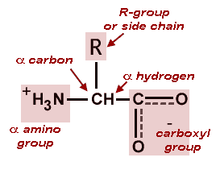
AMINO ACIDS
They are molecules containing an(—NH₂) group, a(—COOH) group, and a side-chain that is specific to each amino acid.
The key elements of amino acid are carbon, hydrogen, oxygen, sulphur and nitrogen

Slide 3
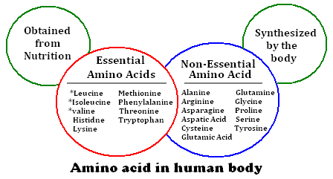
AMINO ACID IN HUMAN BODY

Slide 4
AMINO ACID SEQUENCE
“Peptide sequence or amino acid sequence, is the order in which amino acid residues, connected by peptide bonds, lie in the chain in peptides and proteins.”

Slide 5
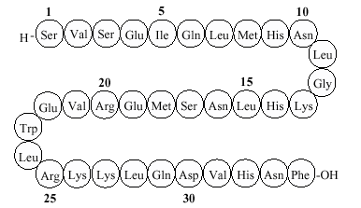
AMINO ACID SEQUENCE

Slide 6
INTRODUCTION
The sequence is generally reported from the N-terminal end containing free amino group to the C-terminal end containing free carboxyl group.
Shorter peptides are sequenced with automated procedures but larger proteins must be sequenced in smaller segments.

Slide 7
IMPORTANCE OF AMINO ACID SEQUENCING
The Amino acid sequence of a protein determines its three-dimensional structure
Many inherited diseases are caused by mutations that result in an amino acid change in a protein.
Amino acid sequence analysis can assist in the development of diagnostic tests and effective therapies.

Slide 8
HISTORY
Frederick Sanger determined the first known protein sequence, that of hormone insulin in 1953.ote
Sanger’s result established that all of the molecules of given protein have the same sequence.can be sequenced in two ways:
- real amino acid sequencing
- sequencing the corresponding DNA in the gene

Slide 9
N-TERMINAL ANALYSIS
Each polypeptide chain (if it is not chemically blocked) has an N- terminal residue.
Identifying this “end group” can establish the number of chemically distinct polypeptides in a protein.

Slide 10
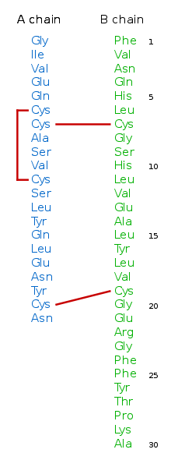
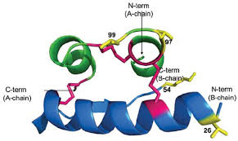
HUMAN INSULIN

Slide 11
METHODS TO DETERMINE N-TERMINAL AMINO ACID
SANGER’S METHOD:
Sanger developed the reagent 1-fluoro-2,4- dinitrobenzene (FDNB).
After treatment of protein with FDNB , the amino terminal residue is labeled with FDNB and the polypeptide is hydrolyzed to its constituent amino acid.
The labeled amino acid is identified.

Slide 12
The Sanger Method

Slide 13
EDMAN DEGRADATION
INTRODUCTION
The Edman degradation is carried out in a machine called a sequenator that:
mixes reagents in the proper proportions
separates the products
identifies them
records the results.
These methods are extremely sensitive. Often, the complete amino acid sequence can be determined starting with only a few micrograms of protein.

Slide 14
EDMAN DEGRADATION
EDMAN DEGRADATION REACTIONS
The Edman degradation procedure labels and removes only the amino terminal residue from a peptide , leaving all other peptide bonds intact.
The peptide is reacted with phenylisothiocyanate (PITC) and a basic buffer solution of 12%trimethylamine. This reacts with the amine group of the N-terminal amino acid. under mildly alkaline conditions.

Slide 15
EDMAN DEGRADATION
The terminal amino acid can then be selectively detached by the addition of anhydrous trifluoroacetic acid acid with removal of the amino- terminal amino acid as an anilinothiazolinone derivative
The derivatized amino acid is extracted with organic solvents, converted to the more stable phenylthiohydantoin derivative by treatment with aqueous acid and then identified.

Slide 16
EDMAN DEGRADATION
After removal and identification of the amino terminal residue, the new amino-terminal residue so exposed can be labeled, removed, and identified through the same series of reactions .
This procedure is repeated until the entire sequence is determined.

Slide 17
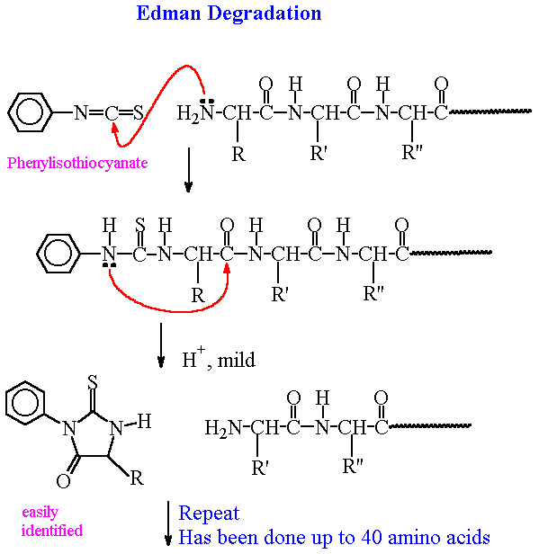
EDMAN DEGRADATION

Slide 18
Mass Spectrometry
Mass Spectrometry
Another method of protein sequencing, called mass spectrometry, uses electric current to break individual amino acids from a protein.
In a mass spectrometer, the released amino acids are collected in a detector and are each identified by their unique mass.

Slide 19
Other Methods for Amino Acid Sequencing
Predicting protein sequence from DNA/RNA sequences
Bioinformatics tools for sequencing

