Slide 1
Microarray technology
Advanced analytical techniques
Submitted to: sir irshad
Submitted By: Ambreen khalid
2016-mphil-1379

Slide 2
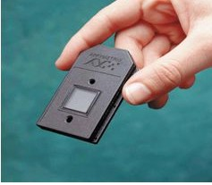
Microarray
A microarray is a multiplex lab-on-a-chip.
It is a 2D array on a solid substrate (usually a glass slide or silicon thin-film cell) that assays large amounts of biological material using high-throughput screening.

Slide 3
An arrangement of dna sequences on a solid support.
A surface (nylon , glass or plastic).
Containing hundred to thousands pixels.
Each pixel has copies of a sequence of single standard dna (ssdna).
Each such sequence is called a probe.
Each microarray contain thousands of genes.
Able to simultaneously monitor gene expression levels in all the genes.

Slide 4
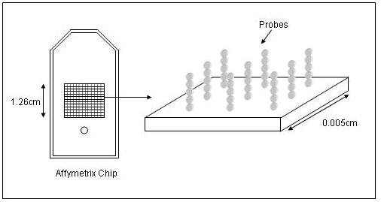

Slide 5
history
Microarray technology evolved from southern blotting , where fragmented dna is attached to a substrate and then probed with a known dna sequence.
The use of miniaturized microarrays for gene expression profiling was first reported in 1995, a complete eukaryotic genome on a microarray was published in 1997 by pat brown’s group.

Slide 6
Microarray technology
Microarray technology measure copy number of molecules in a mixture on a small slide.
Thousands or millions of different kinds of molecules can be measured simultaneously, thus creating large volumes of data per biological sample.
The molecules can be dna , rna or protein.

Slide 7
Types of microarray
DNA microarrays
Protein microarrays
Peptide microarrays
Tissue microarrays
Cellular microarrays
Chemical compound microarrays
Antibody microarrays
Carbohydrate arrays

Slide 8
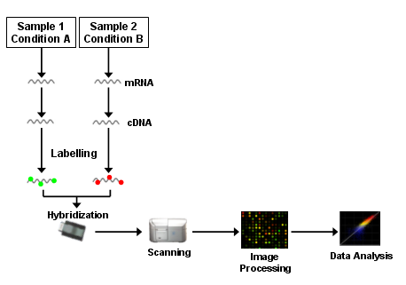

Slide 10
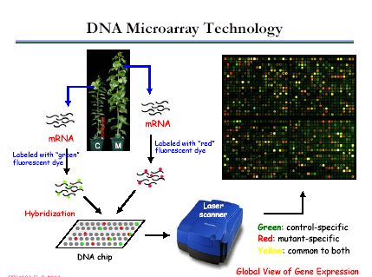

Slide 11
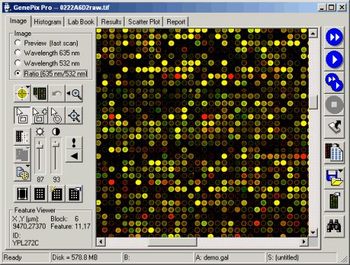

Slide 12
applications
Gene discovery
Disease diagnosis
Drug discovery: pharmacogenomics
Toxicological research: toxicogenomics
Gene expression
Genotyping
Dna sequencing

Slide 13
Identify genes expressed in different cell types ( liver vs kidney)
Learn how expression levels change in different developmental stages ( embryo vs adult )
Learn how expression levels change in disease development ( cancerous vs non-cancerous)
Learn how groups of gene inter-relate ( gene-gene interaction)
Identify cellular processes that genes participate in ( structure, repair, metabolism etc.)

Slide 14
advantages
Simultaneous analysis of multiple gene
High throughput
Allows comparison of genes expression ( healthy vs non- healthy)
Can categorize diseases into subgroups

Slide 15
disadvantages
Confusion to first time users
Result not always reproducible
Gene expression is dictated by qualitative data
Still too expensive

Slide 16
conclusion
Technology is evolving rapidly
Blending of biology, automation, and informatics
New applications are being pursued
Beyond gene discovery into screening, validation, clinical genotyping, etc
Microarrays are becoming more broadly available and accepted
Protein Arrays, tissue arrays, etc.
Diagnostic Applications

