Slide 1
Fish Diseases & Their Control

Slide 2
Introduction
Like all other animals fish also suffer from various diseases and effects of pollutants.
In case of pollution death is rapid and fish of all sizes are affected.
In case of disease, one individual or a group of individuals or in extreme case entire population is affected.
Fish may die within few days, or several weeks or months.
Diseases are more common and dangerous among fishes living in confined spaces as compared to wild.

Slide 3
Signs of Fish Diseases
Fish Become Sluggish
Don’t take Feed
Rub its body with dikes or any other hard object in water
Increase in breathing frequency
Discoloration of body
Rapid secretion of grey colored slime on the body
Appearance of brown, black or white spots on the body.
Fin cuts and eaten out
Whirling or tumbling movements

Slide 4
Abdominal swelling
Fish may stop eating.
Cuts and wounds on fish body
Eyes move inward
Gills colour changed
Thick mucus on body surface

Slide 5
Types of diseases
Based on the causes of the diseases in shrimps/fish, they can be grouped into four main types:
1. Environmental causes: These diseases are caused due to poor environmental conditions like low dissolved oxygen or high ammonia.
2. Nutritional diseases: They are caused by qualitative and/or quantitative deficiency in one or more of the essential feed components in the daily ration of the farmed animals.
3. Pathogens: The pathogens may be of viral, bacterial or fungal origin. Parasitic diseases also are known to inflict huge economic losses to the brackishwater farmers worldwide.
4. Stress: The physiological status of the animal decides the ultimate susceptibility of the fish/shrimp to the disease.

Slide 6
Kinds of Fish Diseases
Viral Diseases: e.g. Viral Hemorrhagic Septicemia
Fungal Diseases: e.g. Saprolegniasis, Branchiomycosis
Bacterial Diseases: e.g. Abdominal Dropsy, Fin rot, Bacterial Gill Disease
Protozoan Diseases: e.g. Costiasis, whirling Disease
Worm Diseases: e.g. Dactylogyrus, Leeches
Crustaceans Diseases :e.g. Lernaeasis, Argulosis
Nutritional Diseases :e.g. Vitamins deficiency, Protein deficiency
Environmental Diseases: e.g. Anoxia, pH Change, Ammonia excess

Slide 7
Viral Hemorrhagic Septicaemia (VHS)
Because of RNA Genome Virus
Changes in metabolic and biochemical Profiles
Damage to Kidney and liver
Sign of Disease
Abnormal Movements
Swollen Eyes
Swollen Belly
Red Intestine
Pale Gills
Swollen Kidneys
Control Measures
No effective treatment
Infected Fish must be removed and buried
Clean ponds and avoid overstocking

Slide 8
Saprolegniasis
Because of fungus Saprolegnia
It attack skin, fins, head, mouth and gills
Reasons
Injuries on skin body because of netting
Attack of parasites
Weakened fish, Fungus spores are present in water and attack fish in favorable conditions
Sign of Disease
Gray white or light brown wooly blotches on fins
Thread like tufts of cotton wool on skin
Fungus on gills
Fish rub its body with hard surface
Control Measures
KMnO4 bath 1g/100lit water for 60-90 minutes
Malachite Green bath10gm/lit for 15 minutes
Disinfection of pond with lime

Slide 9
Abdominal Dropsy
Bacterium Aeromonous punctata
Attack in spring season
Sign of Disease
Swelling Belly
Pinkish or yellowish liquid in body cavity
Intestine, Kidneys and liver infected
In Ulcerative form ulceration of skin with blood spots
Frequent jumping of fish

Slide 10
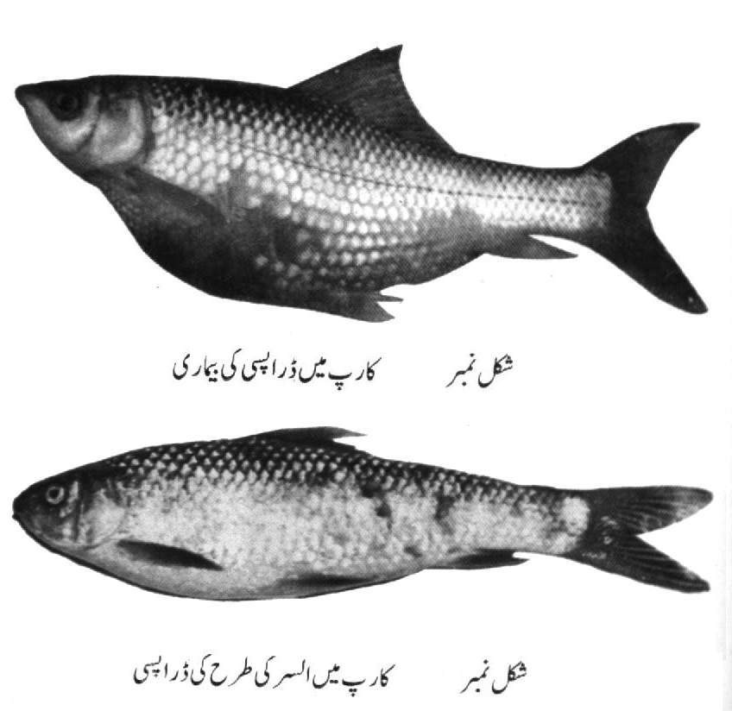
Control Measures
Use of antibiotics e.g. Oxytetracycline either in feed or injection @ 1mg/100gm body weight
Bath in KMnO4 5ppm for 2 minutes
Dead fish should be removed and buried

Slide 11
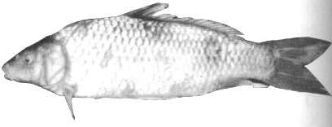
Fin Rot
Because of bacterium Aeromonas and Pseudomonas
Fish become sluggish and fins become black
Cuts and wounds appear on fins
Only fin base left
Control Measures
CuSO4 Bath 50mg/lit for one minute
Apply Mercuric Chloride on fins

Slide 12
Epizootic Ulcerative Syndrome (EUS)
Because of Fungus Aphanomyces
First considered to be caused by Virus
Some scientists consider it to be because of Bacterium Aeromonas invadance
Discovered in Pakistan in 1996
Most dangerous can cause high mortality
Attack is likely in winters and in oxygen deficiency

Slide 13
Epizootic Ulcerative Syndrome (EUS)
Sign of Diseases
Red spots on skin
Restrict feeding
Scales become detach
Fish become sluggish and swim on surface with head out of water
Control Measures
Avoid unnecessary Netting
Disinfection of ponds and utensils and nets
Avoid overstocking
KMnO4 bath 5ppm
Bleaching Powder bath 1ppm or5-10Kg/hector in pond
Oxytetracyclin in feed @ 60mg/Kg
1% common Salt bath for one hour

Slide 14
Costiasis
Caused by flagellate Costia necatrix
When there is excessive cow dung
Scarcity of food and pH acidic
Sign of Disease
Slimy Secretion on skin, fins and gills
Red patches on skin
Gills become brownish
Control Measures
Bath in 40ml Formaline in 100liters water for 15 minutes
Bath in 10gm NaCl in 100liters for 20 minutes

Slide 15
Dactylogyrus
Known as Gill Fluke Dactylogyrus vaslator
Sign of Disease
Gills swell and gray at edges and partly destroyed
Control Measures
Formalin bath 1ml/lit for 15 minutes
NaCl bath 25gm/lit for 10 minutes

Slide 16
Argulosis
Argulus is crustacean parasite
Attaches to skin of fish at base of fins
Anemia may result
Argulus may produce toxic substances
Control Measures
Bath in Lysol 1m/5lit water for 5-10 seconds
KmNO4 bath 1gm/lit for 40 seconds

Slide 17
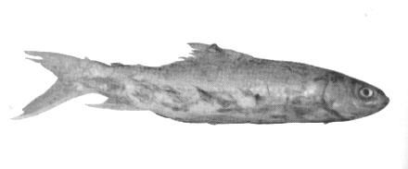
LERNEASIS
Because of a crustacean Lernaea thread like 9-22mm
Attaches with fish body with antennae and enters below scales and cause detachment of scales
Attack mostly in spring
Fish rub its body with some object
Growth stagnant and fish mortality
Control Measures
Remove lernaea with forceps
Bath in KMnO4 25ppm for few seconds & repeat after few days
Disinfection of equipments with KMnO4
1% NaCl bath for few mint followed by 5ppm CuSO4 for few seconds
Add Diptrex 0.2 to 0.5mg/lit or 1 Tea Cup/ Acre

Slide 18
Methods of disease prevention
The farm should be located in a pollution-free environment.
1. Before stocking, the ponds should be drained, sun dried and sufficient quantity of lime should be applied.
2. The ponds should be stocked only with healthy seeds.
3. Quarantine measures: the seed and brood of shrimp/fish should be screened for pathogenic microorganisms before transporting for aquaculture purposes.
4. Water quality plays a very critical role in maintaining the optimal health of the shrimp and utmost care is to be taken to provide the best water quality to the cultured fishes/shrimps.

Slide 19
Contd…
5. Balanced diet at optimum quantity should be supplied. Accumulation of unutilized feed should be avoided which otherwise might lead to spoilage of pond bottom.
6. Though genetically improved, disease resistant varieties of fish or shrimp are not readily available, that remains as the best option for preventing disease incidence in captivity.
7. Drugs are useful to control the diseases if they are applied during the early phase of the diseases.

Slide 20
Prophylactic Measures
Water supply of good quality
Proper aerated water
Free of Pathogens
Avoid excessive growth of plants
Annual drying out of ponds
Disease free stocking
Proper stocking ratio (Avoid over crowding)
In case of out break dead or infected fish must be destroyed
Excessive netting and handling must be avoided
Ponds must be disinfected with lime
Killing of unnecessary fish with piscicide
Disinfection of utensils and nets

Slide 21
Pathological changes in fish organs
Hyperplasia of epidermis: when epidermal cells proliferate at all levels.
Ulceration of epidermis: the epidermis tends to get separated from the basement membrane caused by necrosis of adjacent dermis.
Dermatitis: the upper layer of skin (stratum spongiosum) and lower layer of skin (hypodermis) are commonly affected. The inflammatory response is due to bacterial infection and exudates contain necrotic debris, fibrin and pathogens.

Slide 22
Anaemia: is due to reduction in the total amount of haemoglobin carrying red blood corpuscles, leading to reduction in oxygen transport and pathogens attacking haemopoietic tissues.
Leukaemia: the number of leukocytes increases in blood.
Neoplasia: the formation of tumors in the affected tissue caused by a number of factors such as, virus, toxins, hormones etc. e.g., papiloma of skin, carcinoma of oral mucosa, adenoma of thyroid and liver fibroma of connected tissue.

Slide 23
Oedema of gills: the base of secondary lamellae shows the increased capillary permeability. An extensive oedematous separation of the gill epithelial lining develop followed by cellular necrosis.
Granuloma of gut: small white nodules appear on the gut wall in chronic infection.
Cirrhosis of liver: toxic agents causes extensive cell necrosis . The nuclei pyknotic and cytoplasm vacuolated. Cirrhosis represents an advanced condition as hepatocellular damage.
Glomerulonephrites of kidney: thickening appears on the Bowman’s capsule’s glomerular tuft and also on the basement membrane. Fibrosis may follow , b/c of the diabetic conditions and parasitic or bacterial infection.

Slide 24
Cataract of the eye: common among farm fishes caused by parasite diplostomum spathecum.
Lesions of muscles: muscles is favourable for different parasites, which produces different types of lesions like lernea, nematodes etc.

