Slide 1
“Fishing Communities”

Slide 2
Outline
Definition
Introduction to Fishing Communities:
Bhadala, Machiyar, Maimal and Jhabel
Fishing Techniques
Economic Benefits
Needs of the Fishing Community
Improvements for the Fishing Communities

Slide 3
Introduction
A Fishing Community is a community that is substantially dependent on, or substantially engaged in, the harvest or processing of fishery resources.
“In fishing community everyone is the manager. Everyone has responsibilities” (John Kearney)

Slide 4
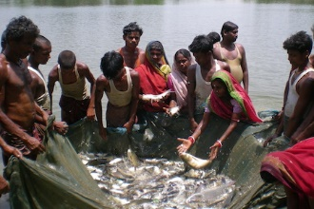

Slide 5
Inland Fishing communities
Inland Fishing communities are as followings:
Bhadala
Machiyar
Maimal
Jhabel

Slide 6
Bhadala and Machiyar
Bhadala are an ethnic group found in Pakistan and India. They are found mainly in the Kutch District of Gujarat.
Machiyar are Muslim community found in the state of Gujarat in India. They also known as Machhi. The Machiyar are a fishing community distributed throughout the areas of Gujarat from Kutch to south Gujarat.

Slide 8
Jhabel and Maimal
Jhabel are a Seraiki tribe, found in the province of Punjab. The Jhabel are essentially a tribe of fishermen and boatmen, found in the southern districts of Punjab.
Mamial are a Muslim community found in the state of Assam in India. They are a community of inland fishermen found in Western Assam. A few are also found in the Sylhet District of Bangladesh.

Slide 9
Fishing techniques
Inland fishing communities mostly used these methods for fish catching.
Fishing techniques include:
Hand gathering
Netting, Angling and Trapping.
Recreational, Commercial fishers use different techniques and also sometimes the same techniques.

Slide 10
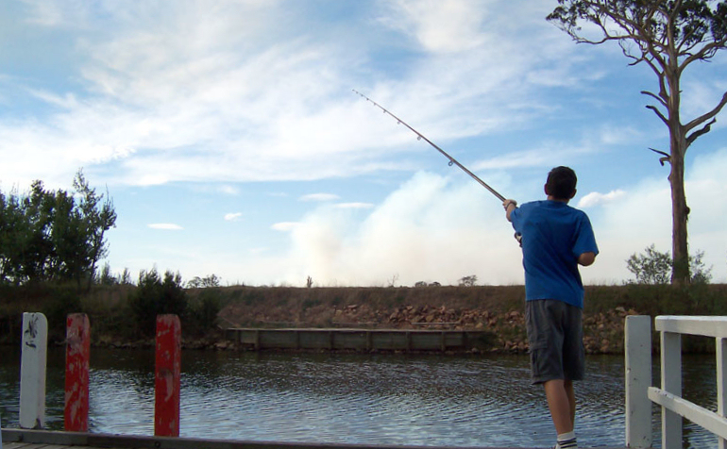
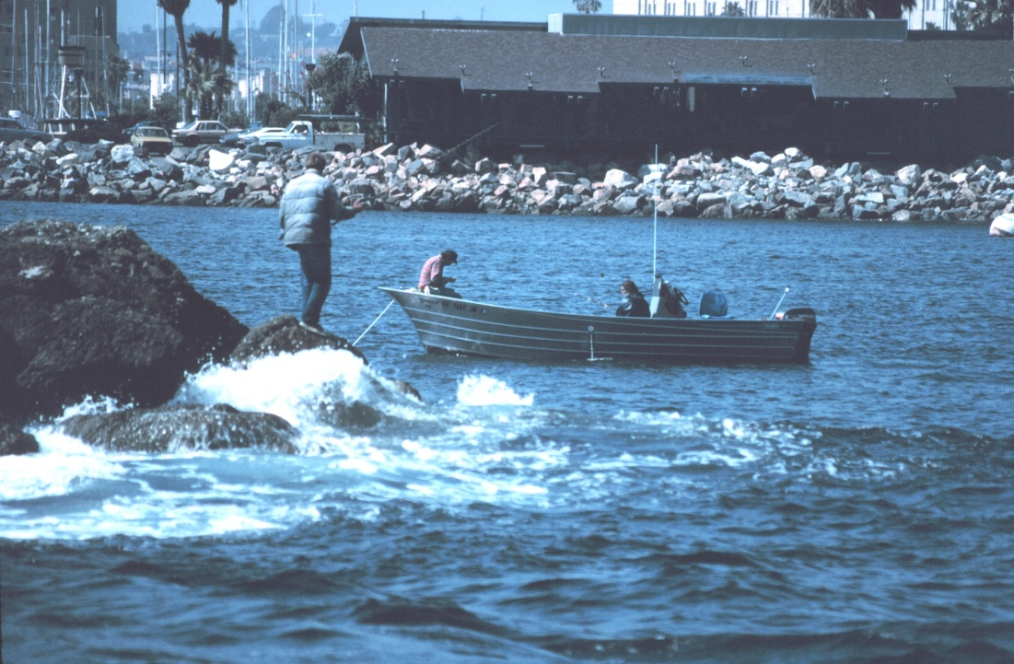
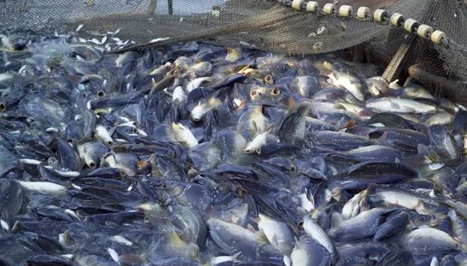

Slide 11
Economic benefits
It provides employment to about 300,000 fishermen directly.
In addition, another 400,000 people are employed in ancillary industries.
In July-May 2015-16 fish and fishery products valued about US $ 300 million were exported from Pakistan.
Federal Government is responsible for fishery of Exclusive Economic Zone of Pakistan.

Slide 12
Contd..
Pakistan is endowed with rich fishery potential. It is located in the northern part of the Arabian Sea and has a coastline of about 1,120 km with a broad continental shelf and its Exclusive Economic Zone extends upto 200 n. miles from the coast.
There are about 16,000 fishing boats in coastal area of Pakistan which operate in shallow coastal waters as well as in offshore areas.
These fishing boats undertake fishing trips lasting for few hours to about 25 days depending upon type of fishing. Total production from inland and marine waters is approximately 0.60 M. tons.

Slide 13
FISH HARBOURS OF PAKISTAN
The major fish harbours of Pakistan are: Karachi Fisheries Harbour is being operated by Provincial Government of Sindh. Karachi Fish Harbour handles about 90% of fish and seafood catch in Pakistan and 95% of fish and seafood exports from Pakistan. Korangi Fish Harbour is being managed by Federal Ministry of Food, Agriculture and Livestock. Pasni Fish Harbour being operated by Provincial Government of Balochistan. Gwadar Fish Harbour being operated by Federal Ministry of Communication.

Slide 14
Contd…
Jiwani
Gwader
Pasni
Ormaro
Sonmiani

Slide 15
FISH PROCESSING PLANTS
There are 29 fish processing units in Pakistan with storage capacity of 10,000 tons, out of these 25 units are locate in Karachi of Federal Government provided intelligentsia and technical assistance to seafood establishments for improving their processing conditions in line with various EU / international standards.
Through this process, 8 establishments have already improved their conditions and were approve to export seafood to European Union countries.
In addition, another five plants have almost upgraded their conditions and others are also undertaking changes in their facilities to comply with EU / international standards.

Slide 16
Measures to improve fisheries export
The Government of Pakistan is taking various measures to increase the export of seafood over US$ 500 million within next two years. The measures are: Up-gradation of fishing vessels to control post harvest losses. Provision of modern peeling sheds for providing raw material to fish processing industry. Flake ice plants on harbours. Intensive marketing efforts at international level. Promotion of marine aquaculture. Human resource development through training. Regular monitoring of resources through stock assessment surveys and exploratory fishing. Procurement of handling and cleaning equipments for fish harbours. Construction of coastal highway.

Slide 17
Management of fishing communities:
Stock assessment.
Harvest Planning.
Allocation and Implementation Monitoring.

Slide 18
need of Inland Fishing community
Protect and maintain systems.
More fish.
Better regulations, not more regulations.
Socio economics

Slide 19
need of Inland Fishermen
Inland Fishermen may also need support in:
Internal communication and communications with government.
Tracking fish landings and how the fishery is progressing in terms of conservation and harvesting plans (e.g. the percentage of total quota caught).

Slide 20
need of Inland Fishermen
Keeping records and convening meetings of the membership or committees. Attending consultation meetings with government and various hearings.
Marketing development, organizational strengthening, strategic planning, and public relations. Many management boards hire administrative personnel to help with those types of management activities.

Slide 21
Improvements for Fishing communities
Incentives to improve Conservation Practices.
Cooperative Research.
Create new Partnerships.
Training/education
Improving their livelihood
Health and insurance

