Slide 1
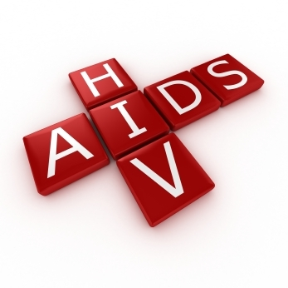
Presented By: First 15 Students

Slide 2
What does HIV stand for?
H. Human
I. Immunodeficiency
V. Virus

Slide 3
What does HIV stand for?
H. Human (Infects only Human beings)
I. Immunodeficiency (Decrease or weakness in the body’s ability to fight off infections and illnesses)
V. Virus (A pathogen having the ability to replicate only inside a living)

Slide 4
History
The world first became aware of AIDS in the early 1980’s.
Researchers aren’t sure exactly when and how HIV developed.
The most likely theories assume that HIV-1 was transmitted to humans from chimpanzees sometime in the early 20th century.

Slide 5
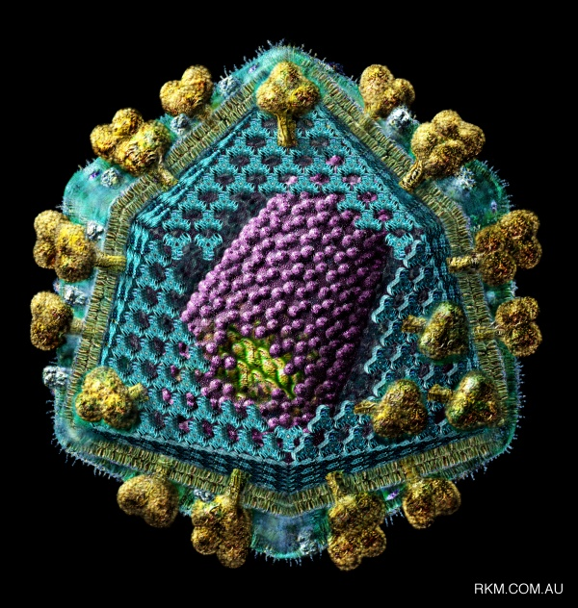
What is HIV?
Human Immunodeficiency Virus
an RNA based virus that causes AIDS
1. Attacks the Immune System
2. Destroys the body’s defenses against diseases
3. Body becomes vulnerable to infections & cancers
that don’t normally develop in healthy people

Slide 6
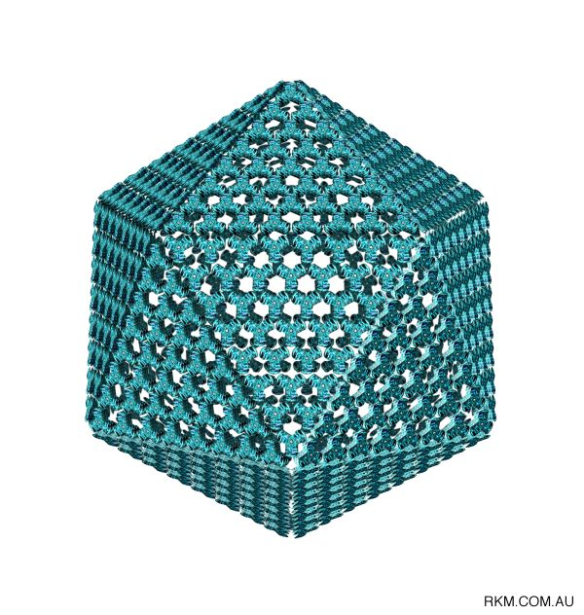
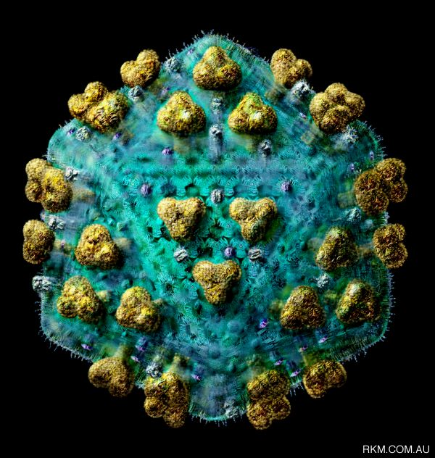
What does HIV look like?
HIV Capsule
HIV

Slide 7
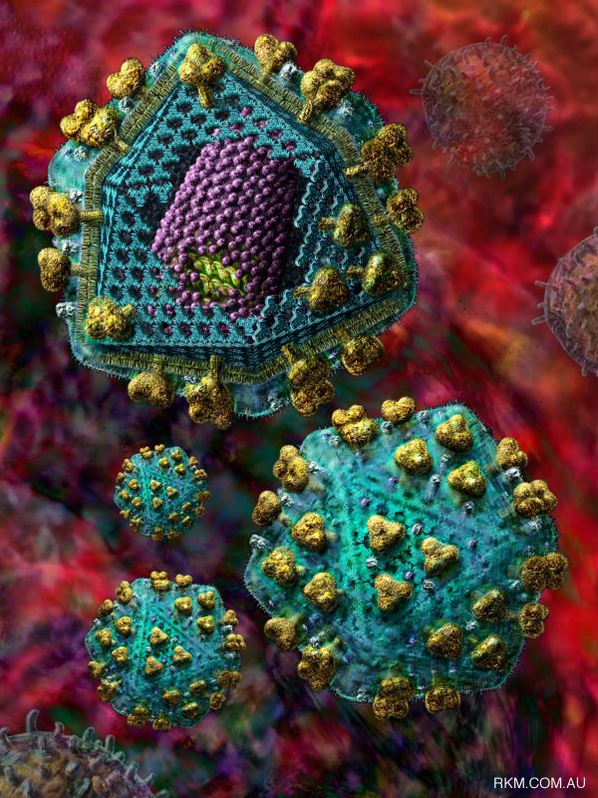
What does HIV look like?
A cut away
view of the virus.

Slide 8
Characteristics of HIV
Icosahedral (20 sided), enveloped virus of the lentivirus subfamily of retroviruses.
Retroviruses transcribe RNA to DNA.
Two viral strands of RNA found in core surrounded by protein outer coat.
Outer envelope contains a lipid matrix within which specific viral glycoproteins are imbedded.
These knob-like structures responsible for binding to target cell.

Slide 9
Structure of HIV

Slide 10
Structure of HIV
The outer shell of the virus is known as the Viral enevlope. Embedded in the viral envelope is a complex protein known as env which consists of an outer protruding cap glycoprotein (gp) 120, and a stem gp14. Within the viral envelope is an HIV protein called p17(matrix), and within this is the viral core or capsid, which is made of another viral protein p24(core antigen).

Slide 11
Structural Genes
Three main structural genes:
Group Specific Antigen
Envelope
Polymerase

Slide 12
Group Specific Antigen
Located in nucleocapsid of virus.
Icosahedral capsid surrounds the internal nucleic acids made up of p24 andp15.
p17 lies between protein core and envelope and is embedded in the internal portion of the envelope.
Two additional p55 products, p7 and p9, are nucleic acid binding proteins closely associated with the RNA.

Slide 13
Envelope
Envelope gene codes for envelope proteins gp160, gp120 and gp41.
These poly proteins will eventually be cleaved by proteases to become HIV envelope glycoproteins gp120 and gp41.
gp160 cleaved to form gp120 and gp41.
gp120 forms the 72 knobs which protrude from outer envelope.
gp41 is a trans membrane glycoprotein antigen that spans the inner and outer membranes and attaches to gp120.
gp120 and gp41 both involved with fusion and attachment of HIV to CD4 antigen on host cells.

Slide 14
Polymerase
Polymerase codes for p66 and p51 subunits of reverse transcriptase and p31 an endonuclease.
Located in the core, close to nucleic acids.
Responsible for conversion of viral RNA into DNA, integration of DNA into host cell DNA and cleavage of protein precursors.

Slide 15
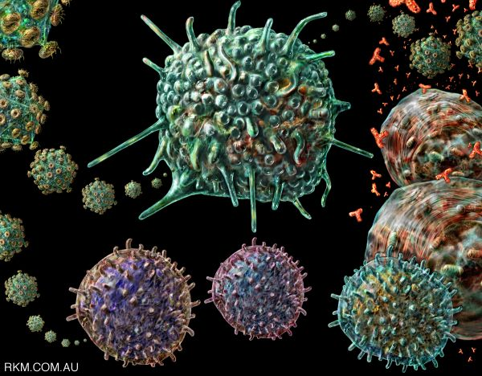
Two Key Parts of the Immune System
1. T4 or CD4 Cell
2. Antibodies
HIV

Slide 16
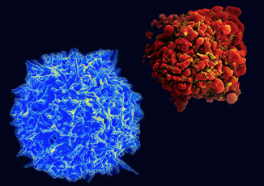
Healthy T Cell & Infected T Cell
HIV
Particles
(yellow)
T4 cell are particularly important in the adaptive immune system.
These cells help suppress or regulate immune responses

Slide 17
Symptoms
When HIV emerges from latency (the period when someone with HIV shows no signs of it) symptoms can include:
Dry, flaky skin (Xeroderma)
Chronic fatigue
Fever that comes and goes (Pyrexia)
Diarrhea that lasts more than a week
Heavy night sweats (Hyperhidrosis)
Rapid weight loss
Swollen lymph nodes
White spots on tongue, mouth & throat

Slide 18
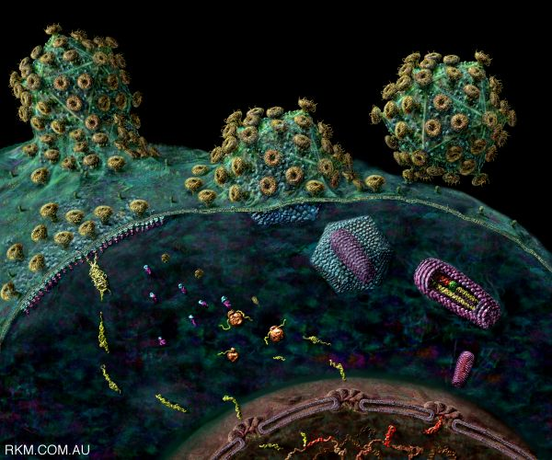
HIV Transmission
Requires:
1. Infected body fluid
AND
2. Entry into body

Slide 19
Infected body fluids
Four Fluids, if infected, can transmit HIV
a. Blood
b. Semen
c. Vaginal Secretions
d. Breast Milk
If these enter the body

Slide 20
Which Fluids are safe?
Four Fluids that can’t transmit HIV
a. Spit/saliva
b. Pee/Urine
c. Sweat
d. Tears

Slide 21
HIV Transmission
Four Most frequent ways to get infected
1. Unprotected sexual intercourse
2. Injected Drug Use
3. From an infected mother to her infant.
4. Direct contact with infected blood
Other, much more rare, ways to get infected
a. Blood Transfusions / Organ Transplant (1:600,000)
b. Health Care Setting

Slide 22
HIV is not transmitted by
Coughing, sneezing
Insect bites
Touching, hugging
Water, food
Work or school contact
Public baths
Handshakes
Sharing cups, glasses, plates, or other utensils
Kissing

Slide 23
How Does HIV get into a T Cell?
1. HIV attaches to
infection fighting T4 cell
2. Locks on to two entry
areas of the T4 cell
at once. (Keys in lock)
3. Tricks T4 cell to allow
Virus RNA to enter

Slide 24
What Does HIV do inside a T Cell?
1. Virus’s RNA changes into DNA
2. Enters Cell nucleus & becomes part of Host’s DNA!
3. Programs T cell to produce virus in abundance
4. New viruses bud off Host T cell, killing T cell, & enters bloodstream
5. New HIV viruses infect more T cells

Slide 25
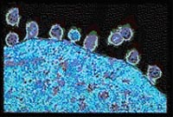
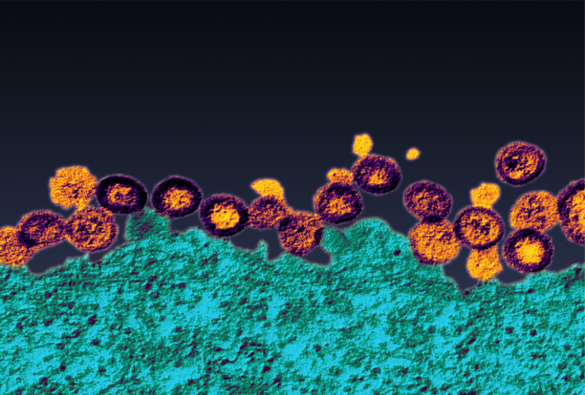
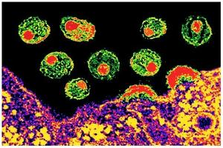
New HIV viruses leaving a cell

Slide 26
What is the “Window Period?”
The time period between a person’s exposure & actual infection with HIV and until antibodies are detectable in the body.
After three months there are usually enough antibodies to show on an AIDS test.
Nearly all people (99%) develop antibodies by
THREE months.

Slide 27
HIV and the Immune System
A person can be HIV infected and not have AIDS if the person’s immune system is intact.
Often this period is from 8-10 years.
Has no symptoms, person is a carrier.
After this period, the immune system begins to lose the fight.
At this point the person has AIDS

Slide 28
HIV-1 and HIV-2
• HIV-1 and HIV-2 are • Transmitted through the same routes • Associated with similar opportunistic infections
• HIV-1 is more common worldwide
• HIV-2 is found in West Africa, Mozambique, and Angola

Slide 29
HIV-1 and HIV-2
HIV-2 is less easily transmitted
HIV-2 is less pathogenic
Duration of HIV-2 infection is shorter
MTCT is relatively rare with HIV-2
MTCT of HIV-2 has not been reported from Pakistan

Slide 30
9. What does AIDS stand for?
A. Acquired
I. Immune
D. Deficiency
S. Syndrome

Slide 31
10. What does AIDS stand for?
A. Acquired (Not inherited)
I. Immune (Weakens of the Immune system)
D. Deficiency (Creates a Deficiency of CD4+ cells in the immune system)
S. Syndrome (A group of illnesses taking place at the same time)

Slide 32
WHAT IS AIDS ??
AIDS~ (Acquired Immune Deficiency Syndrome) It is related to HIV, but they are not one in the same. A person has AIDS only in the final stages of HIV, after the immune system becomes unable to defend itself against foreign invaders like bacteria, other viruses, and allows the development of certain cancers.

Slide 33
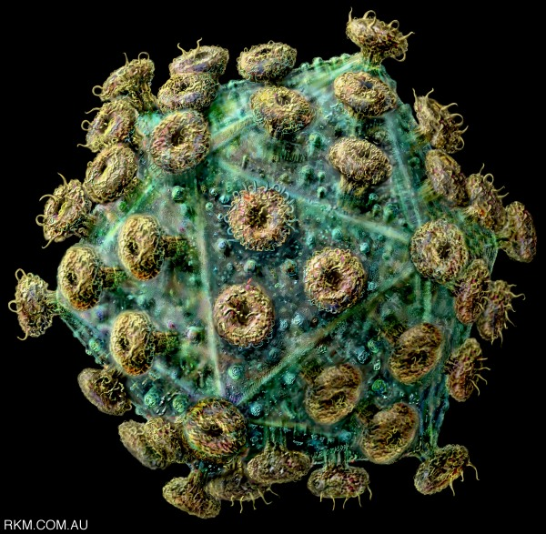
WHAT IS AIDS ??
1. The Late stage of HIV infection
2. A group of symptoms & signs of disease that occur together.
3. Severe immune system breakdown
4. Less than 200 T cells (or CD4 cells).
Normal 1000

Slide 34
What happens to someone with fully involved AIDS?
Immune system breaks down => Hospital ??
Cause of death - a variety of normally preventable diseases. Some are:
a. Pneumonia
b. Toxoplasmosis
c. Kaposi’s sarcoma
d. Mycobacterium Avium complex
e. Invasive cervical cancer

Slide 35
Treatment of AIDS & Life Expectancy
Treatment helps people live longer.
a. In 1993 = less than 7 years
b. In 2006 = 20 years or more…
….if properly treated
c. New drugs are the cause of the increase
2011: About 33.3 million people worldwide are infected with HIV, the virus that causes AIDS. In 2009, the last year for complete statistics, 2.6 million people became infected and 1.8 million people died.

Slide 36
What are the problems with Treatment?
a. Have to take lots of pills
b. Pills can make people sick – side effects
c. Pills don’t work for everyone – or forever
d. Pills cost lots of money!
2010 avg cost est. = $398,000 / 20+ years
or $1,659 / month
Advanced cases = $3,390 / month

Slide 37
Let’s Rewind!
What are the ways you can think of to keep
a person always safe from HIV/AIDS???

Slide 38
How to keep safe?
1. No sex = abstinence
Have only one uninfected partner = monogamy
Use protection = condoms
No Blood Transfusion

Slide 39
Making Progress - AIDS by the numbers 33% decrease in new HIV infections since 2001 29% decrease in AIDS-related deaths (adults and children) since 2005 52% decrease in new HIV infections in children since 2001 40-fold Increase in access to antiretroviral therapy 2002–2012

Slide 40
Key Points
HIV is a global pandemic and the number of people living with HIV continues to increase worldwide.
HIV epidemic is especially severe in resource-constrained settings
HIV is a virus that destroys the immune system, leading to opportunistic infections.
The progression from initial infection with HIV to end-stage AIDS varies from person to person and can take more than 10 years.

Slide 41
Key Points
The most common main route of transmission worldwide is heterosexual transmission.
Women of childbearing age are at particular risk for acquiring HIV through unprotected sex
HIV-positive women who are pregnant are at risk of passing HIV infection to their newborn.
Risk of HIV transmission from mother-to-child can be greatly reduced through effective PMTCT programs.

Slide 42
THANK YOU

