Slide 1
CHROMOSOME STRUCTURE & FUNCTIONS

Slide 2
CHROMOSOME
Introduction: The word choromosome is the combination of two greek words:
Khroma : meaning colour……..
Soma : meaning body…………
In the late 1800s, a scientist, Wilhelm von Waldeyer-Hartz, gave chromosomes their name because chromosomes easily accept dye and take on patterns of light and dark when exposed to different stains that help identify the different chromosomes.

Slide 3
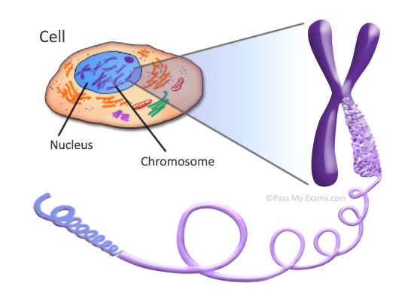
CHROMOSOME
DEFINITION : A thread-like structure of nucleic acids and protein found in the nucleus of most living cells, carrying genetic information in the form of genes.

Slide 4
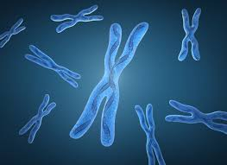
CHROMOSOME STRUCTURE
General appearance: A typical chromosome appears to be consist of :
Pellicle : Each chromosome is bounded by a membrane called pellicle. It is very thin and is formed of achromatic substance

Slide 5
CHROMOSOME STRUCTURE
MATRIX : The pellicle membrane encloses a jelly-like substance which is usually called matrix.
In the matrix is present the chromonemata ( a chromosome thread that is relatively uncoiled at early prophase but assumes a spiral form at metaphase)
The matrix is also formed of achromatic or non-genic material.
The function and structure of the matrix is not known.
Presumably it aids in keeping the chromonemata with in bounds so that the movement of the chromosome during cell division can take place unhindered.
It may also serve as an insulating sheath for the genes during cell division.

Slide 6
CHROMOSOME STRUCTURE
Chromonemata:
Within the matrix of each chromosome are found embedded two identical, spirally coiled threads, the chromonemata or chromonematal fibrils.
Both the chromonemata are so tightly coiled that they appear as a single thread of about 800 A thickness.
This condition is found during prophase and sometimes during interphase

Slide 7
CHROMOSOME STRUCTURE
The chromonema may be composed of 2, 4 or more fibrils depending upon the species.
This number of fibrils in the chromonema may depend on the different phases since at one phase it may contain one fibril and at other phase it may contain three or four fibrils. These fibrils of the chromonema are tightly coiled with each other.
The coils are of two types. —
Paranemic coils:
When the chromonemal fibrils are easily separable from each other, such coils are called paranemic coils.

Slide 8
Plectonemic coils:
Here the chromonemal fibrils are closely intertwined and they cannot be separated easily. Such coils are called plectonemic coils.

Slide 9
Chromonema vs chromatid
Chromonema is the fibre-like structure in prophase in the primary stage of DNA condensation.
In metaphase, they are called chromatids.

Slide 10
CHROMOSOME STRUCTURE
Chromomeres:
It was demonstrated that the chromosomes particularly in early meiotic prophase, were differentiated into morphologically distinct regions which were constant in size and position. These regions called chromomeres, were first described by Balbiani in 1876 and by Pfitzner in 1881.

Slide 11
CHROMOSOME STRUCTURE
Chromatids: two arms of the chromosome……
At metaphase each chromosome consists of two symmetrical structures, the chromatids, each of which contains a single DNA molecule. The chromatids are attached to each other only by the centromere and become separated at the start of anaphase, when sister chromatids migrate to opposite poles.

Slide 12
CHROMOSOME STRUCTURE
Anaphase chromosomes thus have only one chromatid, whereas metaphase chromosomes have two chromatids.
Chromatids are the functional unit of the chromosome in cell division, in gene segregation and in crossing over.

Slide 13
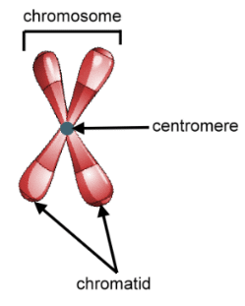
CHROMOSOME STRUCTURE
Primary constriction /Centromere: Primary constriction is the narrower region of a condensed chromosome where the centromere, the structure that binds identical chromatids, is located

Slide 14
CHROMOSOME STRUCTURE
TYPES OF CENTROMERE:
There are two types of centromeres…………..
Regional centromere :
In regional centromeres, DNA sequences contribute to but do not define function.
Regional centromeres contain large amounts of DNA and are often packaged into heterochromatin…………

Slide 15
CHROMOSOME STRUCTURE
Point centromere:
Point centromeres are smaller and more compact.
DNA sequences are both necessary and sufficient to specify centromere identity and function in organisms with point centromeres………..

Slide 16
CHROMOSOME STRUCTURE
Secondary constriction
The secondary constriction is a region similar to the primary constriction, narrower than the normal thickness of the chromosome, and which is normally related to genes that coordinate the formation of the nucleolus and which control ribosomal RNA (rRNA) synthesis.
For this reason, secondary constrictions (there can be one or more in a chromosome) are called nucleolus organizer regions (NOR).

Slide 17
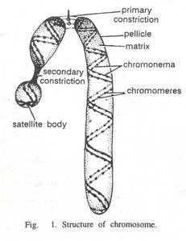
Chromosome structure
Satellite:
Sometimes at the tip of chromatid , a swollen body appears, called satellite, the chromosome then called SAT- chromosome…….. ………
It contains Junk DNA.......
Important in identifying specific chromosome…….
Telomers:
The tips of chromosome are called telomers, responsible for chromosome polarity………

Slide 18
CHROMOSOME STRUCTURE
During replication sometimes part of the telomere are lost so that they appear shorter after cell division. When the enzyme telomerase is present in the cell telomeres can recover their length, but too severe shortening leads to chromosome instability and irreversible damage so that division is impeded and cell death eventually occurs. On the other side, cells with active telomerase can continue to divide.

Slide 20
CHROMOSOME STRUCTURE

Slide 21
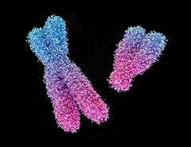
CHROMOSOME TYPES
On the basis of position of centromere:
Position of centromere on chromosome not fixed , but shows variations ………
The position of centromere will determine shape of chromosome……..
Based on the position of the centromere four types of chromosome have been recognized………

Slide 22
CHROMOSOME TYPES
Metacentric : These are X-shaped chromosomes, with the centromere in the middle so that the two arms of the chromosomes are almost equal.
A chromosome is metacentric if its two arms are roughly equal in length………….

Slide 23
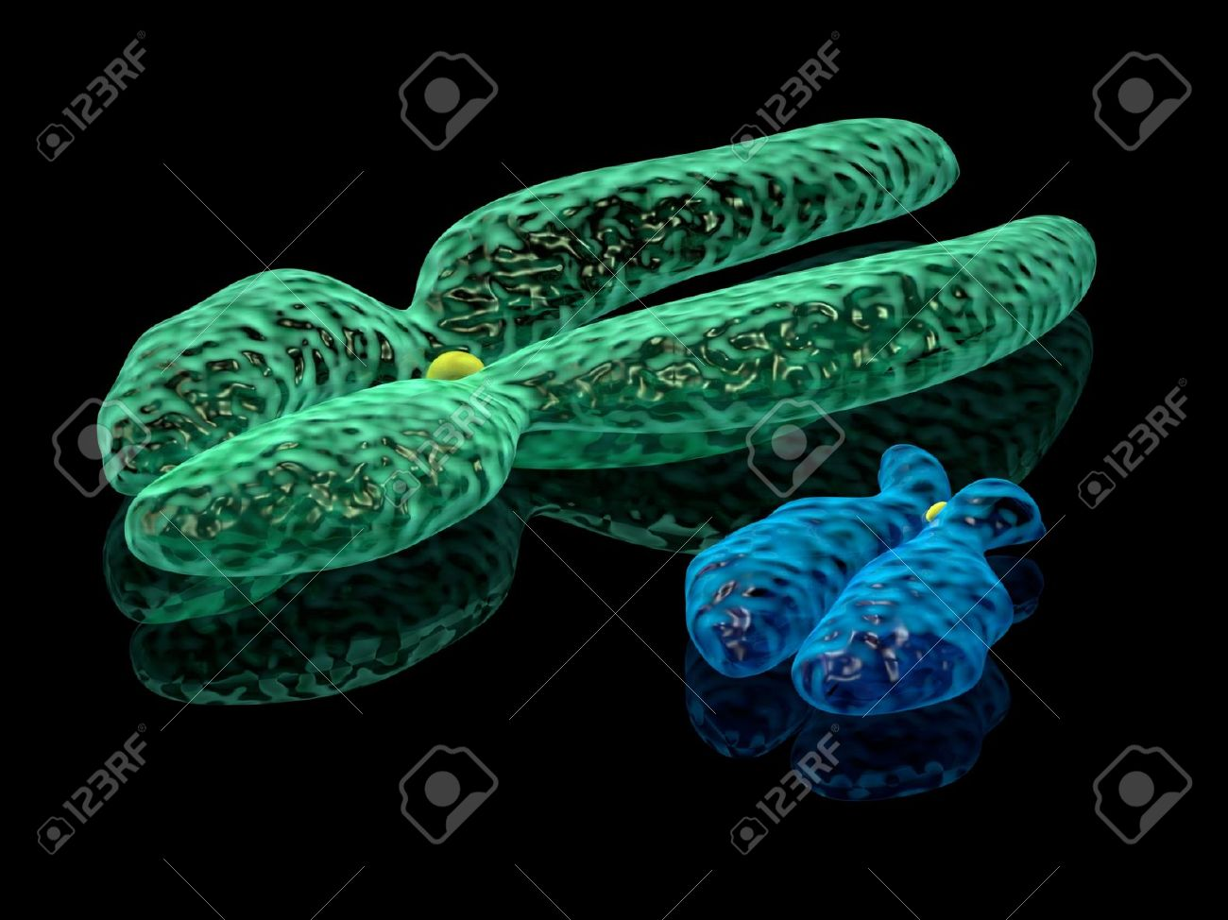
CHROMOSOME TYPES
Sub metacentric: a chromosome with the centromere sub median in position so that it divides the chromosome into two arms of strikingly unequal length……

Slide 24
CHROMOSOME TYPES
Telocentric:
a chromosome with a terminal centromere; such chromosomes in humans are unstable and arise by misdivision or breakage near the centromere and are usually eliminated within a few cell divisions.
Humans do not possess telocentric chromosomes

Slide 25
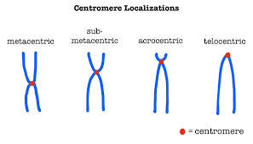
CHROMOSOME TYPES
Acrocentric or sub – telocentric: A chromosome in which the centromere is located quite near one end of the chromosome. Humans normally have five pairs of acrocentric chromosomes.

Slide 26
CHROMOSOME TYPES

Slide 27
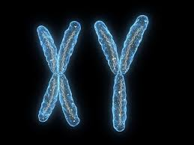
CHROMOSOME TYPES
On the basis of types of cells : There are two types of chromosomes ……..
Sex chromosome: Sex chromosomes are those that are needed for determining sex or gender of an individual….
Types of sex chromosomes: Types of sex chromosomes are………..

Slide 28
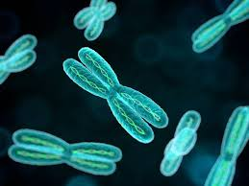
TYPES OF SEX CHROMOSOME
W chromosome sex chromosome in animals such as poultry in which the female is the heterogametic state, the male has the ZZ genotype and the female the ZW genotype.
X chromosome the female sex chromosome, being carried by half the male gametes and all female gametes; female diploid cells have two X chromosomes, the male has the XY genotype.

Slide 29
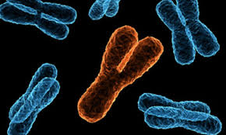
TYPES OF SEX CHROMOSOME
Y chromosome the male sex chromosome, being carried by half the male gametes and none of the female gametes; male diploid cells have an X and a Y chromosome; females carry the XX genotype.
Z chromosome sex chromosome in animals, such as poultry, in which the female is the heterogametic sex; the male has the ZZ genotype and the female the ZW genotype.

Slide 30
CHROMOSOME TYPES
Autosomal chromosome: Autosomes are all the rest of the chromosomes that are not needed for sex determination
You get one set of 22 autosomes from your mom and another set of 22 from your dad. It is often easier to think about our autosomes in pairs because even though we have 44 autosomes, we actually only have 22 types. We have two copies of each type of autosome, one from each parent. Two chromosomes of the same type, called homologous chromosomes, are the same size and shape and have the same genes.

Slide 31
A picture or karyogram of all human chromosomes showing what each chromosome looks like. Autosomes are inside the red box and labeled with numbers. The sex chromosomes are outside of the red box and given the letters X and Y. (This karyogram is from a male because males have one X and one Y, while females have two X chromosomes.)

Slide 32
Some other chromosome terms
homologous chromosomes:
the chromosomes of a matching pair in the diploid complement that contain alleles of specific genes.

Slide 33
Some other chromosome terms
lampbrush chromosome: so named because of the bristling appearance given them by many open loops of chromatin along the extended chromosome. examples
ring chromosome: a chromosome in which both ends have been lost (deletion) and the two broken ends have reunited to form a ring-shaped figure. examples

Slide 34
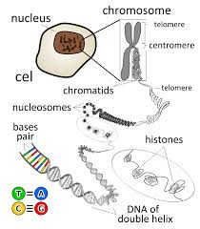
ULTRA STRUCTURE OF CHROMOSOME

Slide 35
CHEMICAL COMPOSITION
Metallic ions : Ca, Mg, Fe ………..
The metallic ions form linkages b/w DNA and the protein or the DNA groups – Salt linkages………..
Traces of lipids are also present…..

Slide 36
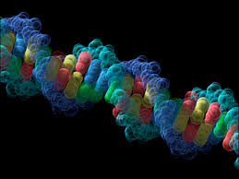
ULTRA STRUCTURE
Ultra Structure of Chromosome Eukaryotic chromosomes are composed of chromatin, a complex of DNA and protein and less amount of RNA.
Deoxyribonucleic Acid (DNA) The DNA of a chromosome is one very long double stranded fiber, duplex which extend unbroken through the entire length of chromosome. A typical human chromosome contain about 140 million nucleotide in its DNA.

Slide 37
ULTRA STRUCTURE

Slide 38
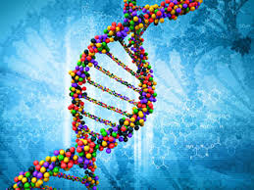
ULTRA STRUCTURE
Size If a strand of DNA from a single chromosome were laid out in a straight line, it would more than 7 feet long (2 meter). It is too much long to fit into a cell. In the cell, however, the DNA is coiled, thus fitting into a much smaller space.

Slide 39
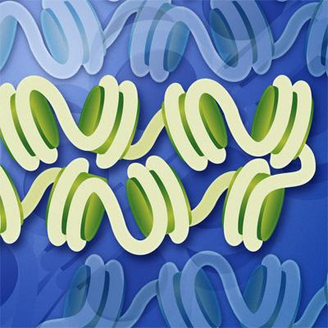
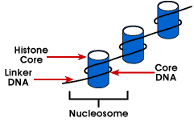
ULTRA STRUCTURE
Nucleosome DNA resemble a string of beads. Even 200 nucleotides, the DNA duplex is coiled around a core eight histone proteins forming a complex known as Nucleosome.

Slide 40
ULTRA STRUCTURE
Protein Histones are positively charged proteins due to an abundance of the basic amino-acids, arginine and lysine.
They are thus strongly attached to the negatively charged phosphate groups of the DNA.
Further coiling occurs when the string of nucleosomes wraps up into higher order coils called Super Coils.

Slide 41
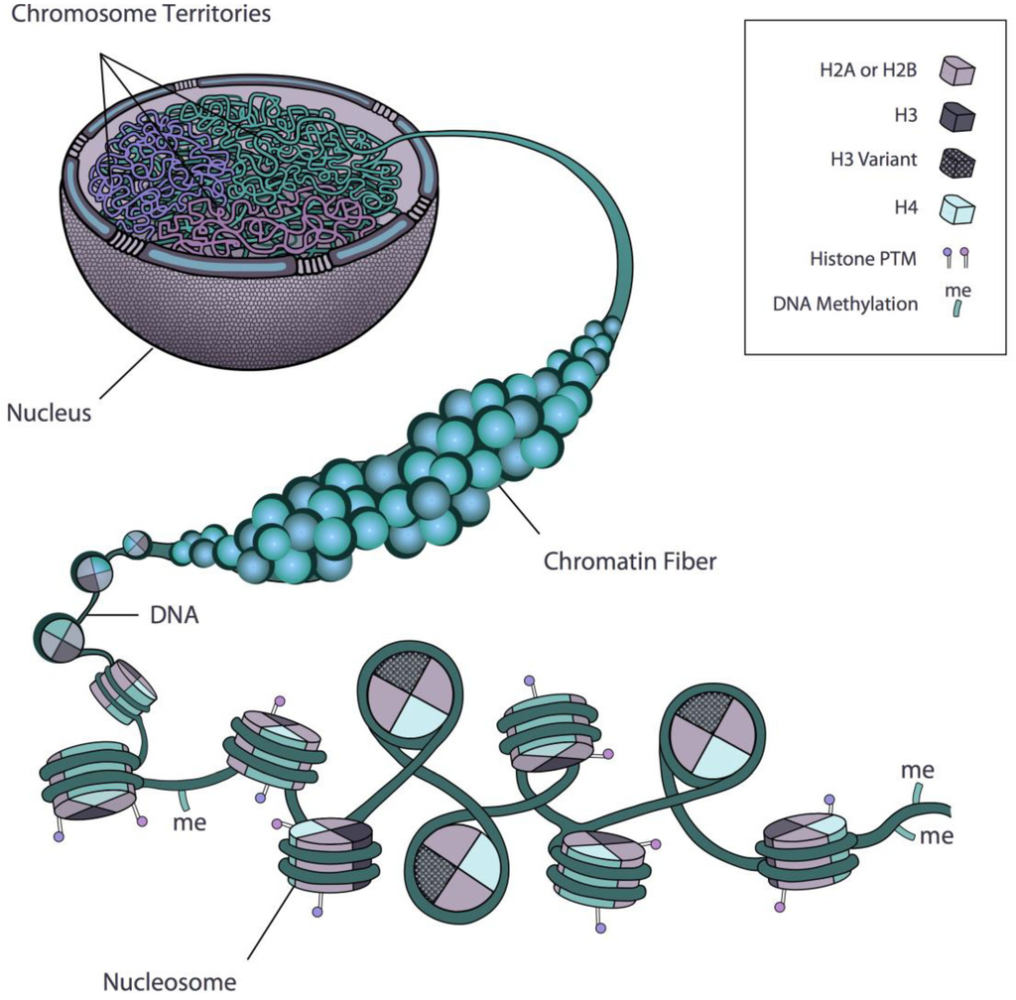
HISTONE PROTIENS
H2A
H2B
H3
H4

Slide 42
ULTRA STRUCTURE

Slide 43
ULTRA STRUCTURE
Heterochromatin Highly condensed portions of the chromatin are called Heterochromatin.
Euchromatin The reminder of the chromosome called Euchromatin is condensed only during the cell division.

Slide 44
ULTRA STRUCTURE

Slide 45
ULTRA STRUCTURE

Slide 46
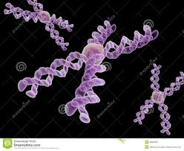
FUNCTIONS OF CHROMOSOME
Functions of Chromosomes:
The role of chromosomes in heredity was suggested independently by Sutton and Bover in 1902. This and various other functions of chromosomes may be summarised as under.

Slide 47
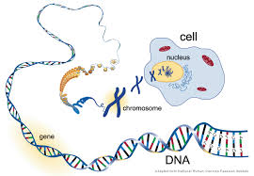
FUNCTIONS
It is universally accepted that DNA is the genetic material, and that in eukaryotes almost all the DNA is present in chromosomes. Thus, the most important function of chromosomes is to provide the genetic information for various cellular functions essential for growth, survival, development, reproduction, etc., of organisms.

Slide 48
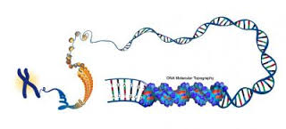
FUNCTIONS
Another very important function of chromosomes is to protect the genetic material (DNA) from being damaged during cell division.

Slide 49
FUNCTIONS
Chromosomes are coated with histones and other proteins which protect it from both chemical (e.g., enzymes) and physical forces.

Slide 50
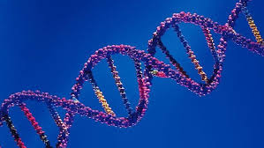
FUNCTIONS
The properties of chromosomes ensure a precise distribution of DNA (genetic material) to the daughter nuclei during cell division.

Slide 51
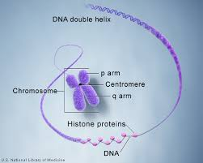
Centromeres of chromosomes perform an important function in chromosome movements during cell division which is due to the contraction of spindle fibres attached to the centromeric regions of chromosomes.

Slide 52
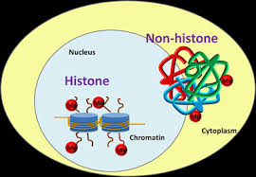
FUNCTIONS
Gene action in eukaryotes is believed to be regulated through histone and non-histone proteins associated with chromosomes.

