Slide 1
DNA EXTRACTION
(Inorganic Salt Based Extraction)

Slide 2
First thing you have to done……
Solution preparation:
In solution preparation first have to prepare stock solution.
1M Tris
0.5M EDTA
5 M NaCl
1% SDS

Slide 3
How to prepare Molar solution?
Molecular weight in 1000 ml (g/L)
So to prepare 1M Tris
121g/ 1000 ml
0.5 M EDTA
186g/1000 ml
5M NaCl
292.5g/ 1000 ml
1% SDS
1 g/100 ml

Slide 4
Important solutions have to prepare before Extraction:
(Lysis Buffer)
For 50ml lysis Buffer working solution
50mM Tris (2.5 ml)
50mM EDTA (5 ml)
100mM NaCl (1 ml)
0.5g SDS
(calculation of final volume)
(initial conc.)(initial vol) = (final conc) (final vol)
(1000 mM) (A) =(50ml) (50ml)
A = (50ml) (50mM) / (1000mM)
A =(2.5 ml)
(A) = final volume of Tris used in solution

Slide 5
(Proteinase K Buffer)
For 20ml proteinase K Buffer working solution
100mM Tris (2ml)
50mM EDTA (2ml)
500mM NaCl (2ml)
200µg/ml (Proteinase K)

Slide 6
(TAE stock buffer)
121g of Tris Base in 200 ml Distilled water
Add 28.6 ml Glacial Acetic acid
Add 50 ml of 0.5 M EDTA
And raise up to 500 ml

Slide 7
Method of DNA extraction
About 1g of the fish flesh will be homogenized and taken into Eppendorf microtubule (2 ml).
Add 550 µL of Lysis buffer +7 µL Proteinase K.
Sample containing Eppendorf microtubule (ml) immediately incubated in water bath at 50 ºC for 12 hrs.
600 µL NaCl solution added and centrifuges for 10 min at 12000 rpm.

Slide 8
Conti…….
Now supernatant will be removed and for precipitating DNA add 70% cold ethanol.
Eppendorf after adding Ethanol will be incubate at -20 ºC for 2 hrs.
Again the samples will be centrifuge 10 min at 12000 rpm.

Slide 9
Conti…….
Now white pellet will appear and the washing sample will be done with 70% ethanol.
The DNA sample will be again suspended with distilled water.

Slide 10
After extraction conformation of DNA…..
Conformation of DNA is done by method
AGAROSE GEL ELECTROPHORESIS.
1% agarose gel prepration:
In the tray the loading gel capacity is 200ml. So, we take 2g agarose and dissolve in 98ml (TAE) distilled water.
Pre weight the solution.
Boil for 1 to 2 min in microwave oven.
Again weight. (if error is there than add distilled water)
Take some time to lower down the temperature now pour it in tray gently.

Slide 11
Loading of sample:
After gel formation the samples of DNA along with the dye are loaded in the valves.
5µl dye + 5µl DNA sample
Pour in valve gently
Power on the electricity and monitor time by time.

Slide 12
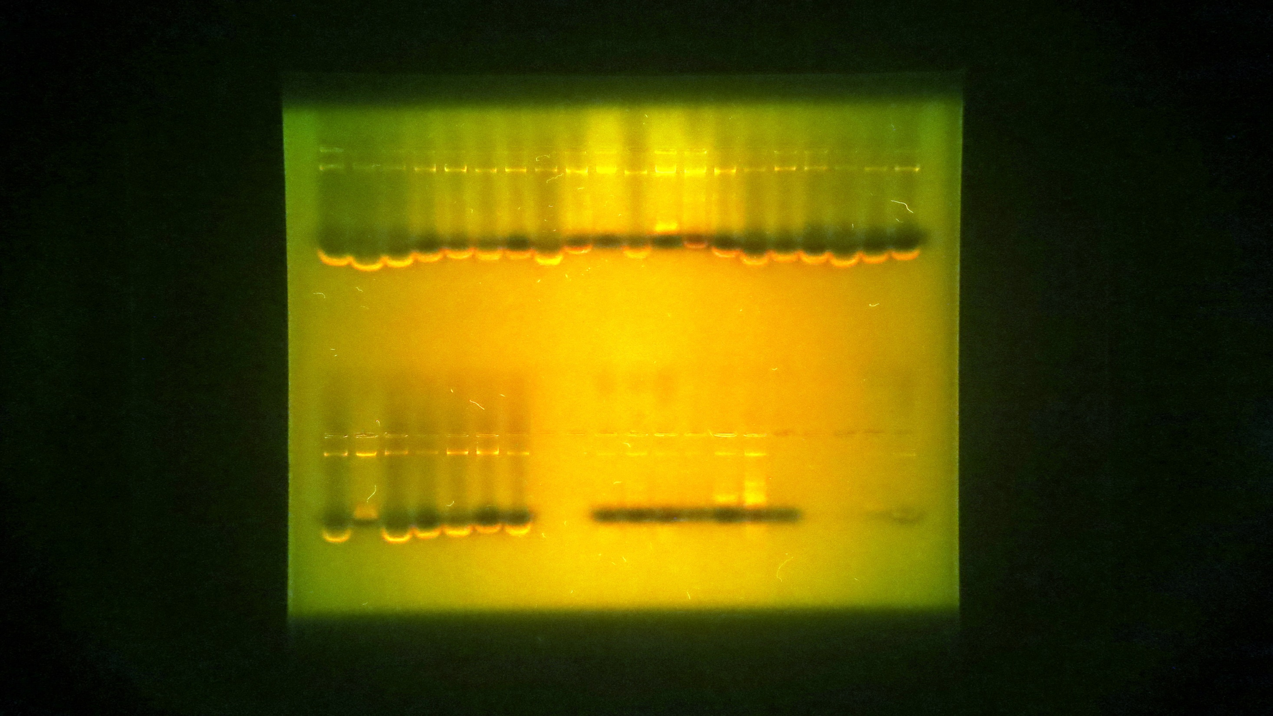
DNA conformation the GEL ELECTROPHORSIS

