Slide 1
Preparation of permanent whole mount (demonstration)
Dr. Shahzad Ali

Slide 2
HISTOLOGY :
It is the branch of science which deals with the gross & microscopic study of normal tissue .
HISTOPATHOLOGY :
It is the branch of science which deals with the gross & microscopic study of tissue affected by disease.
Tissue for study can be obtained from:
Biopsies
Autopsies

Slide 3
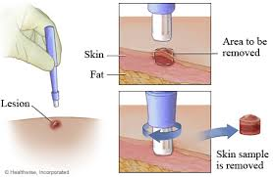
Biopsies A biopsy is a sample of tissue taken from the body in order to examine it more closely. A doctor should recommend a biopsy when an initial test suggests an area of tissue in the body isn't normal. Doctors may call an area of abnormal tissue a lesion, a tumor, or a mass.

Slide 4
HISTOTECHNIQUES:
The techniques for processing the tissues, whether biopsies, larger specimen removed at surgery, or tissues from autopsy so as to enable the pathologist to study them under the microscope.

Slide 5
Protocols followed in Histotechniques ;
Receipt & Identification
Labeling of the specimen with numbering
Fixation
Dehydration
Clearing
Impregnation
Embedding
Section cutting
Staining
Mounting

Slide 6
Specimen identification and labeling:
Tissue specimen received in the surgical pathology laboratory have a request form that lists the patient information and history along with a description of the site of origin.
The specimen are accessioned by giving them a number that will identify each specimen for each patient

Slide 7
Fixation
It is a process in which a specimen is treated by exposing it to a fixative for a particular period of time in order to facilitate the succeeding steps.
The purpose of fixation is to preserve tissues permanently in as life-like a state as possible.
The fixative should be 15 – 20 times more in volume then the specimen.

Slide 8
Aims of Fixation :
It should prevent autolysis & putrefaction of the cell.
It should penetrate evenly and rapidly.
It should harden the tissues
Should not cause shrinkage or swelling of the cells
Must not react with the receptor sites & thus must not interefere with the staining procedure.
It must be cheap and easily available.

Slide 9
The bits should of the size of approximately 2 x 2 cm & 4- 6 micrometer in thickness for optimum fixation to take place.
These bits are then placed in metal cassettes or capsules which are then placed in the fixative.
Tiny biopsies or small specimen can be wrapped in a filter paper and then put in a cassette & fixed.

Slide 12
Simple Fixatives
Formalin

Slide 13
The most commonly used fixative is Formalin .
It is prepared by mixing 40 % Formaldehyde gas in 100 w/v of distilled water.
The resultant mixture is 100 % Formalin.
Routinely, 10 % formalin is used which is prepared by mixing 10 ml of 100 % formalin in 90 ml of distilled water.
MECHANISM OF ACTION:
It forms cross links between amino acids of proteins thereby making them insoluble.
It fixes 4 mm thick tissue in 8 hours .

Slide 14
ADVANTAGES :
Rapid penetration
Easy availability & cheap
Does not overharden the tissue
Fixes lipids for frozen sections
Ideal for mailing
DISADVANTAGES:
Irritant to the nose, the eyes and mucous membranes
Formation of precipitate of paraformaldehyde which can be prevented by adding 11- 16 % methanol.

Slide 15
Other Simple Fixatives
Glutaraldehyde
Potassium Dichromate
Mercuric Chloride

Slide 16
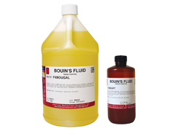
Other Simple Fixatives (contd.)
Picric acid
Zenker's fluid
Zenker’s Formal (Helly’s Fluid)
Bouin’s Fluid

Slide 17
Compound Fixatives
Microanatomical fixatives:
These are used to preserve the anatomy of the tissue.
Cytological fixatives:
These are used to fix intracellular structures.
Histochemical fixatives :
These are used to demonstrate the chemical constituents of the cell.

Slide 18
Microanatomical Fixatives
10 % Formal saline :
It is a microanatomical fixative.
Ideal for fixation of brain.
Buffered formalin:
Due to the presence of buffer, the pH of the solution remains at neutral or near neutral.
As a result, Formalin pigment formation doesn’t take place.

Slide 19
Cytological Fixatives
Nuclear fixatives :
Carnoy’s Fluid
Clarke’s Fluid
Newcomer’s Fluid
Flemming’s Fluid
Cytoplasmic Fixatives :
Champy’s Fluid
Regaud’s Fluid

Slide 20
Histochemical Fixatives:
Formal saline
Cold acetone
Absolute alcohol

Slide 21
Decalcification:
It is the process of removal of the calcium salts from the specimen.
The various agents used for decalcifying are;
Nitric acid
Hydrochloric acid
Formic acid
Picric acid
Acetic acid
Citric acid

Slide 22
Dehydration:
It is the process in which the water content in the tissue to be processed is completely reduced by passing the tissue through increasing concentrations of dehydrating agents.
The various dehydrating agents used are ;
Ethyl alcohol
Acetone
Isopropyl alcohol

Slide 23
The duration of the procedure can be noted down as;
70 % alcohol – 1 hour
70 % alcohol – 1 hour
95 % alcohol – 1 hour
95 % alcohol – 1 hour
Absolute alcohol – 1 hour
Absolute alcohol – 1 hour
Absolute alcohol – 1 hour
Dehydration is done so that the wax i.e Paraffin wax, which is used for impregnation, can be easily miscible as it is immiscible with water.

Slide 24
CLEARING ( DEALCOHOLIZATION):
It is the procedure where the alcohol in the tissue is replaced by a fluid which will dissolve the wax used for impregnating the tissues .
The various clearing agents used are ;
Cedar wood oil : The best agent but is expensive.
Benzene : It is carcinogenic.
Xylene : It is most commonly used.
Chloroform: Toxic and expensive.

Slide 25
Impregnation:
In this, the tissue is kept in a wax bath containing molten paraffin wax for 6 – 8 hours .
The wax is infiltrated deeply in the tissue which increases the optical differentiation & hardens the tissue & helps in easy sectioning of the tissue.

Slide 26
The various waxes which are used are,
Paraffin wax
Paraplast
Paraplast plus
Gelatin
Celloidin

Slide 27
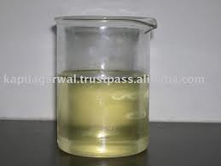
Jar containing molten paraffin wax:

Slide 28
Embedding:
It is done by transferring the tissue which has been cleared of the alcohol to a mould filled with molten wax & is allowed to cool & solidify.
After solidification, a wax block is obtained which is then sectioned to obtain ribbons.

Slide 29
Types of Moulds:
A. Leuckhart’s Moulds:
L- shaped brass pieces which is placed in opposing positions & can be manipulated to increase or decrease the size of the block to be prepared.
B. Glass or Metal petri dishes :
C. Watch glass
D. Paper boats .

Slide 30
Leuckhart’s moulds :

Slide 31
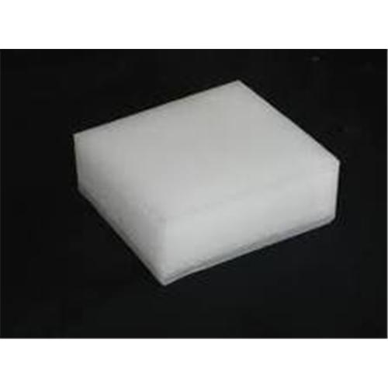
Paraffin block

Slide 32
Section Cutting :
It is the procedure in which the blocks which have been prepared are cut or sectioned and thin strips of varying thickness are prepared.
The instrument by which this is done is called as a Microtome.
TYPES OF MICROTOMES:
Sliding
Rotary

Slide 33
Rotary Microtome:
It is the most commonly used.
Also known as Minnot’s Rotary microtome.
In this the Block holder moves up and down while the knife remains fixed.
It is suitable for cutting of small tissues & serial sections can be taken on it.

Slide 34
Parts of a Microtome ( Rotary ) :
Block holder
Knife clamp screws
Knife clamps
Block adjustment
Thickness gauge
Operating handle.

Slide 36
Tissue floatation bath:
It is a thermostatically controlled water bath with the inside coloured black.
It is maintained at a temperature maintained 5 – 6 degree below the melting point of paraffin wax.

Slide 37
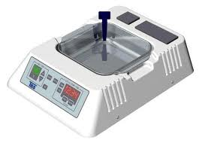
Electronic tissue floatation bath:

Slide 40
Staining :
Staining of the section is done to bring out the particular details in the tissue under study .
The most commonly used stain in routine practice is Haematoxylin & eosin stain.

Slide 41
Procedure :
Deparaffinization with xylene.
Hydration
Wash under water
Stain with Haematoxylin for 15 min
Wash with water
Differentiate with 1 % acid alcohol
Wash with water for 10 min
Stain with 1% Eosin for 2 min
Wash with water.
Dehydration
Clearing with xylene
Dry
Mount

Slide 42
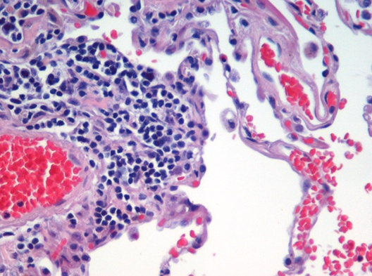
Result :
The nucleus stains Blue
The cytoplasm stains pink.

Slide 43
Mounting:
Adhesives used for fixing the sections on the slides :
Albumin solution ( Mayor’s egg albumin)
Starch paste
Gelatin

Slide 44
Mountants :
DPX ( Distrene Dibutyl phthalate Xylene ).
Canada Balsam
Colophonium resin
Terpene resin

Slide 47
Automation:
Automated tissue processor:
All the before mentioned procedures upto the impregnation step can be done automatically in a single, unmanned instrument , which is the Automated Tissue processor.
Advantages :
It provides constant agitation during every step which ensures better fixation & processing.
It reduces the work load & in turns improves the overall output of the laboratory.

Slide 49
Automatic stainer:

Slide 50
Automatic stainer

Slide 51
References:
Textbook of Medical Laboratory Technology. – Ramnik Sood.
Histotechnology and Cytotechnology- Manipal Academy of Higher Education.
www.en.wikipedia.org
http://en.wikipedia.org/wiki/File:Emphysema_H_and_E.jpg

Slide 52
Thank You !

