Slide 1
What is blotting?
Blots are techniques for transferring DNA , RNA and proteins onto a carrier so they can be separated, and often follows the use of a gel electrophoresis.

Slide 3
TYPES OF BLOTTING TECHNIQUES
BLOTTING TECHNIQUES
Southern Blot
It is used to detect DNA.
Northern Blot
It is used to detect RNA.
Western Blot
It is used to detect protein.

Slide 4
DNA Evidence
DNA evidence-has many uses within the legal system and criminal cases.
Proving someone guilty or innocent for a crime they have or have not committed.
Identification
Paternity Testing
First criminal identification card filed by the NY State Bertillon Bureau.

Slide 5
Criminal Cases
DNA evidence has exonerated people accused of committing crimes.
Only about 30% of all DNA tests run by the FBI have exonerated an accused person; DNA evidence is still not as useful as fingerprinting.
Identification
Used to determine the sex, race, or even name of unnamed victims of crimes.
Used in military to identify those who have died in battle, similar to the purpose of dog tags.

Slide 6
Paternity Testing
Evidence can be used to compare the DNA of the suspected parent(s) and that of the child and determine the real parent.
SOUTHERN BLOTTING
Professor Sir Edwin Southern, Professor of Biochemistry and Fellow of Trinity developed this method in 1975.
Southern won the Lasker Award for Clinical Medical Research prize for the method of finding specific DNA sequences he developed this procedure at Edinburgh University more than 30 years ago. The technique is known as DNA transfer or 'Southern blotting'

Slide 7
This method Involves separation, transfer and hybridization.
It is a method routinely used in molecular biology for detection of a specific DNA sequence in DNA samples.
The DNA detected can be a single gene, or it can be part of a larger piece of DNA such as a viral genome.
Southern blotting combines agarose gel electrophoresis for size separation of DNA with methods to transfer the size separated DNA to a filter membrane for probe hybridization
The key to this method is Hybridization.
Hybridization - Process of forming a double stranded DNA molecule between a single stranded DNA probe and a single-stranded target patient DNA.

Slide 8
PRINCIPLE
The mixture of molecules is separated.
The molecules are immobilized on a matrix.
The probe is added to the matrix to bind to the molecules.
Any unbound probes are then removed.
The place where the probe is connected corresponds to the location of the immobilized target molecule.

Slide 9
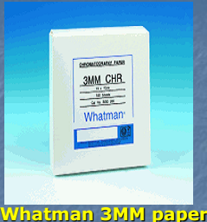
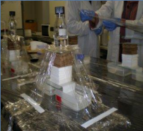
APPARATUS

Slide 10
Capillary plotting apparatus

Slide 11
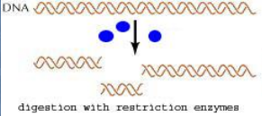
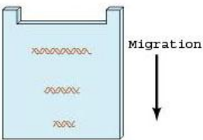
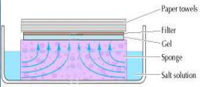
Steps in southern blotting
1. Digest the DNA with an appropriate restriction enzyme.
2. The complex mixture of fragments is subjected to gel electrophoresis to separate the fragments according to size.
3. The restriction fragments present in the gel are denatured with alkali and transferred onto a nitrocellulose filter or nylon membrane by blotting.

Slide 12
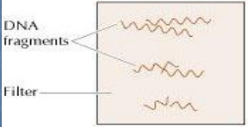
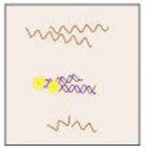
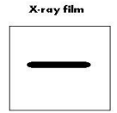
This procedure preserves the distribution of the fragments in the gel, creating a replica of the gel on the filter.
4. The filter is incubated under hybridization conditions with a specific radio-labeled DNA probe.
The probe hybridizes to the complementary DNA restriction fragment.
5. Excess probe is washed away and the probe bound to the filter is detected by autoradiography, which reveals the DNA fragment to which the probe hybridized.

Slide 14
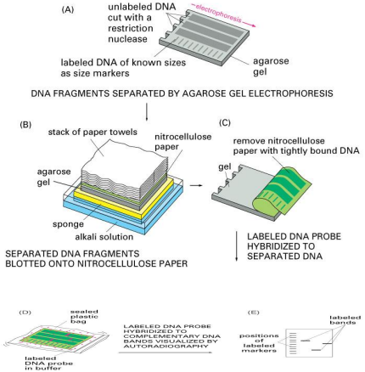

Slide 15
APPLICATIONS
Southern blots are used in gene discovery, mapping, evolution and development studies, diagnostics and forensics (It is used for DNA fingerprinting, preparation of RFLP maps)
Identification of the transferred genes in transgenic individuals, etc.
Southern blots allow investigators to determine the molecular weight of a restriction fragment and to measure relative amounts in different samples.
Southern blot is used to detect the presence of a particular bit of DNA in a sample
Analyze the genetic patterns which appear in a person's DNA.

Slide 16
NORTHERN BLOTTING
The northern blot is used to study the expression patterns of a specific type of RNA molecule as relative comparison among a set of different samples of RNA.
RNA is separated based on size and is then transferred to a membrane then probed with a labeled complement of a sequence of interest.
The results may be visualized through a variety of ways depending on the label used. Most result in the revelation of bands representing the sizes of the RNA detected in sample.
The intensity of these bands is related to the amount of the target RNA in the samples analyzed.

Slide 17
It is used to study when and how much gene expression is occurring by measuring how much of that RNA is present in different samples.
One of the most basic tools for determining at what time, and under what conditions, certain genes are expressed in living tissues.
WESTERN BLOTTING
In western blotting, proteins are first separated by size, in a thin gel sandwiched between two glass plates in a technique known as SDSPAGE sodium dodecyl sulphate polyacrylamide gel electrophoresis.
The proteins in the gel are then transferred to a nitrocellulose, nylon or other support membrane.

Slide 18
This membrane probed with solutions of antibodies. Antibodies specifically bind to the protein of interest & visualized by a variety of techniques, including colored products, chemiluminescence, or autoradiography.
Antibodies are labeled with enzymes. When a chemiluminescent substrate is exposed to the enzyme it allows detection.
Using western blotting techniques allows not only detection but also quantitative analysis.
Northern Blotting
Northern blotting is a technique for detection of specific RNA sequences. Northern blotting was developed by James Alwine and George Stark at Stanford University (1979) and was named such by analogy to Southern blotting.

Slide 19
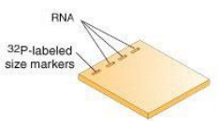
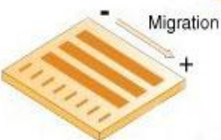
Steps involved in Northern blotting
1) RNA is isolated from several biological samples (e.g. various tissues, various developmental stages of same tissue etc.)
RNA is more susceptible to degradation
than DNA.
2) Sample’s are loaded on gel and the RNA
samples are separated according to their size
on an agarose gel.
The resulting gel following after the
electrophoresis run.

Slide 20
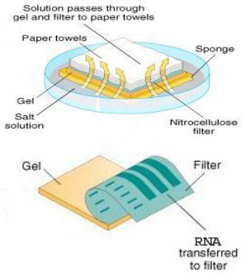
3) The gel is then blotted on a nylon membrane or a nitrocellulose filter paper by creating the sandwich arrangement.

Slide 21
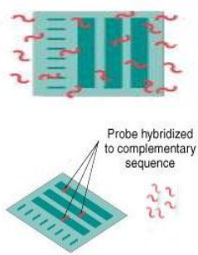
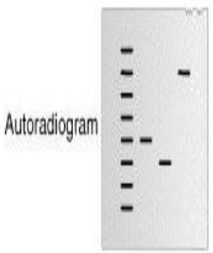
4) The membrane is placed in a dish
containing hybridization buffer with
a labeled probe.
Thus, it will hybridize to the RNA on
the blot that corresponds to the sequence
of interest.
5) The membrane is washed to
remove unbound probe.
6) The labeled probe is detected via
autoradiography or via a
chemiluminescence reaction
(if a chemically labeled probe
is used). In both cases this results
In the formation of a dark band
on an X-ray film.

Slide 22
Now the expression patterns of the sequence of interest in the different samples can be compared.
APPLICATIONS
A standard for the study of gene expression at the level of mRNA (messenger RNA transcripts).
Detection of mRNA transcript size.
Study RNA degradation.
Study RNA splicing.
Study RNA half-life.
Often used to confirm and check transgenic / knockout mice (animals)

Slide 23
Disadvantage of Northern plotting
1) The standard northern blot method is relatively less sensitive than nuclease protection assays and RT-PCR.
2) Detection with multiple probes is a problem.
3) If RNA samples are even slightly degraded by RNASES, the quality of the data and quantization of expression is quite negatively affected.

Slide 24
Western blotting
Western blotting (1981) is an Immunoblotting technique which rely on the specificity of binding between a protein of interest and a probe (antibody raised against that particular protein) to allow detection of the protein of interest in a mixture of many other similar molecules.
The SDS PAGE technique is a prerequisite for Western blotting.
Steps in western blotting
1) A protein sample is subjected to electrophoresis on an SDS-polyacrylamide gel.

Slide 25
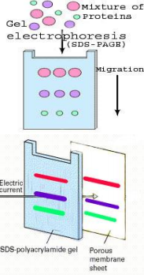
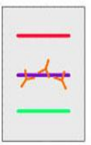
2) Electroblotting transfers the
separated proteins from the gel
to the surface of a nitrocellulose
membrane.
3) The blot is incubated with a
generic protein (such as milk
proteins or BSA) which binds to
Any remaining sticky places on the
nitrocellulose.

Slide 26
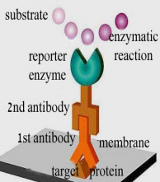
4) An antibody that is specific for the protein of interest (the primary antibody - Ab1) is added to the nitrocellulose sheet and reacts with the antigen. Only the band containing the protein of interest binds the antibody, forming a layer of antibody molecules.
5) After washing for removal of non-
specifically bound Ab1, second antibody
(Ab2) is added, which specifically
recognizes the FC domain of the
primary antibody and binds it. Ab2 is
radioactively labeled, or is covalently
linked to a reporter enzyme, which
allows to visualize the protein-Ab1-Ab2
complex.

Slide 27
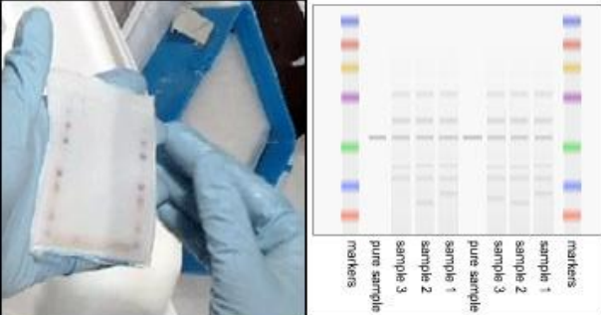
An example

Slide 28
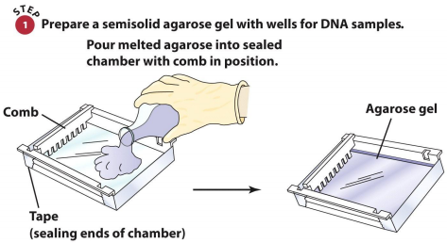
Application
1. The confirmatory HIV test.
2. Western blot is also used as the definitive test for Bovine spongiform encephalopathy (BSE).
3. Some forms of Lyme disease testing employ Western blotting.
Agarose Gel Electrophoresis

Slide 33
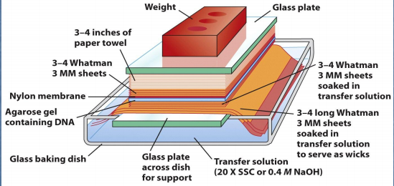
Southern Blot: Transferring DNA from the Gel to a Membrane

Slide 34
Identification of a Specific Fragment by Southern Blot Hybridization

