Slide 1
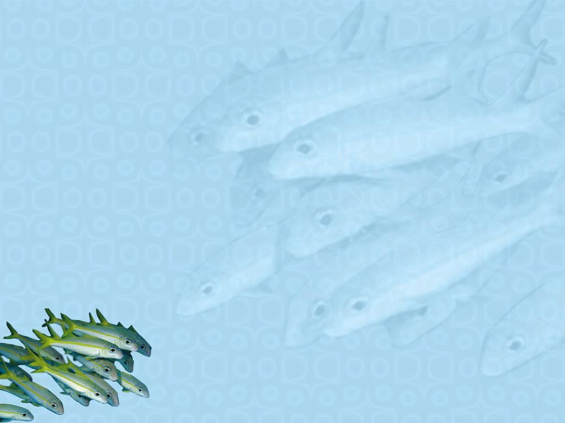
GENE MAPPING

Slide 2
Evolution & Genes
The function of many genes is conserved across
immense evolutionary distances
The function
environment
of a gene
is affected
by its
Many gene products
cascade or pathway
function
as part of a

Slide 3
“Nothing in Biology Makes Sense Except in the Light of Evolution” (Theodosius Dobzhansky)

Slide 4
Gene Mapping
Gene mapping determines the order of genes and the relative distances between them in map units
1 map unit = 1 cM (centimorgan)
Gene mapping methods use recombination frequencies between alleles in order to determine the relative distances between them
Recombination frequencies between genes are inversely
proportional to their distance apart
Distance measurement: 1 map unit = 1 percent recombination (true for short distances)
4

Slide 5
One map unit | (mu) is | defined | as 1 | percent
recombination | between | two | genes | on a
chromosome.
Map units are often called centimorgans (cM)
and are relative distances, not exact ones.
A single crossover (SCO) alters linkage between two genes only if the crossover occurs between those two genes.

Slide 6
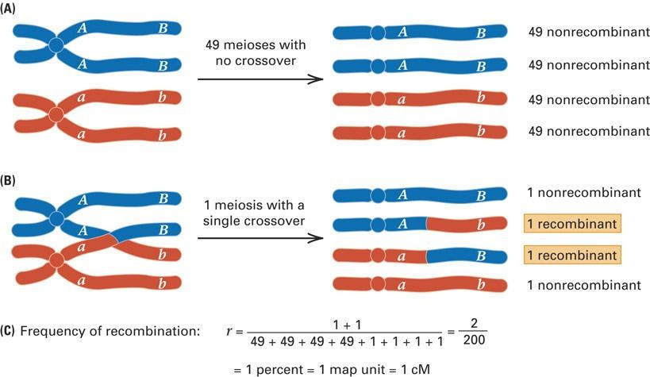
6

Slide 7
Uses of Gene Mapping
Identify genes responsible for diseases
  Heritable diseases
  Cancer
Identify genes responsible for traits
  Plants or Animals
  Disease resistance
  Meat or Milk Production

Slide 8
Types of Maps
Nucleotide Sequence Maps
  complete or partially sequenced organisms
Cytogenetic Maps
  Breakpoints in disease
  Direct binding of probes to chromosome
Genetic Linkage Maps
  Markers
Physical Maps

Slide 9
Mapping Genes
Essential element -- Markers
Differences between two members of a species
Typically between 1-400 nucleotides in length
Can also be gross chromosomal rearrangements

Slide 10
Gene Mapping
Genes with recombination frequencies less than 50
percent are on the same chromosome = linked
Linkage group = all known genes on a chromosome
Two genes that undergo independent assortment have recombination frequency of 50 percent and are located on nonhomologous chromosomes or far apart on the same chromosome = unlinked
10

Slide 11
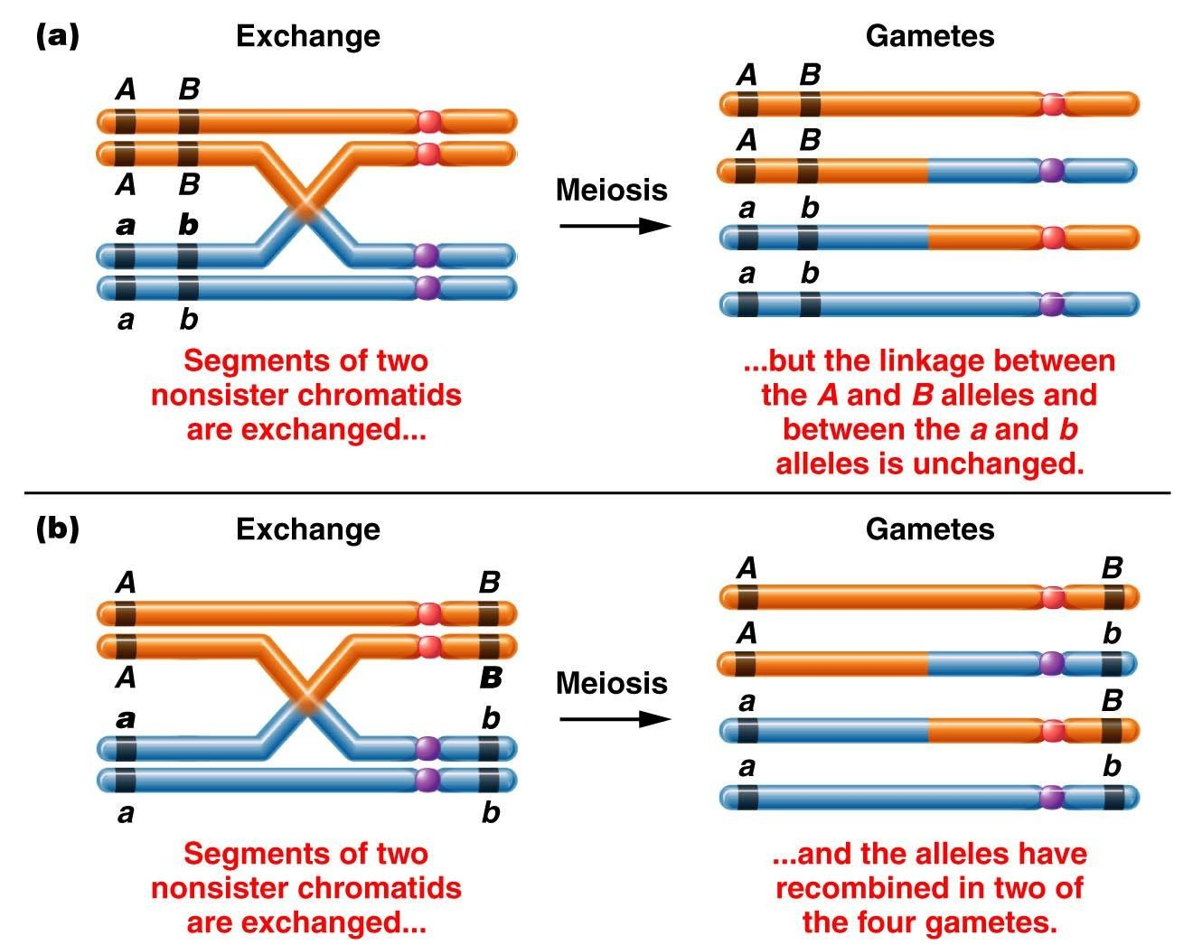

Slide 12
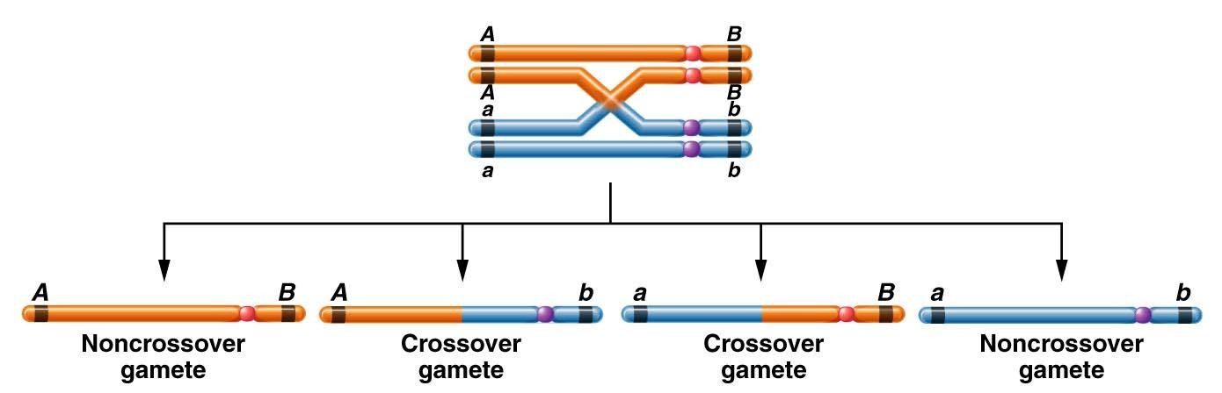

Slide 13
Single
crossovers
can be used to
two
determine the distance between
linked genes, but double crossovers (DCOs) can be used to determine the order of three genes on the chromosome and the distance between the linked genes.

Slide 14
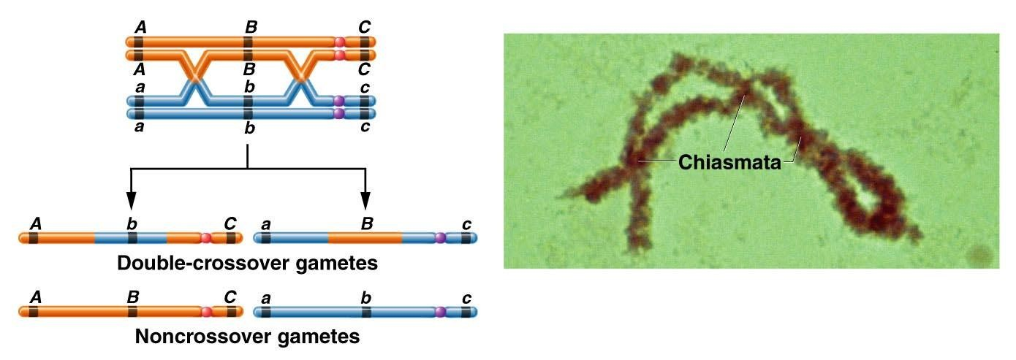
To study double exchanges, three pairs of genes must be investigated, each heterozygous for two alleles.
The expected frequency of double-crossover gametes is much lower than that of either single- crossover gamete class.

Slide 15
In Three-Point Mapping,
– Parent must
consideration.
be heterozygous
for all 3 genes
under
– Cross constructed so genotypes can be determined by offspring
phenotypes.
– Many offspring
produced
to get a representative
sample of
crossover events.
A three-point mapping cross is shown in (Drosophila).

Slide 16
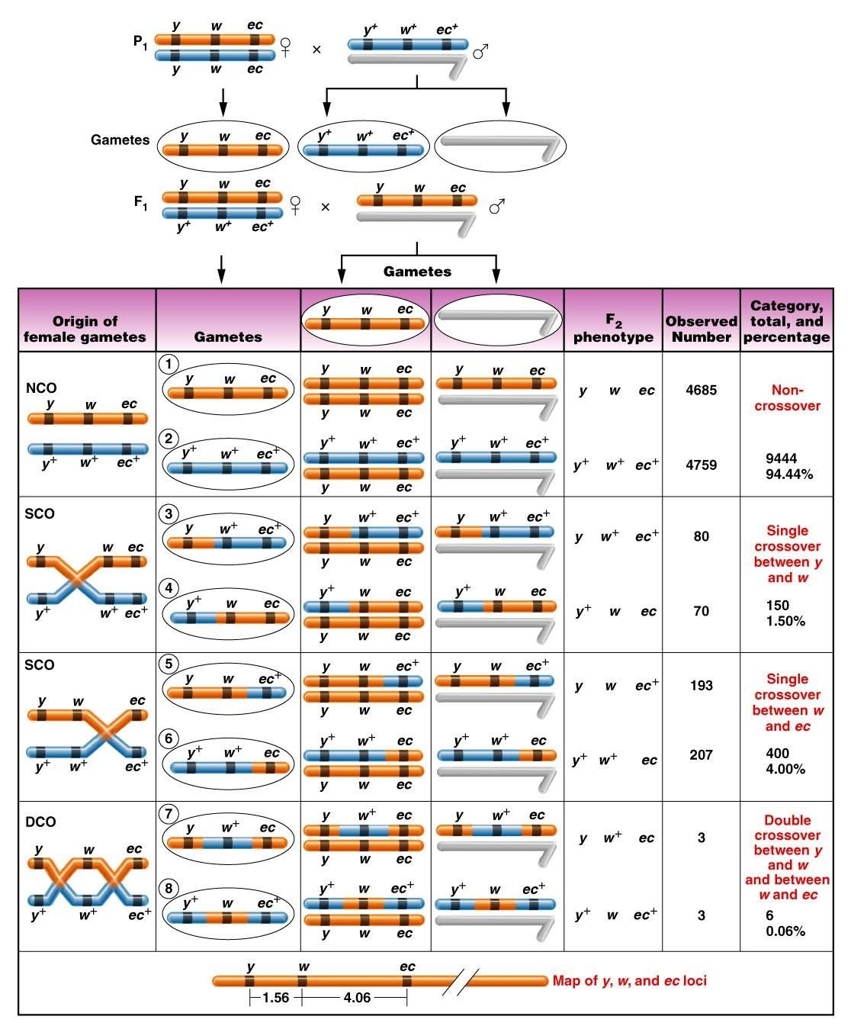

Slide 17
The
occur in
noncrossover
F₂ phenotypes
proportion of
the greatest
offspring.
The double-crossover phenotypes
occur in the smallest proportion.

Slide 18
Because the
F₂
phenotypes
complement each other (i.e., one is wild type and the other is mutant for all three genes), they are called reciprocal classes of phenotypes.

Slide 19
Distance between two genes in a three- point cross is equal to the percentage of all detectable exchanges occurring between them and includes all single and double crossovers.

Slide 20
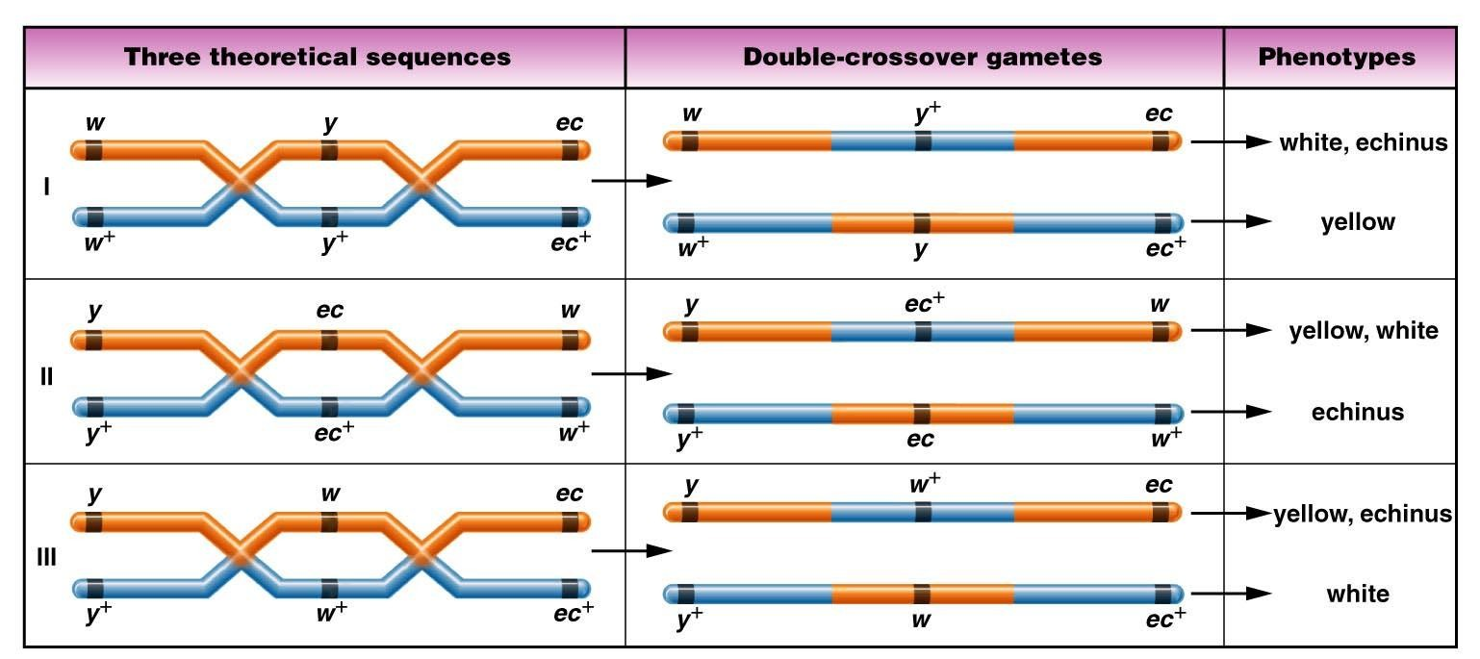
Determining Gene Sequence
We assumed sequence is y-w-ec
But don’t know if that is correct order

Slide 21
2 methods for determining gene order from a three-point
cross.
Method I
Method II

Slide 22
– There are only 3 possible arrangements of our
3 genes

Slide 23
Method I
(1) Determine arrangement of alleles on homologs of heterozygote producing crossover gametes by identifying reciprocal noncrossover phenotypes
(2) test each of 3 possible orders to see which one gives you the observed double-crossover phenotypes – the one that does is the winner!

Slide 24
Method II
(1) Determine arrangement of alleles on homologs of heterozygote producing crossover gametes by identifying reciprocal noncrossover phenotypes
(2) Look at observed double-crossover phenotypes and id single allele that has been switched
  Will be one that is by itself (no longer associated with other
mutant alleles)
  That is the one in the middle!

Slide 25
Mapping Problem in Maize
– An example of a three-point cross and mapping of the three
genes involved is shown in Figures.
3 Linked Genes
  bm = brown midrib
  v = virescent seedling
  pr = purple aleurone

Slide 26
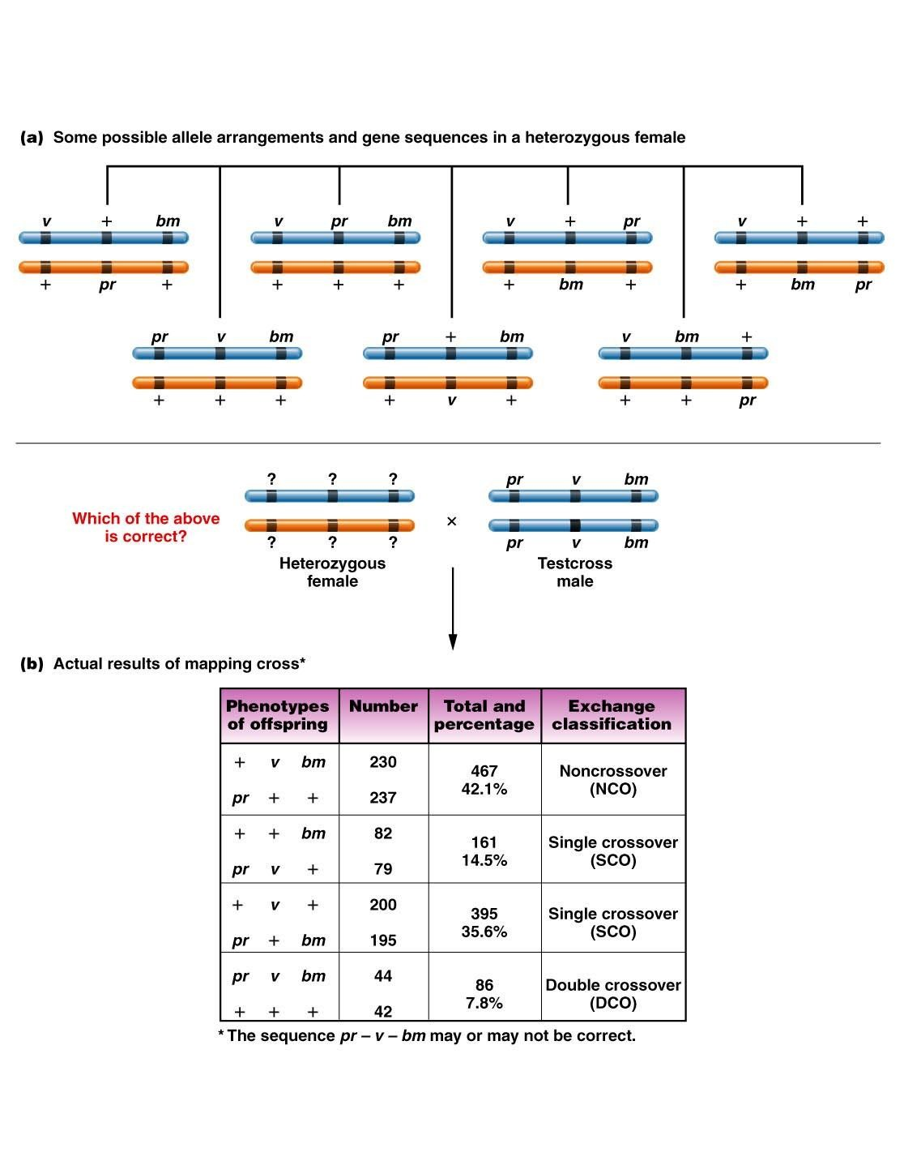

Slide 27
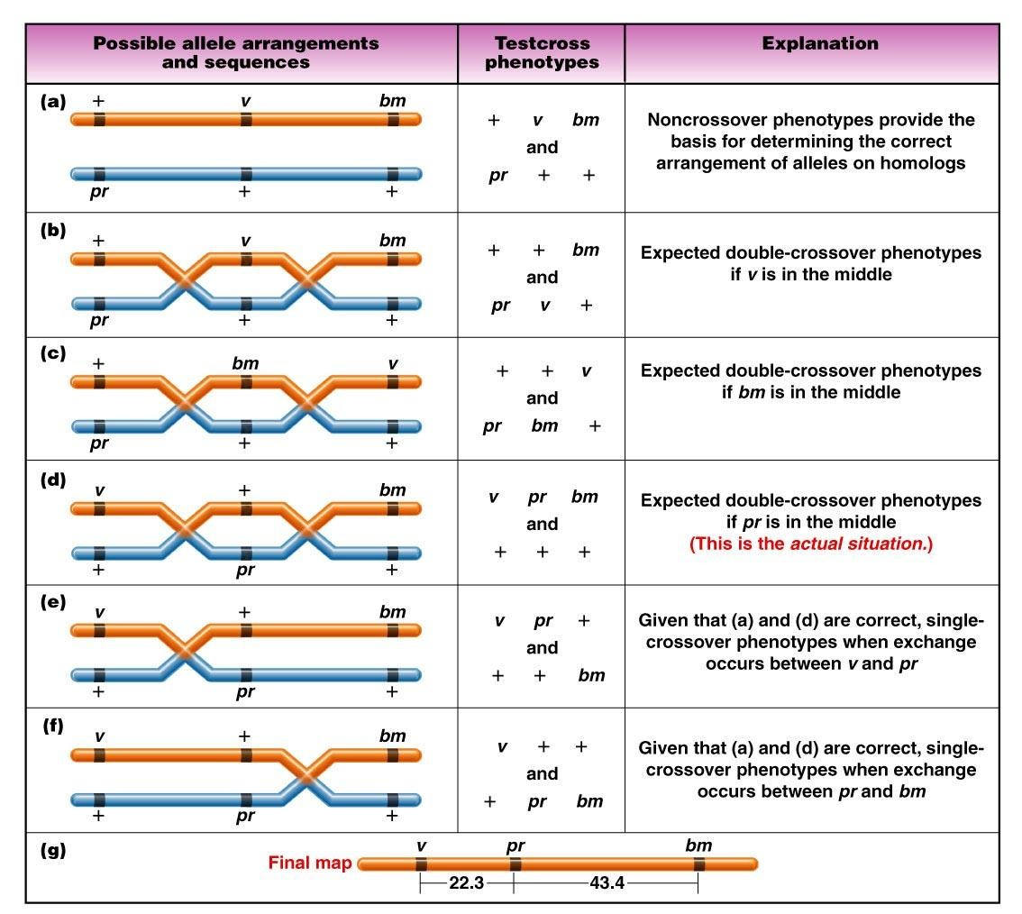

Slide 28
The expected frequency of multiple exchanges between two genes can be predicted from the distance between them.
The coefficient of coincidence (C) is the observed number of DCOs divided by the expected number of DCOs.

Slide 29
Interference reduces the expected number of multiple crossovers when a crossover event in one region of the chromosome inhibits a second event nearby.
Interference is positive if fewer double-crossover events than expected occur and negative if more double- crossover events than expected occur.

Slide 30
When two genes are close together, the
accuracy of mapping is high.
As the distance between them increases, the accuracy of mapping decreases.

Slide 31
Two exchanges between linked genes that are far apart on a chromosome can involve two, three, or all four strands.
They
can result
in production of
different
percentages
of recombinant
chromatids.

Slide 32
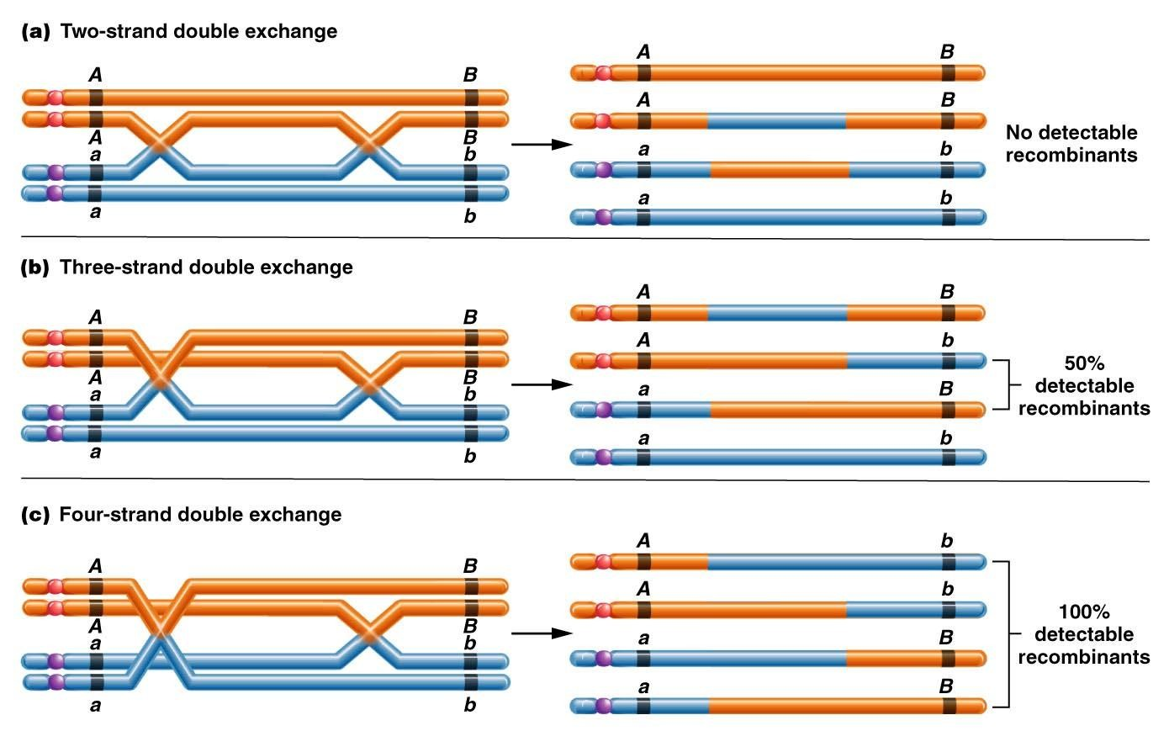

Slide 33
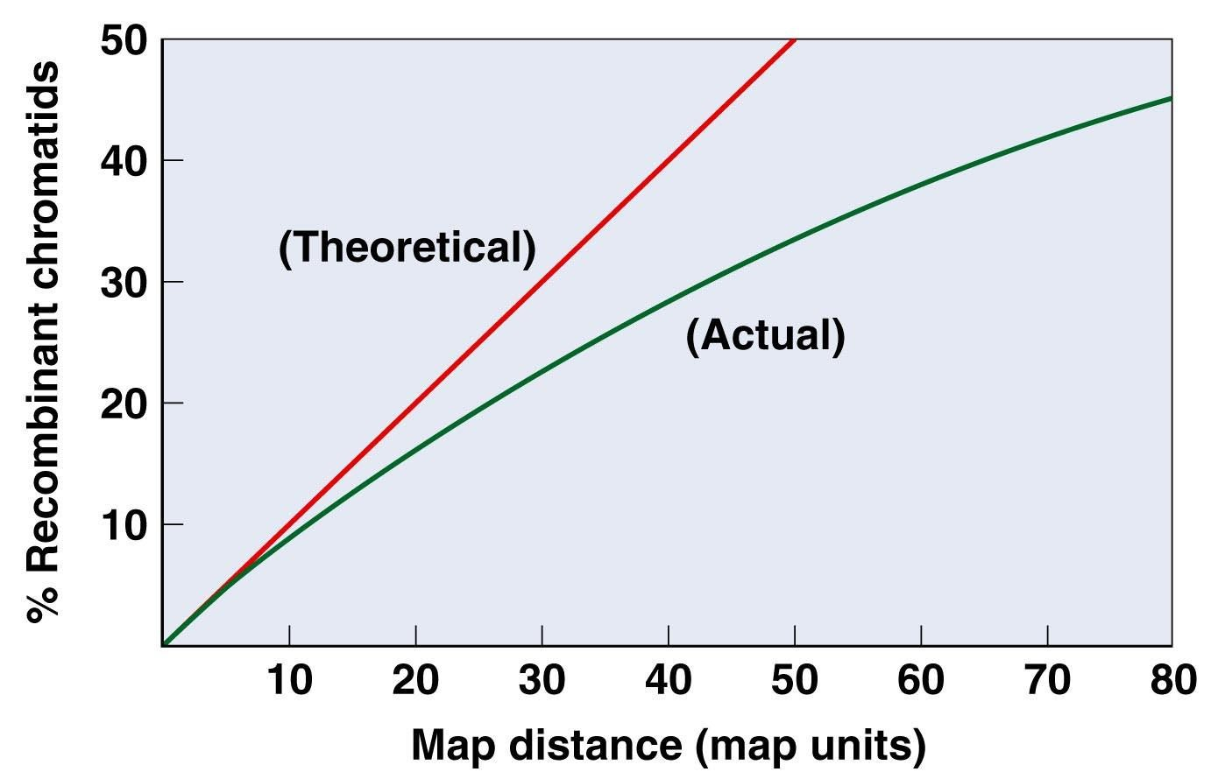

Slide 34
Drosophila
Mapped
Genes
Have
Been
Extensively
The large numbers of mutants in Drosophila, maize, and mice have allowed extensive chromosome mapping in these organisms.

Slide 35
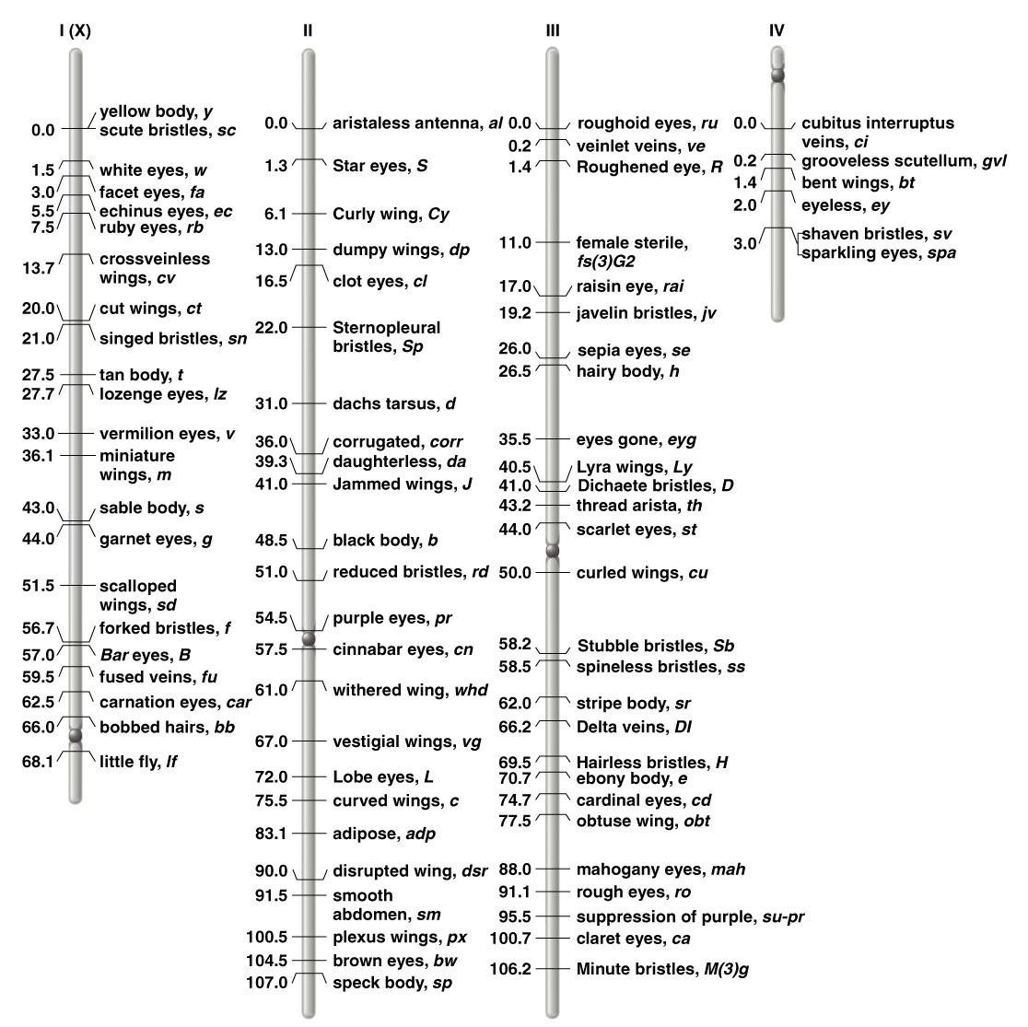

Slide 36
Lod score
analysis relies on
probability calculations to demonstrate linkage between two genes in organisms in which linkage analysis relies primarily on pedigrees.

Slide 37
Somatic cell hybridization involves fusion of two cells in culture to form a single hybrid cell, called a heterokaryon.

Slide 38
Synkaryon – nuclei eventually fuse in
cell
Upon continued culturing of the hybrid cell, chromosomes from one of the two parental species are gradually lost until only a few chromosomes of one species remain and most chromosomes are from the other species

Slide 39
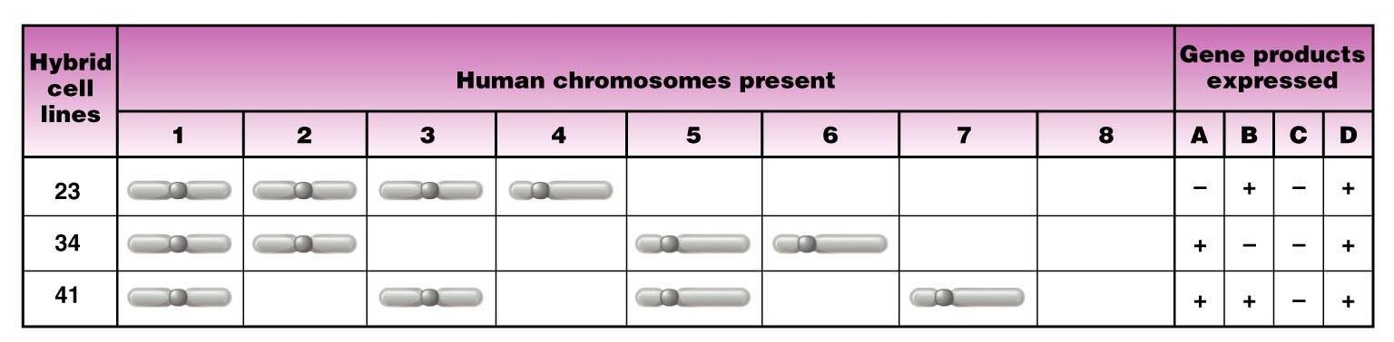
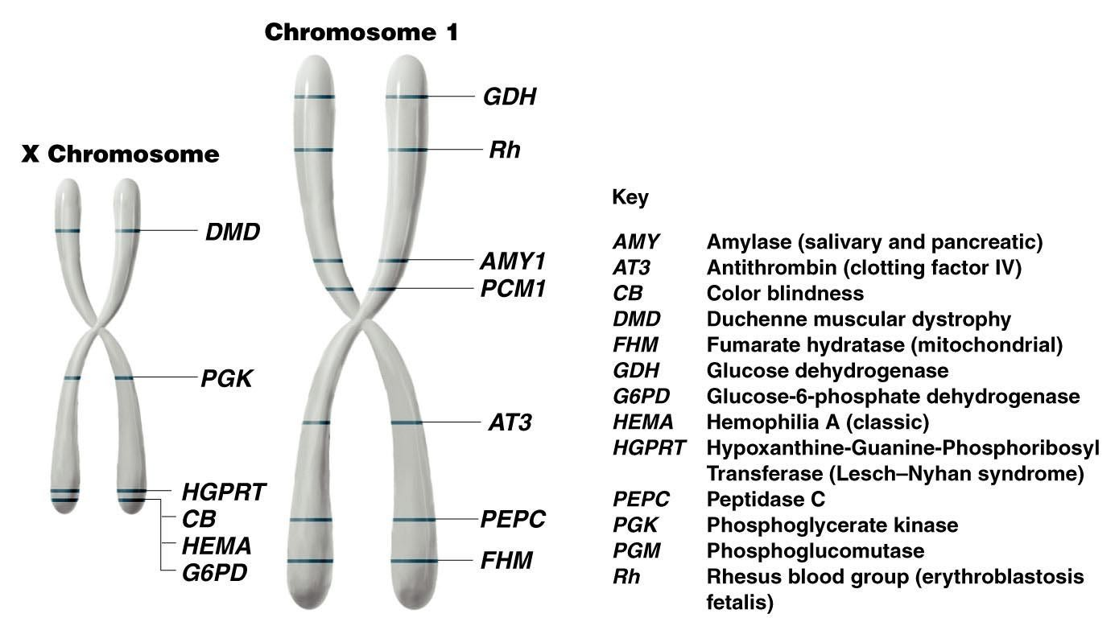

Slide 40
Chromosome Mapping is Now Possible Using DNA Markers and Annotated Computer Databases
DNA markers represent landmarks along the chromosome.
  RFLPs – Restriction Fragment Length Polymorphisms
  Microsatellites
  SNPs – Single Nucleotide Polymorphisms

Slide 41
Recombination Occurs between Mitotic Chromosomes
In Drosophila and certain fungi, homologs pair up during mitosis,
allowing crossing over to take place.
Sister chromatid exchanges (SCEs) occur during mitosis but
do not produce new allelic combinations.

Slide 42
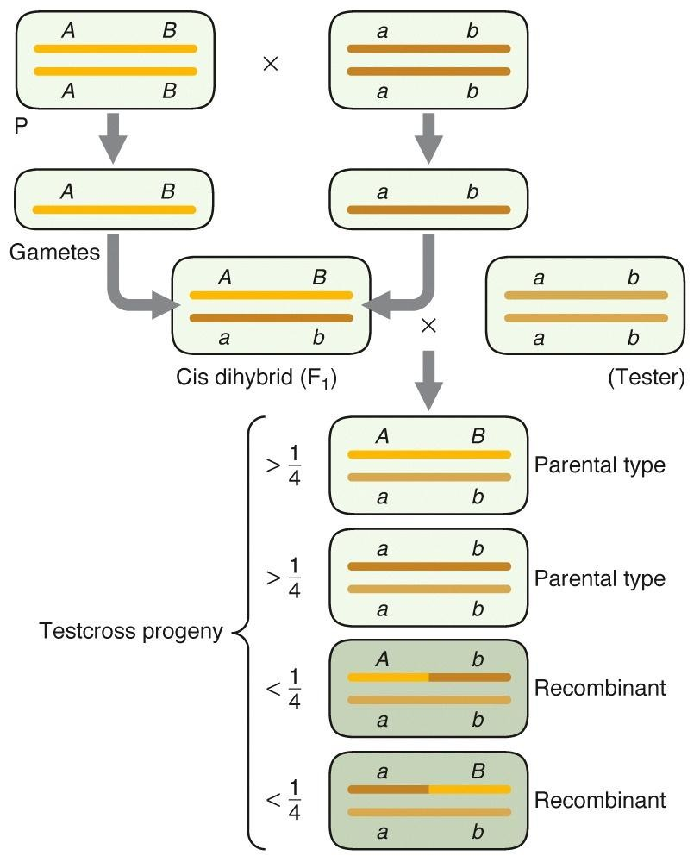
Mapping the distance between two genes
Starting with pure breeding lines,
Cross Parent 1(AA BB) with Parent 2(aa bb)
So Parental chromosomes in the F1 have to be AB and ab
Now cross (AB ab) F1 progeny with (ab ab) tester to look for recombination on these chromosomes. Suppose you Get……
AB ab | 583 | <parental
ab ab | 597 | <parental
Ab ab | 134 | <recombinant
aB ab | 134 | <recombinant
total= 1448
so….
268 recombinants /1448 progeny =
0.185 recombinants/progeny= 18.5% recombinants=
18.5 mu
4
2

Slide 43
Mapping (and ordering) three genes
Starting with pure breeding lines, Cross Parent 1(AA BB DD) with Parent 2(aa bb dd)
So you know the Parental chromosomes in the F1 have to be ABD and abc
Cross (ABD abd) F1 progeny with (abd abd) tester
Ab + aB = (45+89)+(94+40)
recom
268 recom/1448 total =0.185
A-B =18.5mu
Bd + bD = (3+40)+(5+45)
93 recom/1448 total= 0.064
B-D =6.4mu
Suppose you Get……
ABD abd ABd abd
580
3
<parental
abD abd abd abd
5
592
<parental
AbD abd
Abd abd
45
89
<recombinant
Ad + aD = (3+89)+(5+94)
191 recom/1448 total= 0.132
A-D =13.2mu
aBD abd aBd abd
94
40
total= 1448
<recombinant
so the order must be A-----D---B
-13.2--6.4-
----18.5----
3
4

Slide 44
So How come 13.2 + 6.4 does not equal 18.5?
We missed the double recombinants on the first pass…
Cross (ABD abd) F1 progeny with (abd abd) tester
Ab + aB = (45+89)+(94+40)
recom
268 recom/1448 total =0.185
A-B =18.5mu
(45+89)+(94+40)+2(3+5) recom
284recom/1448 total = 0.196
A-B =19.6mu
Suppose you Get……
ABD abd ABd abd
580
3
<parental
abD abd abd abd
5
592
<parental
longer the distance, more potential to underestimate recomb freq.
AbD abd
Abd abd
45
89
<recombinant
aBD abd aBd abd
94
40
total= 1448
<recombinant
A-----D---B
-13.2--6.4-
----18.5----
4
4

Slide 45
Chromosome interference: crossovers in one region decrease the probability of a second crossover close by
Coefficient of coincidence = observed number of double recombinants
divided by the expected number
If the two crossovers were independent,
\
we would expect that the probability of seeing two recombination events occur would be
0.132 between A-D AND 0.064 between D-B 0.132 X 0.064 = 0.008
For every 1448 progeny, this would be (1448x0.008)=12.23 double recombinants We actually observed only (5+3)= 8 double recombinants
So the Coefficient of coincidence = observed / expected = 8/12.23 =0.65
Interference = 1-Coefficient of coincidence
Interference
= 1-Coefficient of coincidence
= 1- 0.65
= 0.35
45

Slide 46
DNA Sequencing
Two methods originally developed:
  Chemical or Allan Maxim and Walter Gilbert method in 1976-77.
  Dideoxynucleotide or Frederick Sanger method.
  Both Gilber and Sanger won Nobel prizes
for developing these techniques.
Dideoxynucleotide method is by far the most common employed today.

Slide 47
Automated Sequencing
Each nucleotide is
labeled with a
different fluorescent chromophore.
Uses Taq polymerase
to incorporate
fluorescent dideoxy nucleotide.
Analysis on a polyacrylamide gel or capillary matrix that can separate DNA based upon a 1 nucleotide difference.
30-1000 nucleotides in length can theoretically be determined.

Slide 48
O
Base
O P O CH₂
O
Deoxy
O
OH
O
Base
O P O CH₂
O
O
Dideoxy (3’2’)

Slide 49
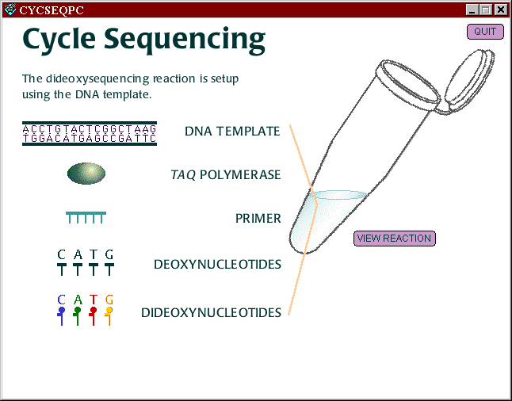
Copyright Cold Spring Harbor Laboratories

Slide 50
G A T C G G A T C C
G A T C G G A T C C
T A G G

Slide 51

G A T C G G A T C C
C T A G G
C
dd
G A T C G G A T C C
C C T A G G
dd

Slide 52
G A T C G G A T C C
G C C T A G G
dd

Slide 53
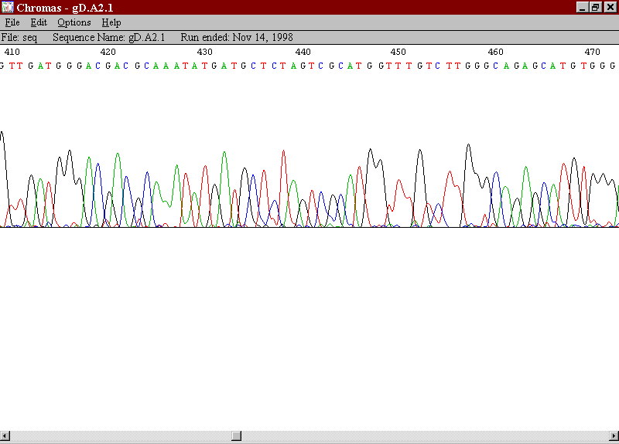

Slide 54
Nucleotide Sequencing
Complete Genome Sequencing
  Bacterial Artificial Chromosomes (BAC)
    Can grow in bacteria
    Have large inserts 100,000-300,000 nucleotides
  Collect a large library of BACs
  Restriction Endonuclease (RE) Map
    RE - cuts DNA at specific sites
    EcoRI cuts at GAATTC

Slide 55
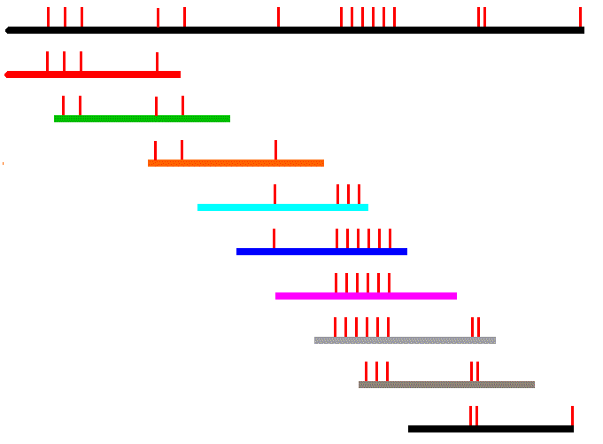
B A C
s
meds.queensu.ca/~mbio318/ EXTRA_MATERIAL.html

Slide 56
Genomic Sequencing
Once BAC map complete
Sequence ends of BAC clones.
– With dense BAC map, large
regions may be
covered by overlapping the sequences.
Individual BACs can be completely sequenced.
Individual BACs can be hybridized to chromosomes
to identify chromosome of origin.

Slide 57
Recombination
Permits Mapping by providing:
  Linkage groups
  Distances
During Meiosis

Slide 58
Recombination
Linkage Groups - markers that tend to remain together.
Distance - the further apart two markers lie, the more
often recombination will occur between those markers.
Markers on the same chromosome can be so far apart
that they appear in different linkage groups.

Slide 59
Cytogenetic Mapping
Philadelphia Chromosome
•
Chronic myelogenous leukemia (CML) is
characterized by a reciprocal translocation between chromosomes 9 and 22 that produces the Philadelphia chromosome.
Invariably there is disease progression, with loss of the capacity for terminal differentiation by the hematopoietic stem cell, resulting in an acute leukemia.

Slide 60
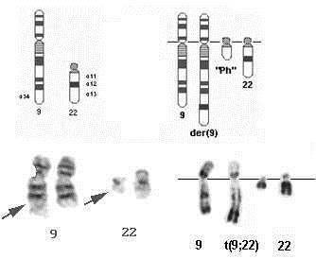

Slide 61
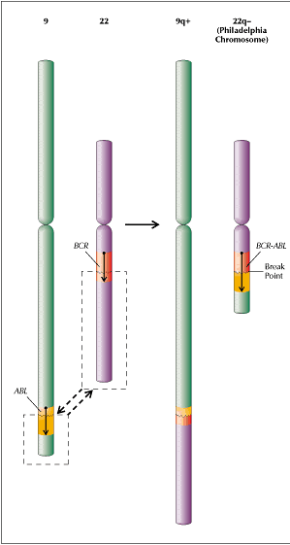

Slide 62
Genetic Linkage Maps Polymorphism
Polymorphisms
  Polymorphism - an allele present in a population that exhibits
multiple forms.
  Monomorph - Single form in a population.
  Common.
  Typically result in no effect on survival of individual.

Slide 63
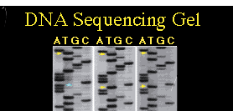
Types of Markers
Single Nucleotide Polymorphisms (SNPs)
– Occur approximately every 100-300 bp in humans.
Names: rs8111765

Slide 64
Markers
Microsatellites or Tandem Repeats
  acgCACACAtgc
  acgCACACACAtgc

Slide 65
Physical Maps
Sequence Tagged Sites (STSs)
  Use Polymerase Chain Reaction (PCR).
  Primers based upon:
    random sequence
    expressed sequence tag
  Amplify from library of clones containing large inserts (BAC).
  Relate to BAC map.
  If more than one on same clone, then close together

Slide 66
Genes and Maps
Bcl2
Map Link
OMIM Link
Syntenic Relationships - tendency of closely linked genes to remain linked during evolution.

Slide 67
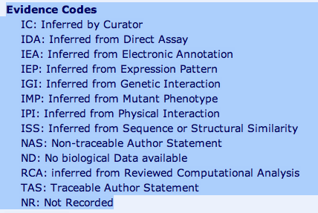
GO evidence codes

