Slide 1
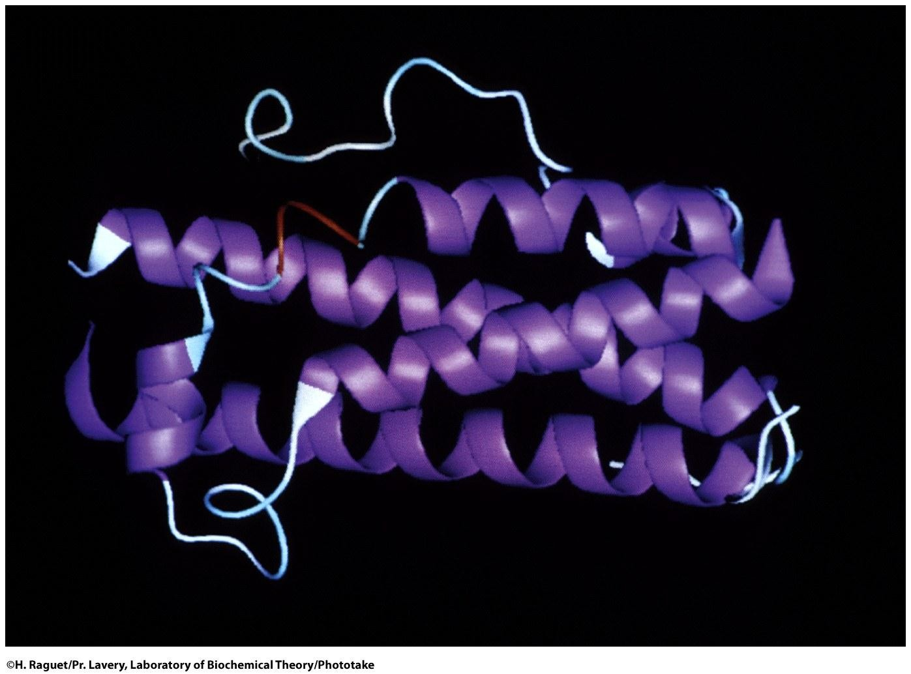
The Techniques of Molecular
Genetics

Slide 2
Molecular genetics is the field of biology and genetics that studies the structure and function of genes at a molecular level.
Molecular genetics employs the methods of genetics and molecular biology to elucidate molecular function and interactions among genes.
It is so called to differentiate it from other sub fields of genetics such as ecological genetics and population genetics.

Slide 3
Along with | determining | the pattern | of
descendants, | molecular | genetics helps | in
understanding
developmental biology,
genetic mutations types of diseases.
that can cause certain
Through utilizing the methods of genetics and molecular biology, molecular genetics discovers the reasons why traits are carried on and how and why some may mutate.

Slide 4
Basic Techniques used to Identify, Amplify,
and Clone Genes
Construction and Screening of DNA Libraries
The Molecular Analysis of DNA, RNA, and
Protein
The Molecular Chromosomes
Analysis
of Genes and

Slide 5
Basic | Techniques | Used to
Identify, | Amplify, | and Clone
Genes
Recombinant
DNA,
gene cloning, techniques
and allow
DNA amplification
scientists to isolate and characterize
essentially any DNA sequence from any
organism.

Slide 6
Gene Cloning
Gene cloning is the isolation and amplification of a given gene.
A recombinant DNA molecule is a DNA molecule made by joining two or more different DNA molecules.

Slide 7
Amplification of a Gene In Vivo
A minichromosome carrying the gene of interest is produced in the test tube.
The
recombinant
minichromosome is
introduced into a host cell (such as E. coli), and the host cell replicates the minochromosome.

Slide 8
Amplification of a Gene In Vitro
Short DNA strands complementary to DNA sequences on either side of the gene of interest are synthesized.
These short DNA strands are used to initiate the amplification of the gene by a heat-stable DNA polymerase in the polymerase chain reaction (PCR).

Slide 9
Restriction Endonucleases
Restriction endonucleases make
site-
specific cuts in DNA.
The nucleotide sequences are
restriction sites.
called
Restriction endonucleases protect bacteria from foreign DNA.
Bacteria protect endogenous restriction sites by methylation.
Restriction enzymes commonly recognize
palindromic sequences.

Slide 10
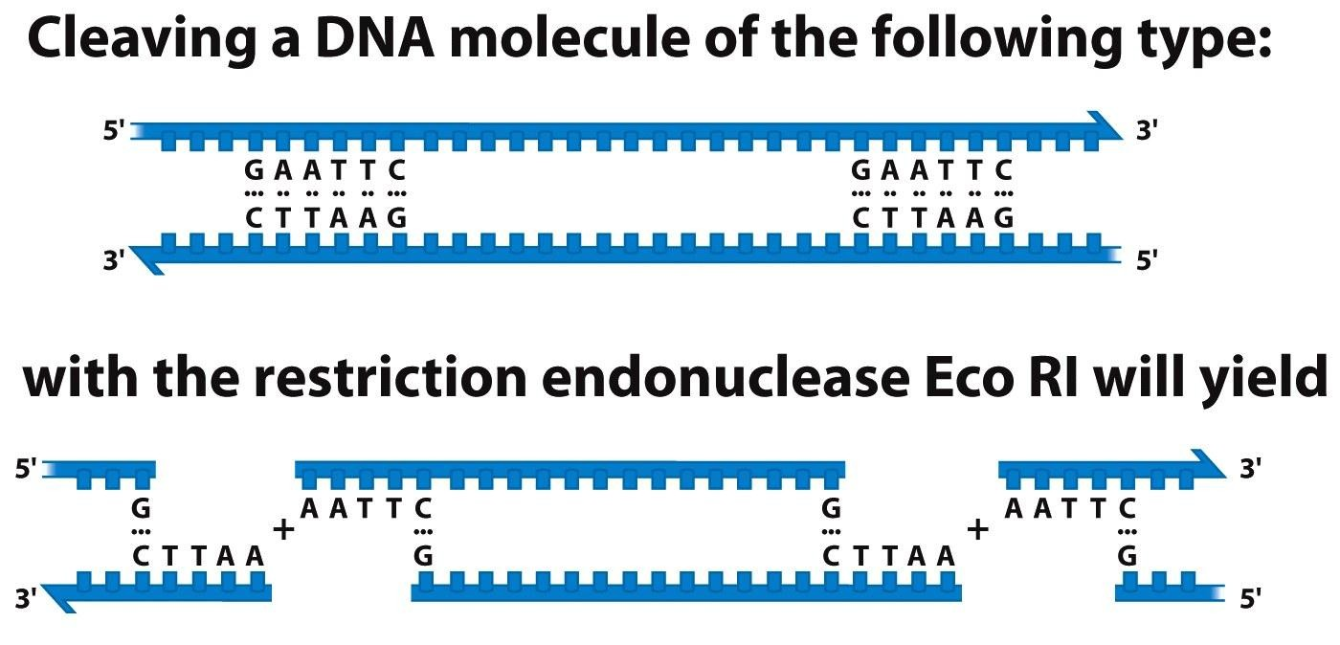
Many Restriction Endonucleases
Make Staggered Cuts

Slide 11
When DNA is cleaved with a restriction endonuclease that makes staggered cuts, all of the resulting restriction fragments have complementary single-stranded termini.
The complementary single-stranded termini can hydrogen bond with each other and be joined together by DNA ligase.

Slide 12
Plasmid Vectors
Circular, double-stranded circular DNA molecules present in bacteria.
Range from 1 kb to over 200 kb.
Replicate autonomously.
Many carry antibiotic-resistance genes, which can be used as selectable markers.
Many useful cloning vectors were derived
from plasmid pBR322.

Slide 13
Bacteriophage Vectors
Most
been
bacteriophage cloning vectors have constructed from the phage λ
chromosome.
The central one-third (about 15 kb) of the λ chromosome contains genes required for lysogeny but not for lytic growth.
This portion of the chromosome can be excised and replaced with foreign DNA.
The foreign DNA inserted must be 10-15 kb.

Slide 14
Cosmid Vectors
Hybrids between plasmids and the phage λ
chromosome.
Replicate autonomously in E. coli.
Can be packaged in vitro into phage λ heads.
Accept inserts of 35-45 kb.

Slide 15
Phagemid Vectors
Contain components chromosomes and plasmids.
from phage
double-stranded
Replicate
plasmids.
Addition
in E. coli as
of a helper phage
causes the
phagemid to switch to the phage mode of replication, resulting in the packaging of single-stranded DNA into phage heads.

Slide 16
Eukaryotic and Shuttle Vectors
Because different organisms use different origins of replication and regulatory signals, different cloning vectors must be used in different species.
Special cloning vectors can replicate in other
prokaryotes and in eukaryotes.
Shuttle vectors can replicate in E. coli and in
another species.

Slide 17
Yeast Artificial Chromosomes (YACs)
Genetically engineered yeast minichromosomes.
Accept foreign DNA inserts of 200-500
kb.
Contain a yeast origin of replication, yeast centromere, two yeast telomeres, a selectable marker, and a polycloning site.

Slide 18
BACs and PACs
Bacterial artificial chromosomes (BACs) have been constructed from bacterial fertility (F) factors.
Bacteriophage P1 artificial chromosomes (PACs) have been constructed from bacteriophage P1 chromosomes.
BACs and PACs accept 150-300 kb inserts and are less complex than YACs.

Slide 19
The Polymerase Chain Reaction (PCR)
 Synthetic nucleotides complementary to known flanking sequences are used to prime enzymatic amplification of the sequence of interest.
 Three repeated steps
Denaturation of genomic DNA (92-95°C)
Annealing of denatured DNA to oligonucleotide primers (50-
60 ⁰C)
Replication of the DNA segment between the sites complementary to the primers (70-72°C)
 Amplification occurs exponentially; each cycle doubles the number of molecules of the sequence of interest.

Slide 20
Taq Polymerase
 DNA polymerase from Thermus aquaticus is used for
PCR because it is heat-stable.
 Taq polymerase lacks proofreading activity, so errors are introduced into the amplified DNA at low but significant frequencies.
When high fidelity is required, heat-stable polymerases with
proofreading activity are used (Pfu or Tli).
 Taq is amplifies fragments of DNA larger than a few thousand base pairs inefficiently.
For amplification of long segments of DNA (up to 35 kb), Tfl
polymerase is used.

Slide 21
Applications of PCR
Diagnosis of inherited human diseases (e.g., prenatal diagnosis).
Identification forensic cases samples.
of individuals in
from small DNA

Slide 22
Key Points
The discovery of restriction endonucleases— enzymes that recognize and cleave DNA in a sequence-specific manner allowed scientists to produce recombinant DNA molecules in vitro.
DNA sequences can be inserted into small, self-replicating DNA molecules called cloning vectors and amplified by replication in vivo after being introduced into living cells by transformation.

Slide 23
Key Points
The polymerase chain reaction (PCR) can be used to amplify specific DNA sequences in vitro.

Slide 24
Construction and Screening of
DNA Libraries
DNA libraries can be constructed and screened for genes and other sequences of interest.

Slide 25
DNA Libraries
A genomic DNA library
is a set of DNA
the entire
clones collectively containing
genome of an organism.
A cDNA library contains the coding regions of the expressed genes of an organism. It is
made of complementary synthesized from RNA transcriptase.
DNA (cDNA)
by reverse

Slide 26
Amplification of Recombinant DNA
Antibiotic-sensitive | recipient cells | are
transformed with | the recombinant | DNA
molecule.
Transformed cells are selected by growth under conditions requiring the presence of a
selectable | marker | present | on | the
recombinant | DNA | molecule | (usually | an
antibiotic).
The recombinant DNA molecule is amplified
by the host cell.

Slide 27
Screening DNA Libraries for
Genes of Interest
Genetic Selection—searching for a DNA sequence that restores the wild- type phenotype to a mutant organism.
Molecular hybridization is based on the hybridization of similar DNA sequences.

Slide 28
Key Points
DNA libraries can be constructed that contain complete sets of genomic DNA sequences or DNA copies (cDNAs) of mRNAs in an organism.
Specific genes or other DNA sequences can be isolated from DNA libraries by genetic complementation or by hybridization to labeled nucleic acid probes containing sequences of known function.

