Slide 1





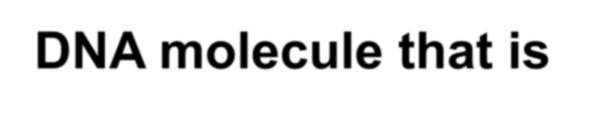






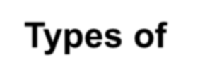



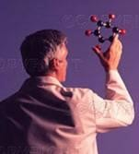




What is Marker?
Marker is a piece of
DNA molecule that is associated with a certain trait of a organism
Morphological
Biochemical
Types of
Markers
Genetic
Chromosomal

Slide 2




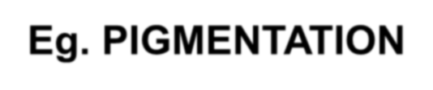
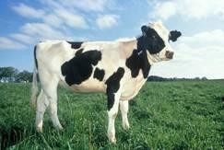
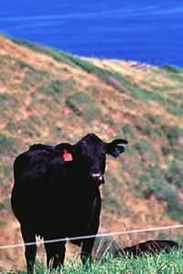
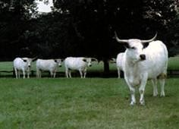

Animals are selected based on
appearance
Eg. PIGMENTATION
Disadvantage: lack of polymorphism

Slide 3






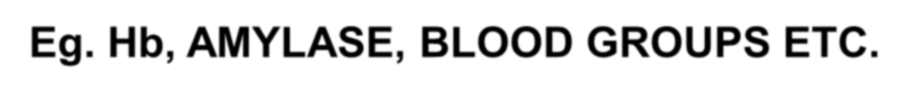

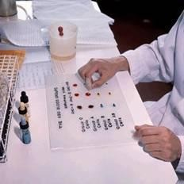








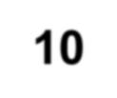
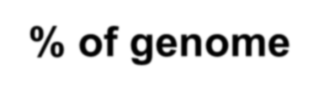

Animals are selected based on biochemical
properties
Eg. Hb, AMYLASE, BLOOD GROUPS ETC.
Disadvantage:
Sex limited Age dependent
Influenced by environment
It covers less than 10% of genome

Slide 4





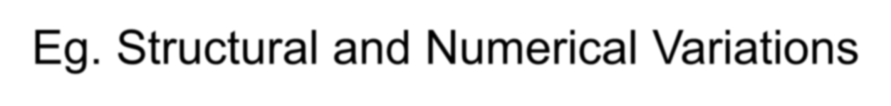
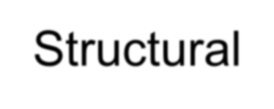
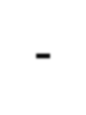
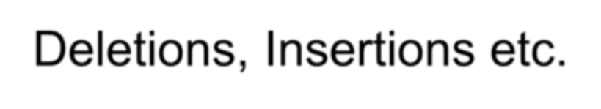
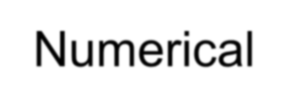
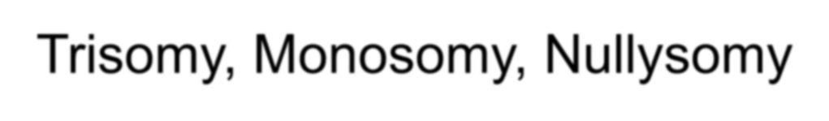
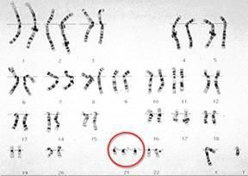
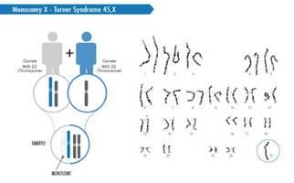
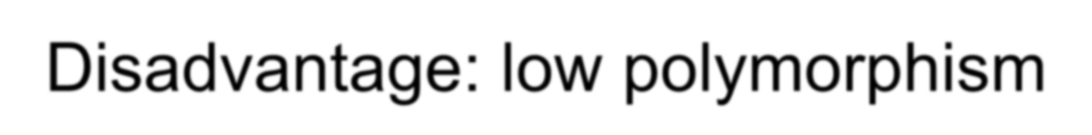

Animals are selected based on structural & numerical variations
Eg. Structural and Numerical Variations Structural- Deletions, Insertions etc.
Numerical- Trisomy, Monosomy, Nullysomy
Disadvantage: low polymorphism

Slide 5
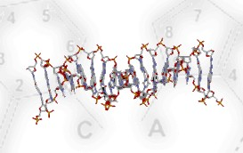
Molecular Marker
Revealing variation at a DNA level
Characteristics:
  Co-dominant expression
  Nondestructive assay
  Complete penetrance
  Early onset of phenotypic
expression
  High polymorphism
  Random distribution
throughout the genome
  Assay can be automated

Slide 6



DNA isolated from any tissue eg. Blood, hair etc. DNA isolated at any stage even during foetal life
DNA has longer shelf-life readily exchangeable b/w labs
Analysis of DNA carried out at early age/ even at the
embryonic
Stage irrespective of sex.

Slide 7

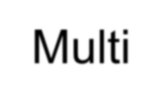
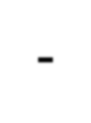
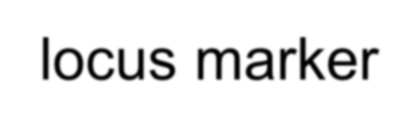
Single locus marker
Microsatellite
RFLP
STS
Molecular Markers
DNA Fingerprinting
RAPD
Multi-locus marker
AFLP

Slide 8
MORPHOLOGICAL MARKERS
Some mutant characters of organisms found to be linked with other easily
have been observable
morphological characters and this property has been
utilized in constructing conventional linkage maps
Any character
showing association
markers are supposed
with such
to be
morphological
controlled by genes situated near their loci
The major limitation their limited number.
of morphological
markers is

Slide 9
PROTEIN MARKERS
Proteins are products of gene action
The product of a gene can be used as a marker for
the presence of a gene
Different
proteins
alleles
of a gene
may produce
different
Sometimes, different forms of a protein with same catalytic activity but with different molecular weight and electrophoretic properties may be produced by different alleles.

Slide 10
Such enzymes are called isozymes.
The difference in enzyme mobility is caused by point mutations resulting in amino acid substitution.
The
differences in banding
patterns
observed on electrophoresis can be used for comparison and selection.

Slide 11
Isozyme marker alleles can be associated with other characters and selection is practiced.
Easily | assayable | isozymes | have
been | widely | used for | the
characterization of germplasm.
However, the availability of useful
protein markers is a limitation.

Slide 12
DNA MARKERS
DNA is the genetic material
Each chromosome has about 10⁸-10¹⁰ base pairs but only 10% of the genome is actively engaged in translation
The rest of the genetic material remains unnoticed in terms of character expression

Slide 13
DNA level
The assessment of variation at the provides a chance to map the genome
Specific regions on the DNA molecule both in the coding as well as non-coding regions can be identified as markers
The assessment of DNA sequences polymorphism is the most attractive application of molecular biology for human welfare
DNA markers are such polymorphic sequences seen
in different individuals

Slide 14
A considerable part of the DNA shows highly repetitive sequences in the non-coding regions of DNA
The comparison of these regions can also provide valuable clues of genetic and evolutionary relationships
The DNA sequences can be cut with the help of restriction endonucleases, analyzed with the help of DNA probes and electrophoretic procedures
Accordingly, RFLP, RAPD,
different SCAR
DNA-based (Sequenced
markers like Characterized
Amplified Region Marker) and SSR Sequence Repeats) have been developed.
(Simple

Slide 15

Information Provided by the Molecular Tools
Genetic identification and discrimination of stocks
Monitoring of inbreeding or other changes in the genetic composition of the stocks that may result from such phenomena as breeding programmes, founder events and genetic drift
Comparisons between hatchery and wild stocks

Slide 16
Assessment of the impact on natural populations of escaped or
released cultured organism
Assignment of progeny to parents through genetic tags, so that animals from different families can be reared together in breeding programmes
Identification of marker genetic loci associated
quantitative trait loci (QTL) and use of these markers in
with
selection programmes (marker assisted selection)
Assessment manipulations gynogenesis
of successful
implementation
of genetic
such
as induction
of polyploidy and

Slide 17

Molecular Tools
Allozyme markers
Nuclear DNA markers (nDNA)
Mitochondrial DNA markers (mtDNA)
Restriction fragment length polymorphism (RFLP)
Random amplified polymorphic DNA (RAPD)
Amplified fragment length polymorphism (AFLP)
Tandemly repeated DNA (mini and microsatellites)
Single nucleotide polymorphism (SNP)
Expressed sequence tags (ESTs)

Slide 18

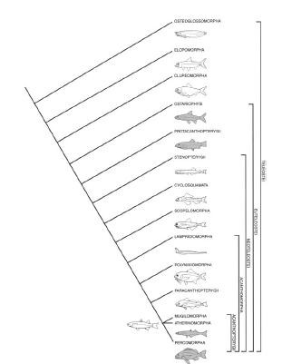
Allozyme Markers
Allozymes: allelic variants of proteins produced by a single gene locus,
i.e., electrophoretically distinguishable protein variants.
Applications:
Tracking inbreeding
Stock identification
Parentage analysis

Slide 19



Allozyme Markers
Advantages:
Codominant type I markers
Ease to use
Easily adjustable from species to species
Low cost
General applicability
Disadvantages:
Limited number of available allozyme loci precludes their use in large-scale genome mapping
Heterozygote deficiencies due to null alleles and the amount and quality of tissue samples required
Reduce the level of detectable variation due to some changes in DNA sequence are masked at the protein level
Only a small fraction of enzyme loci appear to be allozymically polymorphic
Are not selectively neutral

Slide 20

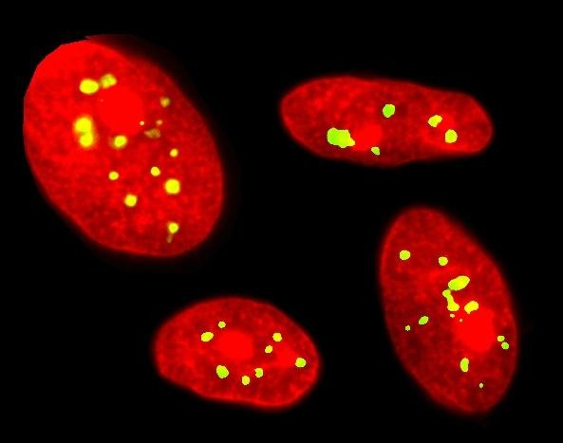
Nuclear DNA Markers
Main Characteristics:
Abundant in genome
Mendelian inheritance
Potential to detect high levels of polymorphism
Suitable for assessment of genetic structuring at the species or lower level
Source: www.abcam.com/ps/datasheet/images/ab13716_1.jpg

Slide 21



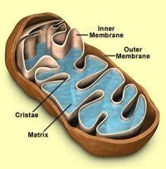
Mitochondrial DNA Markers versus Nuclear DNA Markers
Fast sequence divergence accumulation, when compared with nDNA, due to:
Faster mutation rate, that may result from a lack of repair mechanisms
during replication
Smaller effective population size because of the strictly maternal inheritance of the haploid mitochondrial genome
Applications of mtDNA:
To investigate stock structure
Used in identification of brood stocks
Source: http://www.esr.cri.nz/NR/rdonlyres/11D8037B-3585-
40BF-AA10-15B0DCA8D110/0/Mitochondria.jpg
Technically, mtDNA markers are RFLP markers.

Slide 22



Mitochondrial DNA Markers versus Nuclear DNA Markers
Advantages:
High levels of polymorphism (compared to allozymes);
More sensitive indicator of population phenomena, e. g. bottlenecks and hybridizations;
Multiple copies in each cell;
Transmitted uniparentally (it does not recombine);
It evolves much faster than coding regions of DNA.
Disadvantage:
Inability to detect male mediated genetic mixing of stocks.
Compared
with nDNA
Sex-specific differences in gene flow can be revealed by contrasting nDNA with mtDNA.

Slide 23
Restriction Fragment Length Polymorphism (RFLP)
RFLP: Fragment
originated
by a restriction
a
endonuclease
sequence.
which cleaves
specific DNA
RFLP can be analysed by:
Southern blot method
Polymerase chain reaction (PCR).

Slide 24
Restriction Fragment Length Polymorphism (RFLP)
Advantages:
Codominant marker
Disadvantages:
Relatively low level of polymorphism
Difficult and time- consuming in development of markers to species which lack molecular information
Relatively low power in revealing genetic variation

Slide 25

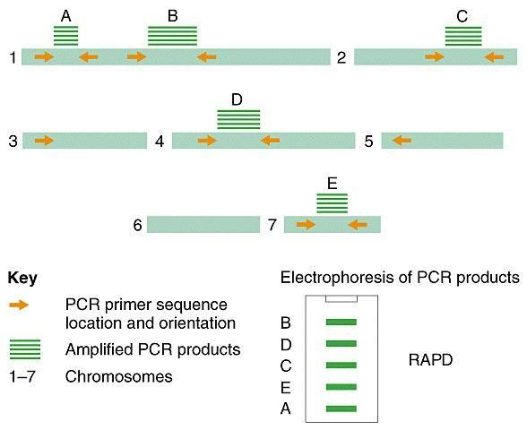
Random Amplified Polymorphic DNA (RAPD)
RAPD: use short primers of arbitrary sequence to amplify unrecognized regions of genomic DNA.
Applications:
Species identification
Analysis of population structure
Analysis of genetic impact of
environmental stressors
Analysis of genetic diversity
More suitable for species and subspecies comparisons, than for intra-species population studies.

Slide 26

Random Amplified Polymorphic DNA (RAPD)
Advantages:
Fast and economic
selectively neutral
Relatively high
Disadvantages:
Poor reproducibility and ambiguity in the interpretation of results
Most population genetics models cannot be applied
Analysis is based on phenotype
(rather than allelic frequencies)
Difficulty of demonstrating Mendelian inheritance of the loci
power in
detection of polymorphism
Primers are commercially available and not require prior knowledge of the target DNA sequence or gene organization
Mendelian inheritance in dominant fashion
It is ease to screen a large
number of loci and individuals

Slide 27
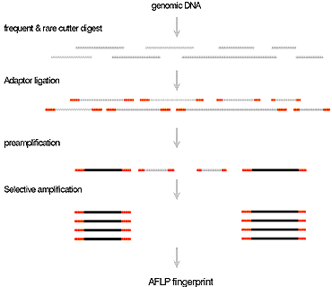
Amplified Fragment Length Polymorphism (AFLP)
AFLP: PCR-based, multi-locus fingerprinting technique.
Applications:
Analysis of meiogynogens
and androgens
Generation of high-
resolution linkage maps
Source:http://www.udel.edu/dnasequence/UDSGC/Images/figure1.gif

Slide 28
Amplified Fragment Length Polymorphism (AFLP)
Advantages:
it allows the analysis of many loci simultaneously
high power analysis for revealing genomic polymorphisms
inherited as dominant markers;
high reproducibility
does not require any prior molecular information
Disadvantages:
need special equipment (e. g. automated gene sequencers)

Slide 29


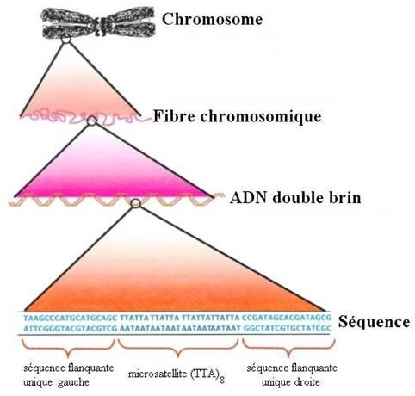
Tandemly Repeated DNA (Mini and Microsatellites)
Minisatellites/Variable Number of Tandem Repeat (VNRT) DNA: refers to genetic loci with repeats a length of 10-64 bp.
Disadvantages:
unsuited for population level
applications;
•protocols are not reproducible.
Source:http://www.edu.upmc.fr/sdv/masselot_05001/polymorphisme/im ages/pic021.jpg

Slide 30


Tandemly Repeated DNA ( Mini and Microsatellites)
Microsatellites/Simple Sequence/Short Tandem Repeat (STR) DNA: refers
to genetic loci with repeat unit is only 1-6 bp long.
Advantages:
ease of scoring through PCR;
high polymorphism;
accuracy of allele characterization;
numerous in genome;
evenly distributed in the genome on all chromosomes and all regions of the chromosomes;
codominant Mendelian markers;
small locus size
Disadvantages:
high cost;
labour-intensiveness in the development of primers;
existence of null alleles

Slide 31

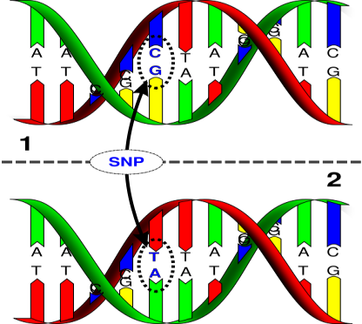
Single Nucleotide Polymorphism (SNP)
SNP: describes polymorphisms caused by point mutations that give rise to different alleles containing alternative bases at a given nucleotide position within a locus.
Advantages:
most abundant polymorphism in any organism;
adaptable to automation;
reveal hidden polymorphism not detected with other markers and methods;
inherited as co-dominant markers.
Disadvantages:
need specialized equipment;
large-scale analysis depends on the availability of expensive, cutting- edge equipment.
Source: http://upload.wikimedia.org/wikipedia/commons/thumb/2/2e/Dna-SNP.svg/416px-Dna-SNP.svg.png

Slide 32

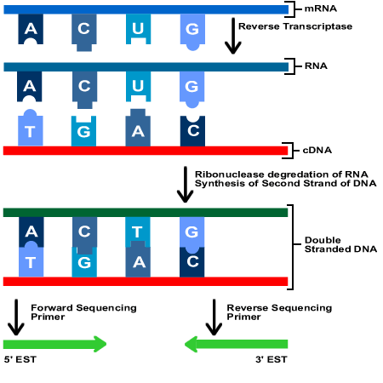
Expressed Sequence Tags (ESTs)
ESTs: single-pass sequences generated from random sequencing of cDNA clones.
Advantages:
efficient way to identify genes and analyze their expression by means of expression profiling;
rapid and valuable estimation of genes expressed in specific tissue;
useful for the development of cDNA microarrays;
great value in genome mapping.
Disadvantages:
identification of polymorphic ESTs is necessary for genome mapping.
Source: http://www.ncbi.nlm.nih.gov/About/primer/images/est_chart.gif

Slide 33

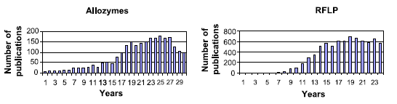
Trends in Marker Usage
Source: Liu & Cordes, 2004
The use of allozymes and RFLPs is on decline.

Slide 34

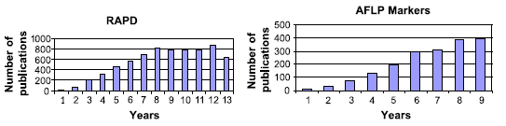
Trends in Marker Usage
Source: Liu & Cordes, 2004
RAPD markers had probably reached its peak.
AFLP markers are still in their log phase of growth.

Slide 35

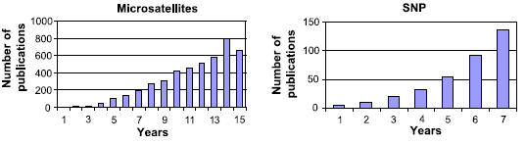
Trends in Marker Usage
Source: Liu & Cordes, 2004
Microsatellites and SNP markers are still in their log phase of growth.

Slide 36
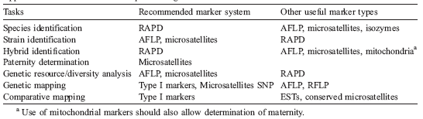
Applications of DNA Markers in Aquaculture Genetics
Source: Liu & Cordes, 2004
Microsatellites have a wide range of applications.
SNP and ESTs markers are new tools.
Not yet widely used.

Slide 37
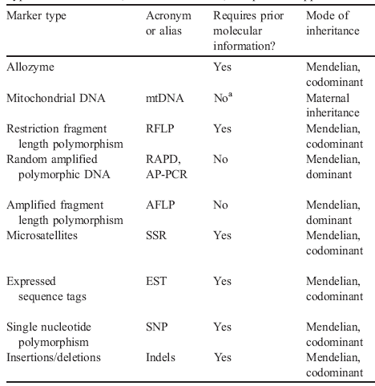
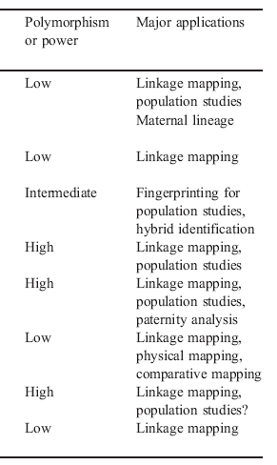
Conclusions
Adapted from Liu & Cordes, 2004.

