Slide 1
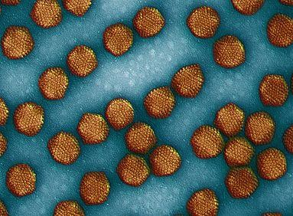
What is a virus?
1. Obligate intracellular parasite
- A small [20 to 250nm in diameter] infectious agent that requires a host cell to replicate (make more of itself).
**1/1000th the diameter of a eukaryotic cell. If the classroom was a cell, a virus would be about the size of a paperclip.
General Structure
Nucleic acid enclosed in a protein coat and, in some cases, a membranous envelope
Host Range
- Each virus can only infect a specific range
of cell types
Ex. HIV can only infect CD4+ Helper T-cells
SEM of adenovirus

Slide 2
An obligate parasite, or holoparasite, is a parasitic organism that cannot complete its life-cycle without exploiting a suitable host. If an obligate parasite cannot obtain a host it will fail to reproduce.
A facultative anaerobe is an organism that makes ATP by aerobic respiration if oxygen is present, but is capable of switching to fermentation or anaerobic respiration if oxygen is absent.
An obligate aerobe, by contrast, cannot make ATP in the absence of oxygen, and obligate anaerobes die in the presence of oxygen.

Slide 3
The Discovery of Viruses: Scientific
Inquiry
Tobacco mosaic disease stunts growth of tobacco plants and gives their leaves a mosaic coloration
In the late 1800s, researchers hypothesized that a
particle smaller than bacteria caused the disease
In 1935, Wendell Stanley confirmed this hypothesis by crystallizing the infectious particle, now known as tobacco mosaic virus (TMV)

Slide 4
Virology; the study of viruses
(or, lifestyles of the small and nasty)
Viruses have one major characteristic in common: they are obligate intracellular parasites.
Viruses are UNABLE to grow and reproduce outside of a living cell. No virus is able to produce its own energy (ATP) to drive macromolecular synthesis.
However, in many other respects, they are a
highly diverse group.

Slide 5
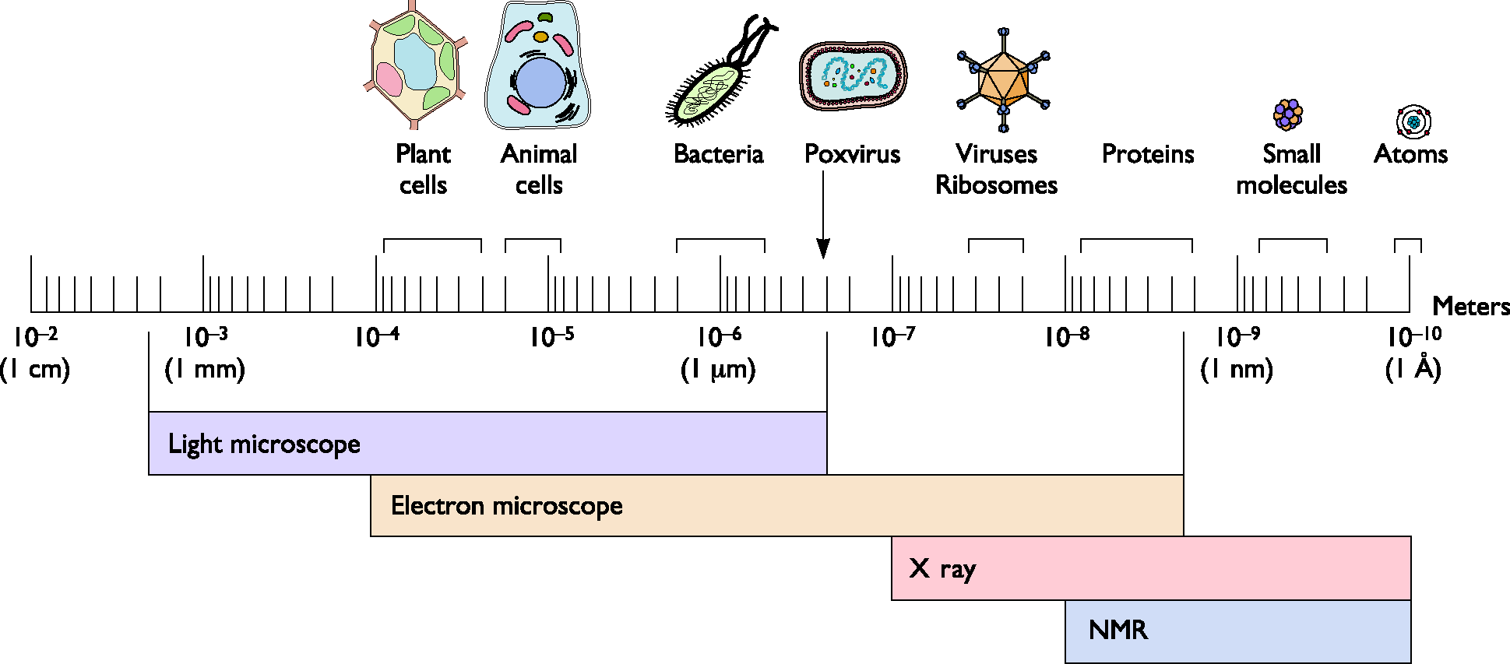
The size of viruses

Slide 6
Sub-viral agents
Satellites
  Contain nucleic acid
  Depend on co-infection with a helper virus
  May be encapsidated (satellite virus)
  Mostly in plants, can be human e.g. hepatitis delta virus
  If nucleic acid only = virusoid
Viroids
  Unencapsidated, small circular ssRNA molecules that
replicate autonomously
  Only in plants, e.g. potato spindle tuber viroid
  Depend on host cell polII for replication, no protein or mRNA
Prions
  No nucleic acid
  Infectious protein e.g. BSE (Bovine spongiform encephalopathy)

Slide 7
Unifying principles
All viruses package their genomes inside a particle that mediates transmission of the viral genome from host to host
The viral genome contains the information for initiating and completing an infectious cycle within a susceptible, permissive cell. An infectious cycle includes attachment, and entry of the particle, decoding of genome information, translation of viral mRNA by host ribosomes, genome replication, and assembly and release of particles containing the genome
All viruses are able to establish themselves in a host population so that virus survival is ensured

Slide 8








Strategies for virus survival
Finding and getting into a host cell. As viruses are obligate parasites they must find the right type of cell for their replication, they must invade that cell and get their genome to the site of replication.
Making virus protein. All viruses are parasites of translation. The virus must make mRNA (unless it has a + sense RNA genome already). Strategies must exist to synthesize mRNA.
Making viral genomes. Many viral genomes are copied by the cell’s synthetic machinery in cooperation with viral proteins.
Forming progeny virions. The virus genome, capsid (and envelope) proteins must be transported through the cell to the assembly site, and the correct information for assembly must be pre-programmed.
Spread within and between hosts. To ensure survival the virus must
propagate itself in new cells.
Overcoming host defences.The host defends itself against “nonself”. Viruses have evolved ways to fight back.

Slide 9
Three problems every virus must solve
1 How to reproduce during its “visit”
inside the cell. How to a) copy its genetic information and b) produce mRNA
for protein production
2 How to spread from one individual to another
3 How to evade the host defenses. This need not be complete.
Viral diseases are the (usually unintended) consequences of the way each virus has chosen to solve these three problems.

Slide 10
How are viruses named?
Based on:
  the disease they cause
poliovirus, rabies virus
  the type of disease
murine leukemia virus
  geographic locations
Sendai virus, Coxsackie virus
  their discovers
Epstein-Barr virus
  how they were originally thought to be contracted
dengue virus (“evil spirit”), influenza virus (the “influence” of bad air)
  combinations of the above
Rous Sarcoma virus

Slide 11
Virus Classification
Taxonomy from Order downward (three orders now recognized)
•Family often the highest classification. Ends in -viridae.
•Many families have subfamilies. Ends in -virinae.
•Bacterial viruses referred to as bacteriophage or phage (with a few exceptions).
Examples
family Myoviridae
genus T4-like phages
type species Enterobacteria phage T4
family Herpesviridae, subfamily Betaherpesvirinae
genus Muromegalovirus
type species Murine herpesvirus 1

Slide 12
The Baltimore classification system
Based on genetic contents and replication strategies of viruses. According to the Baltimore classification, viruses are divided into the following seven classes:
dsDNA viruses
ssDNA viruses
dsRNA viruses
(+) sense ssRNA viruses (codes directly for protein)
(-) sense ssRNA viruses
RNA reverse transcribing viruses
DNA reverse transcribing viruses
where "ds" represents "double strand" and "ss" denotes "single strand".

Slide 13
3'CGCTATAGCGTTT 5' | DNA antisense strand (template/noncoding) | Used as a template for transcription.
5'GCGATATCGCAAA 3' | DNA sense strand (nontemplate/coding) | Complementary to the template strand.
5'GCGAUAUCGCAAA 3' | mRNA Sense transcript | RNA strand that is transcribed from the noncoding (template/antisense) strand. Note: Except for the fact that all thymines are now uracils (T-- >U), it is complementary to the noncoding (template/antisense) DNA strand (identical to the coding (nontemplate/sense) DNA strand).
3'CGCUAUAGCGUUU 5' | mRNA Antisense transcript | RNA strand that is transcribed from the coding (nontemplate/sense) strand. Note: Except for the fact that all thymines are now uracils (T-- >U), it is complementary to the coding (nontemplate/sense) DNA strand (identical to the noncoding (template/antisense) DNA strand.)

Slide 14
I: dsDNA Viruses (e.g. Adenoviruses, Herpesviruses, Poxviruses)
II: ssDNA viruses (+ strand or "sense") DNA (e.g. Parvoviruses)
III: dsRNA viruses (e.g. Reoviruses)
IV: (+)ssRNA viruses (+ strand or sense) RNA (e.g. Picornaviruses, Togaviruses)
V: (−)ssRNA viruses (− strand or antisense) RNA (e.g. Orthomyxoviruses, Rhabdoviruses)
VI: ssRNA-RT viruses (+ strand or sense) RNA with DNA intermediate
in life-cycle (e.g. Retroviruses)
VII: dsDNA-RT viruses (e.g. Hepadnaviruses)

Slide 15
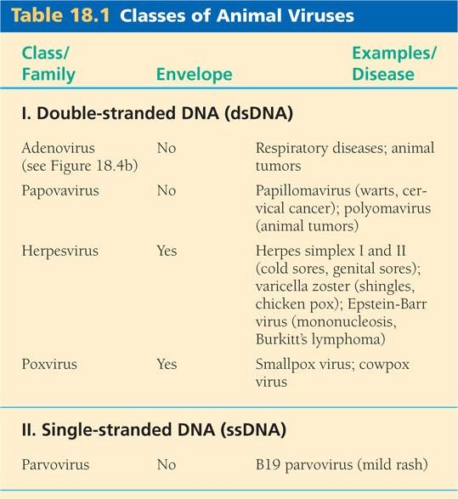
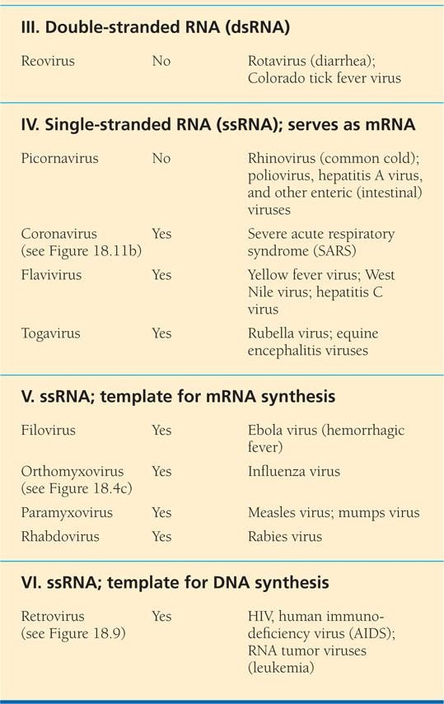
Animal viruses
They are classified by their genetic material.

Slide 16
Virus Classification I
- the Baltimore classification
All viruses must produce mRNA, or (+) sense RNA
A complementary strand of nucleic acid is (–) sense
The Baltimore classification has + RNA as its central point
Its principles are fundamental to an understanding of virus classification and genome replication, but it is rarely used as a classification system in its own right

Slide 17
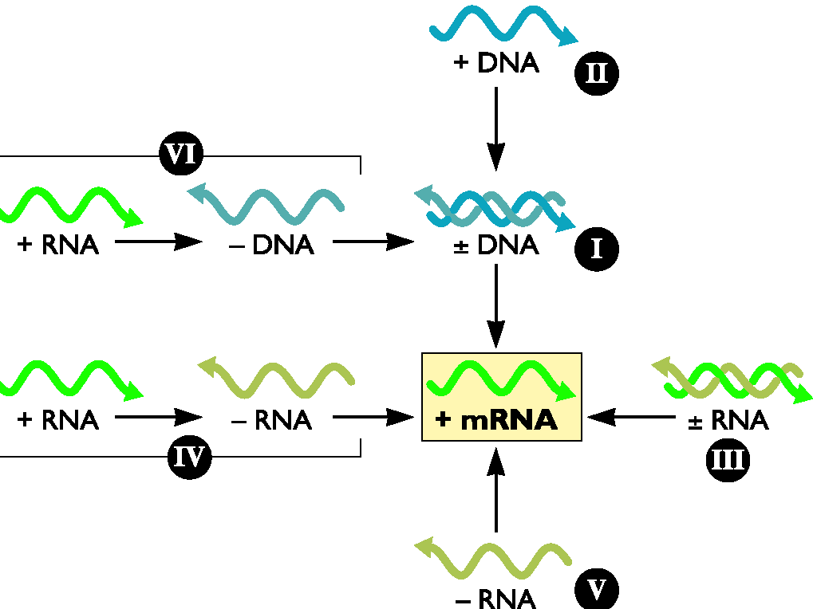
From Principles of Virology Flint et al ASM Press

Slide 18
Virus classification II - the Classical system
This is a based on three principles -
  1) that we are classifying the virus itself, not the host
  2) the nucleic acid genome
  3) the shared physical properties of the infectious agent (e.g capsid symmetry, dimensions, lipid envelope)

Slide 19
Virus classification III -
the genomic system
More recently a precise ordering of viruses within and between families is possible based on DNA/RNA sequence
By the year 2000 there were over 4000 viruses of plants, animals and bacteria - in 71 families, 9 subfamilies and 164 genera

Slide 20
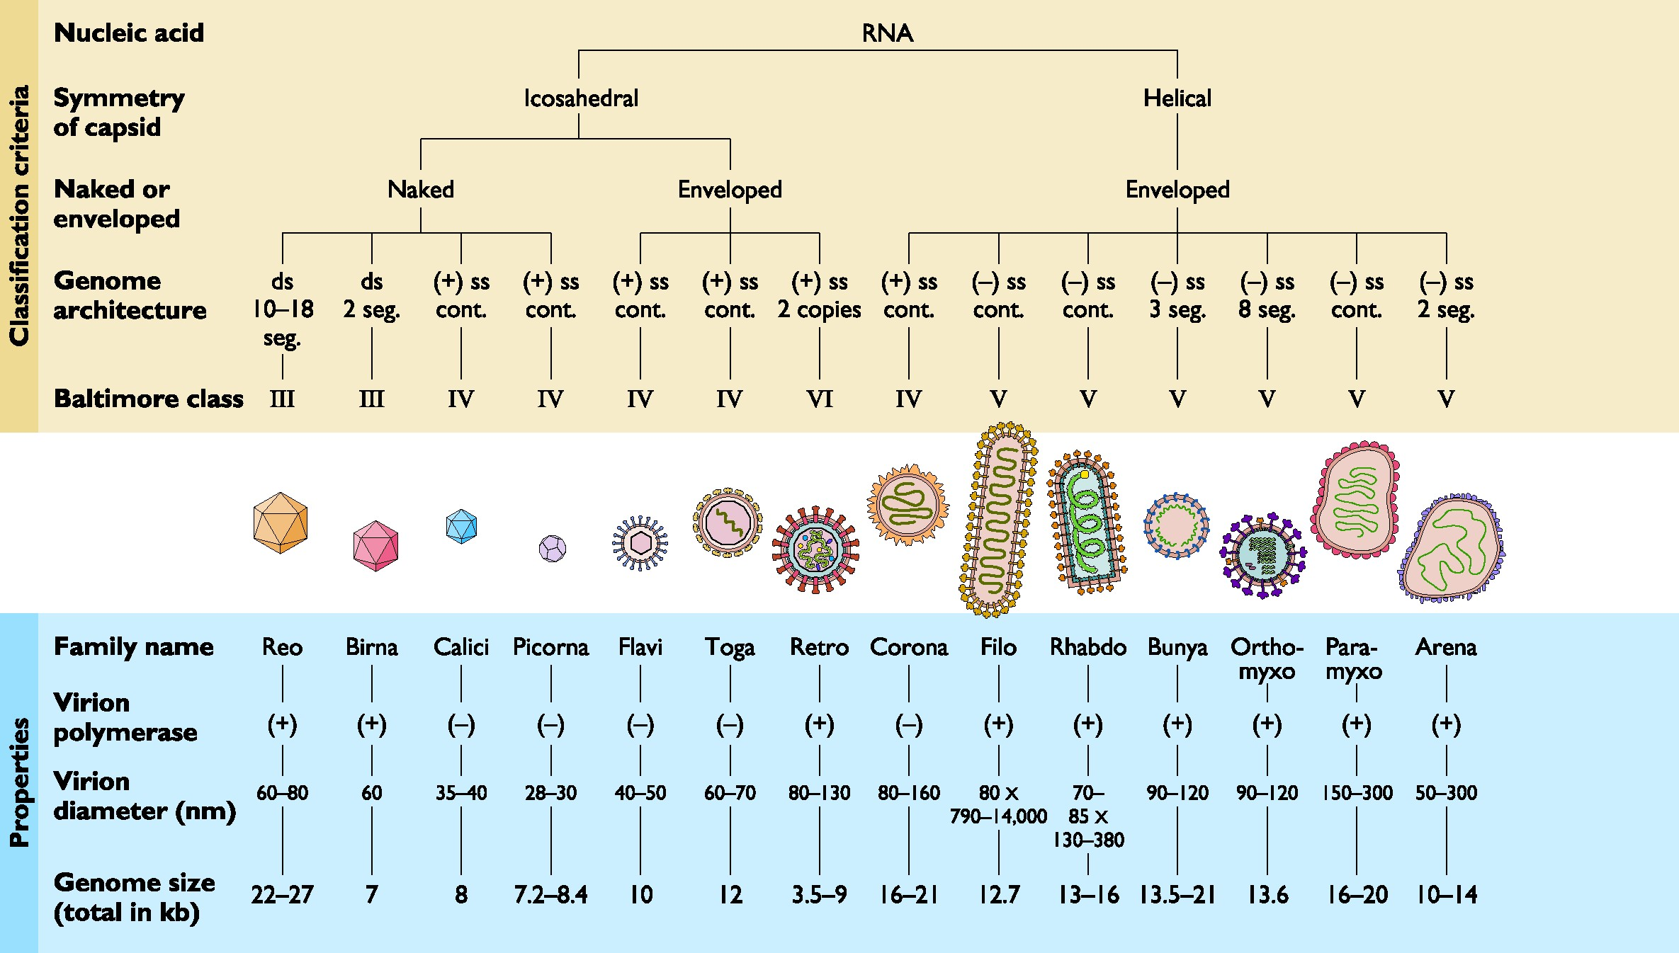
RNA viruses
From Principles of Virology Flint et al ASM Press

Slide 21
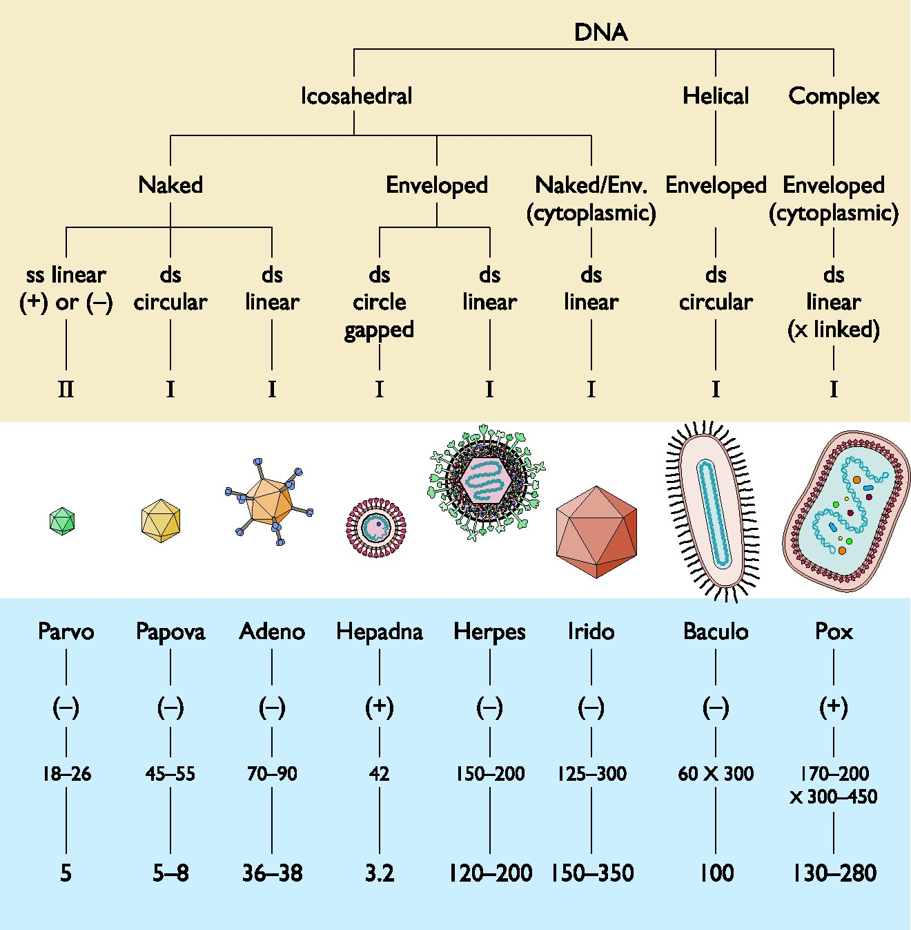
DNA viruses
From Principles of Virology Flint et al ASM Press

Slide 22
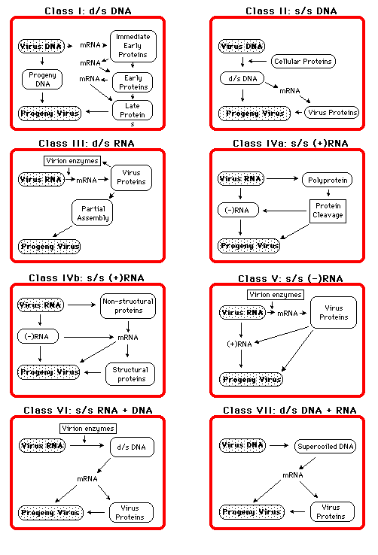
The seven “Baltimore” replication classes

Slide 23
Replication Strategy of ss(+)RNA Viruses
Steps in Replication
Translation of virion RNA as mRNA (early products = RNA- Dependent RNA Pol)
Synthesis of (-)sense RNA on (+)sense template by RDRP (=
formation of replicative complex, RC)
Synthesis of (+)sense RNA, mRNA and (-)sense RNA
Translation of (+)sense and mRNA, synthesis of structural protein
Assembly of structural protein and (+)sense RNA and
maturation of virions

Slide 24
Replication Strategy of ss(-)RNA Viruses
Steps in Replication
Primary transcription of virion (-)sense RNA by RNA-Dependent RNA Pol in virion core in cytoplasm, production (mainly) mRNA and (+)sense RNA, formation replicative complex (RC)
Translation mRNAs, accumulation of products
Virion proteins interact with RC, bias it towards production of full-
length (+)sense RNA and therefore of genomic (-)sense RNA
Secondary transcription from progeny (-)sense RNA, translation, accumulation structural proteins
Nucleocapsid assembly and maturation, budding of nucleocapsid through host membrane containing viral envelope proteins

Slide 25
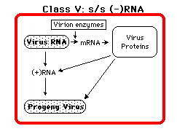
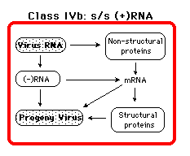
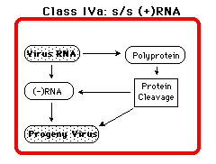
RNA virus
replication

Slide 26
Structural Classes
•Icosahedral symmetry
•Helical symmetry
•Non enveloped (“naked”)
•Enveloped

Slide 27
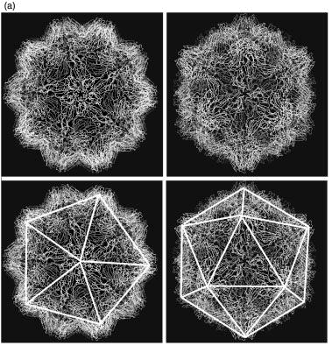
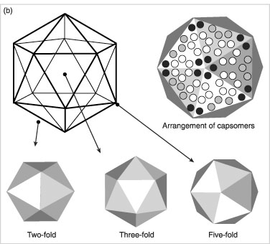
Icosahedral capsids
a) Crystallographic structure of
a simple icosahedral virus.
b) The axes of symmetry

Slide 28
A comparison of T=3, picornavirus and comovirus capsids
The icosahedral asymmetric units are outlined in bold
The icosahedral asymmetric unit of the T = 3 shell contains three identical subunits
QuickTime™ and a TIFF (LZW) decompressor
are needed to see this picture.

Slide 29
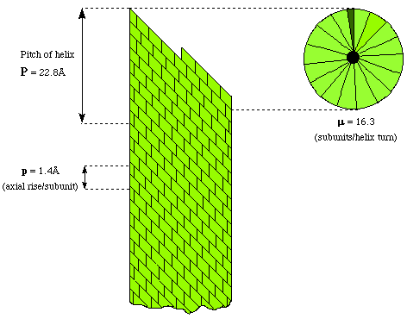
Helical symmetry
In 1955, Fraenkel, Conrat, and Williams demonstrated that tobacco mosaic virus (TMV) spontaneously formed when mixtures of purified coat protein and its genomic RNA were incubated together.
TMV, a filamentous virus

Slide 30
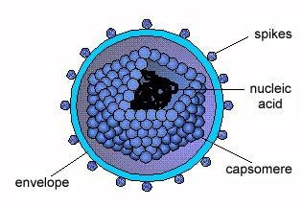
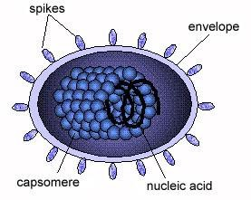
Enveloped icosahedral virus
Enveloped helical virus

Slide 31
Transmission Electron Micrograph of HIV-1
Enveloped Structure of HIV
The nucleocapsid (arrows) can
be seen within the envelope.

Slide 32
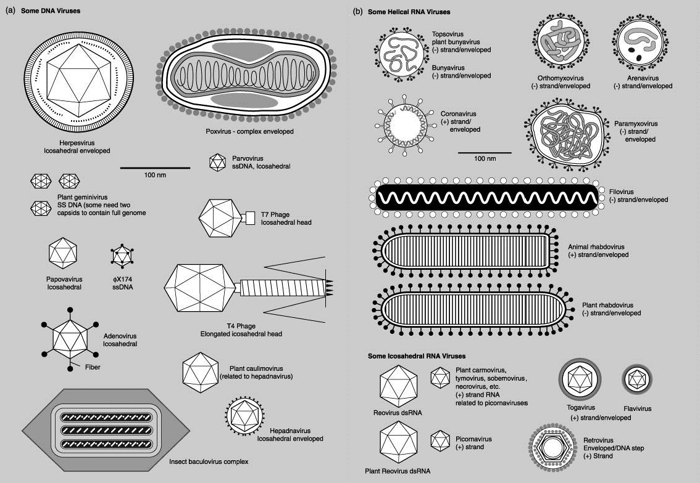

Slide 33
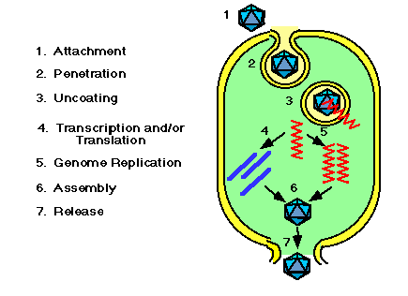
Typical infectious cycle
Attachment
Penetration
Uncoating
Transcription and/or translation
Replication
Assembly
Release

Slide 34
Virus recognition, attachment, and entry
•Specific viral receptor
•Co-receptor
•Receptor-mediated endocytosis
•Fusion of the viral membrane at the cell surface

Slide 35
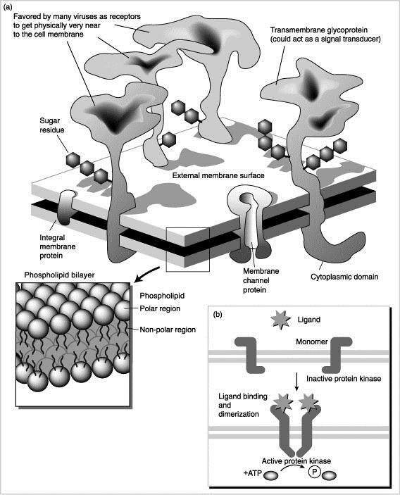
RECEPTOR | VIRUS
ICAM-1 | polio
CD4 | HIV
acetylcholine | rabies
EGF | vaccinia
CR2/CD21 | Epstein- Barr
HVEM | herpes
Sialic acid | Influenza, reo, corona

Slide 36
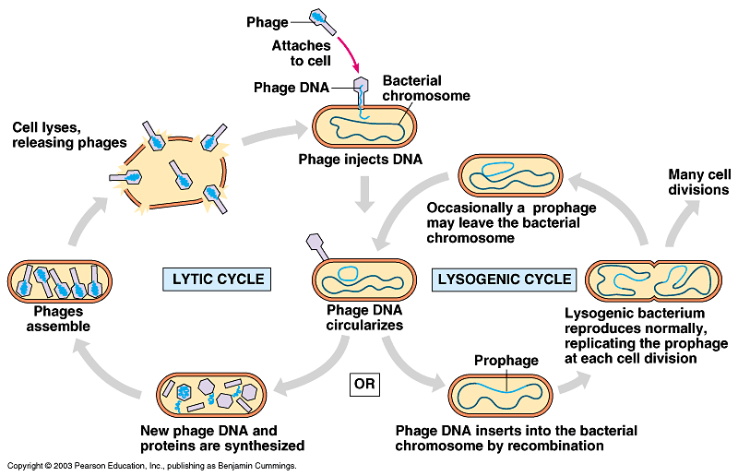
Bacteriophage
reproductive cycle
(two methods of reproduction)
Bacteriophage binds to the surface of the bacterium using the tail fibers and injects its DNA into the cell…

Slide 37
Bacteriophage
reproductive
cycle
(two
methods of reproduction)
Lysogenic cycle

Slide 38
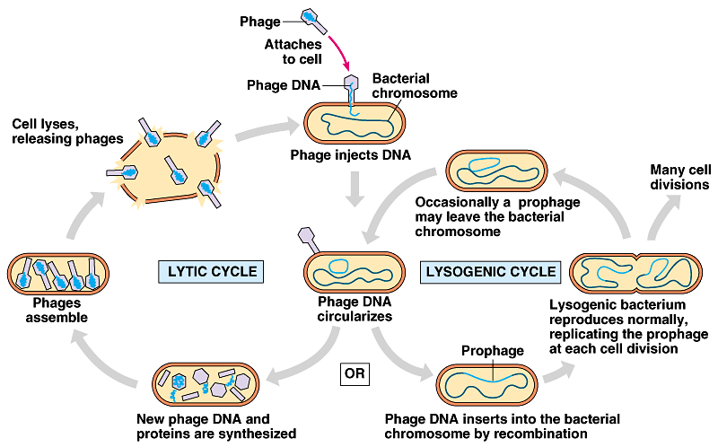
Bacteriophage
reproductive
cycle
(two
methods of reproduction)
Lytic cycle
Lysogenic cycle

Slide 39
Lysogenic cycle
- After the bacteriophage injects its DNA, it might get incorporated into the bacterial chromosome and is now called a prophage. Now when the bacterial cells replicates, the phage DNA replicates with it.
Lytic cycle
- After the bacteriophage injects its DNA or when the prophage jumps out of
the DNA, it can hijack the cell and use it (its ribosomes and other enzymes)
to make more viral DNA and proteins to in turn make more viral particles. The cell will lyse and the viruses will be released.
Temperate Phages
- Phages that can do both lytic and lysogenic methods of reproduction Ex. Lambda (λ) phage

Slide 40
What causes a temperate phage like lambda to switch from lysogenic to lytic?
We observed the switch to be caused by environmental factors like radiation or certain chemicals perhaps preserving its own survival if the bacterium is going to perish due to this stress.

Slide 41
Can prokaryotes defend themselves against this attack?
Of course. They contain enzymes that attempt to hydrolyze the viral DNA known as restriction enzymes like little molecular scissors.

Slide 42
1. Gain access to a cell
What do viruses need to accomplish to continue to exist?
Use the cell’s workers (ribosomes, RNA polymerase, etc…) to make more of itself.
  Synthesize viral proteins
  Replicate its genome
  Assemble these into new viral particles

Slide 43
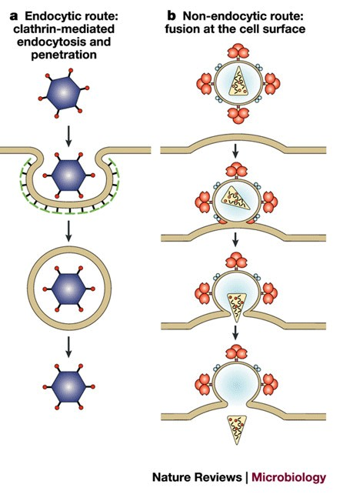
Life cycle of a DNA virus
What is the first thing a virus
must be able to do?
Viral Attachment and Entry
  If the virus does not have an envelope, protein spikes on the capside will act as ligands and bind cell receptors, triggering receptor mediated endocytosis.

Slide 44
Life cycle of a DNA
virus
1. Viral Attachment and Entry
b. If it does have an envelope, the protein spikes in the envelope will act as ligands and bind to cell receptors resulting in fusion of the viral membrane and cell membrane, injecting the capsid into the cell…

Slide 45
Life cycle of a DNA
virus
1. Viral Attachment and Entry
Analogy:
Cell receptors = door lock Protein spikes = the key
In either case, the protein spikes on the surface need to bind receptors to gain access to the cell, which is why specific viruses can only infect specific cells with matching receptors.

Slide 46
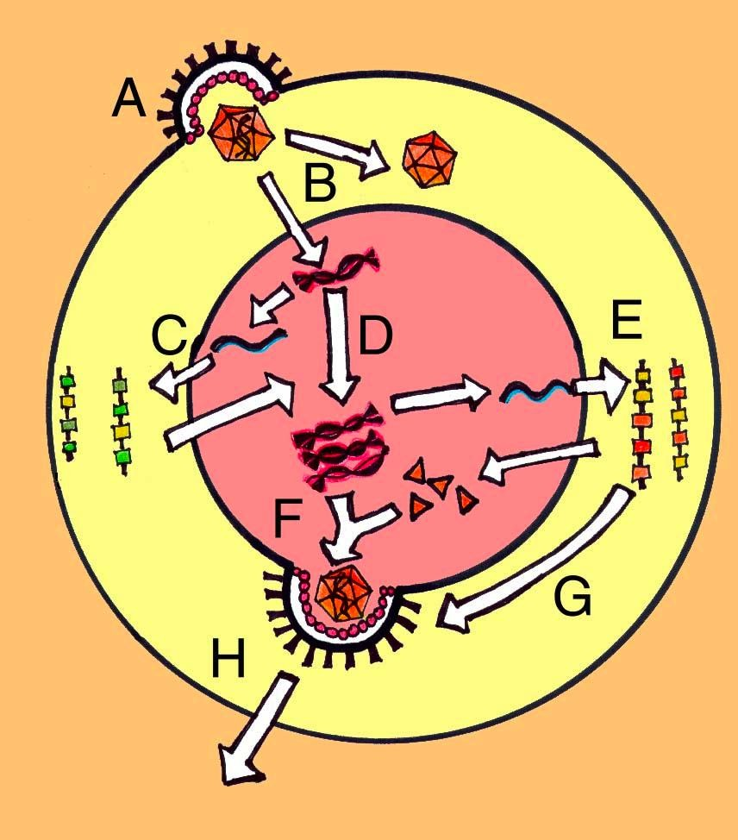
Life cycle of a DNA virus
Viral attachment and entry
Uncoating
The capsid fall apart and the viral DNA enters the nucleus
Transcription and translation of the viral DNA
The viral DNA is transcribed and translated by our workers (our RNA polymerases, ribosomes/tRNAs/etc…) using our ATP made by our mitochondria!!

Slide 47
Life cycle of a DNA
virus
D. Replication of the viral DNA
E. Viral protein sorting
Capsid proteins are brought into the nucleus while envelope proteins get into nuclear membrane via endomembrane system.

Slide 48
Life cycle of a DNA virus
F. Viral assembly
Capsid forms around DNA and then buds out of nucleus picking up its envelope
H. Release
How the virus, now in the cytoplasm, gets out of the cell is not understood yet.

Slide 49
Life cycle of a DNA
virus
This process typically happens over and over and over again until the cell dies…The cell is a virus producing factory.
DNA integration
In certain viruses, like Herpes virus, the viral DNA can integrate (become part of) the cell’s DNA (your DNA), and sit quietly similar to the lysogenic cycle of bacteriophages. Almost all adults carry Herpes Simplex 1 virus (oral herpes).

