Slide 1
Statistical analysis system (SAS)

Slide 2
SAS a Blessing…
Statistics: Most Critical phase of a Research
Calculators Excel Sheets Statistical Software
User friendly software
Just properly arrange your data

Slide 3
SAS
Since 1976
USDA Data
Development of such software was critically important to members of the University Statisticians Southern Experiment Stations, a consortium of eight land-grant universities that received the majority of their research funding from the USDA. The schools came together under a grant from the National Institutes of Health (NIH) to develop a general-purpose statistical software package to analyze all the agricultural data they were generating

Slide 4
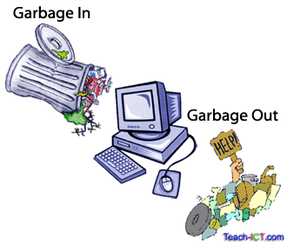
GIGO

Slide 5
application
Menu based (Basic level)
Command based (Advanced level)

Slide 6
Preparing Data for sas
Experiment Design
Treatments x Replicates
Feed Restriction (4 x 6)

Slide 7
Data collection
Treatment | Body Weight
F1H1
F1H2
F1H3
F1H4
F1H5
F1H6
F2H1
F2H2
F2H3
F2H4
F2H5
F2H6
Treatment | Body Weight
F3H1
F3H2
F3H3
F3H4
F3H5
F3H6
F4H1
F4H2
F4H3
F4H4
F4H5
F4H6

Slide 8
Data for sas
Treatment | Body Weight
A
A
A
A
A
A
B
B
B
B
B
B
Treatment | Body Weight
C
C
C
C
C
C
D
D
D
D
D
D
F1H = A
F2H = B
F3H = C
F4H = D
Replication??
Don’t calculate averages

Slide 9
Starting with sas
Requirements
SAS works on 32 bit version of any of the following windows
Windows XP
Windows 7
Windows 8
SAS only uses Excel workbook 2002-03
However, latest version of SAS like 9.3, 9.4 also work on 64 bit windows
But, their one year license is very costly

Slide 10
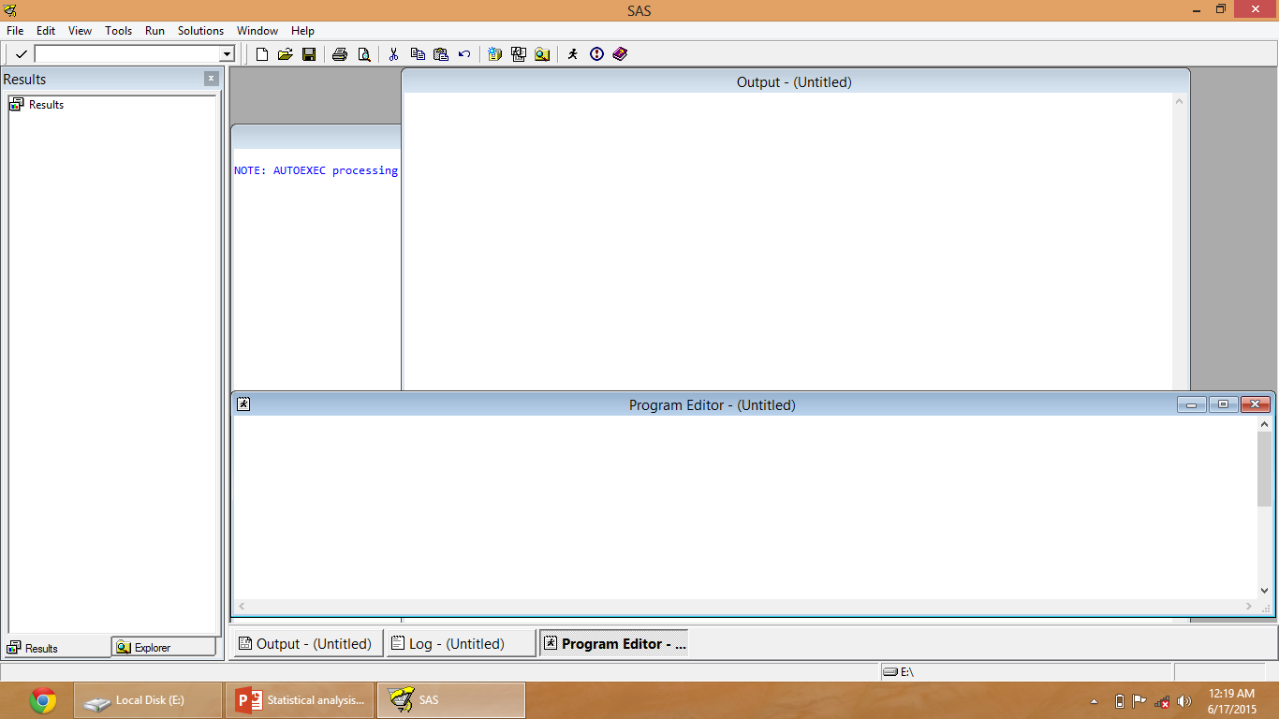

Slide 11
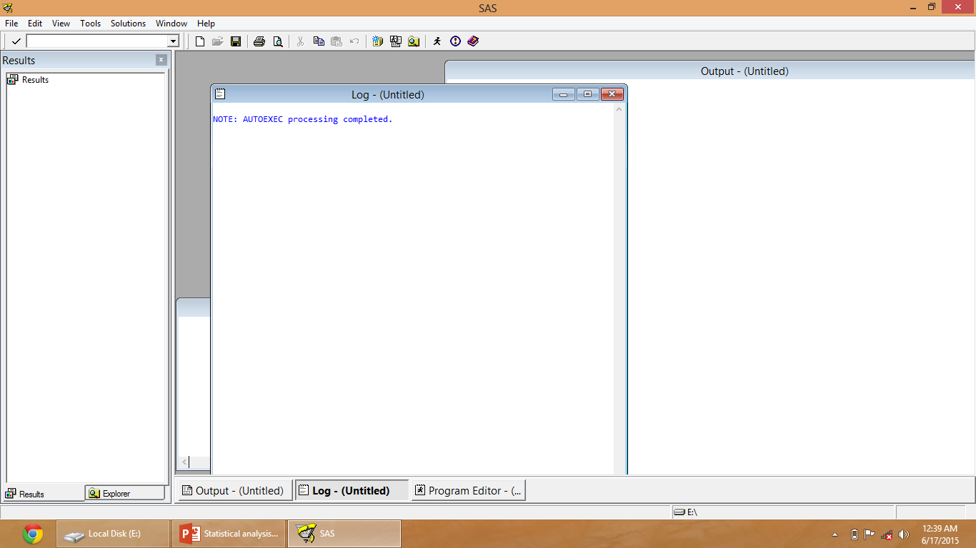

Slide 12
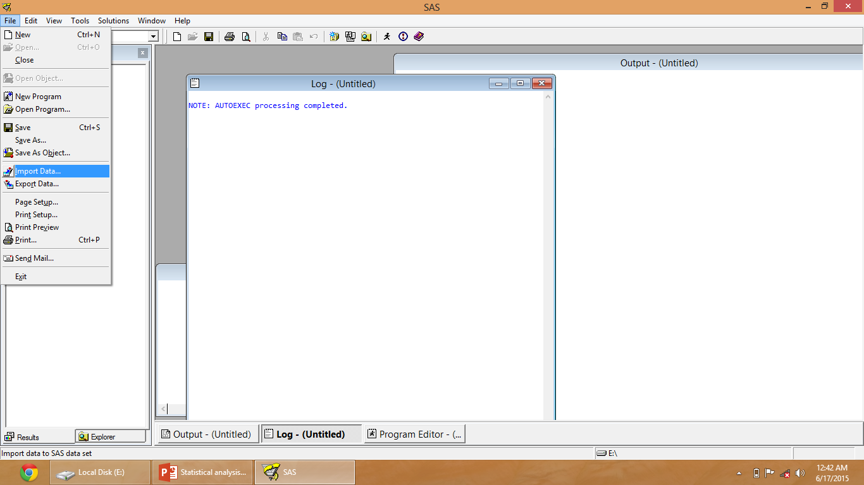

Slide 13
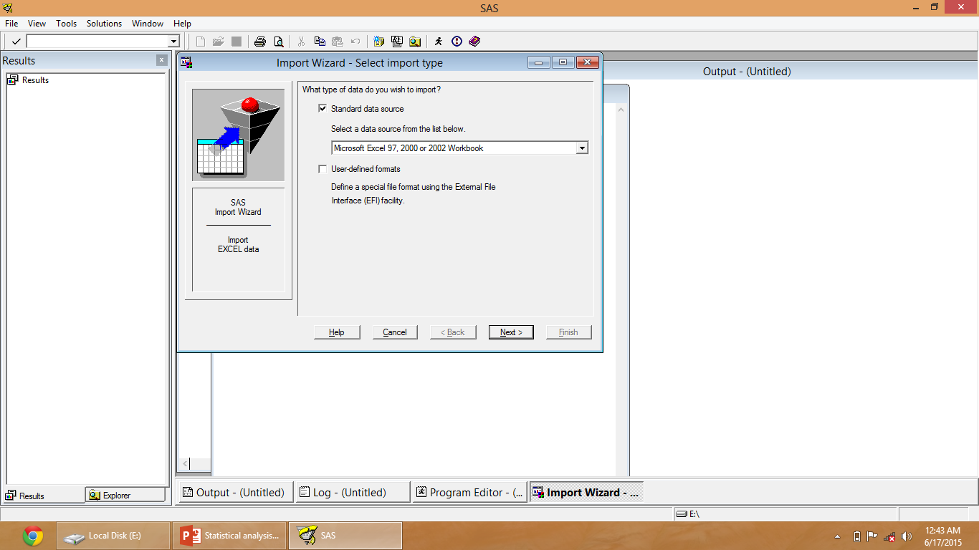

Slide 14
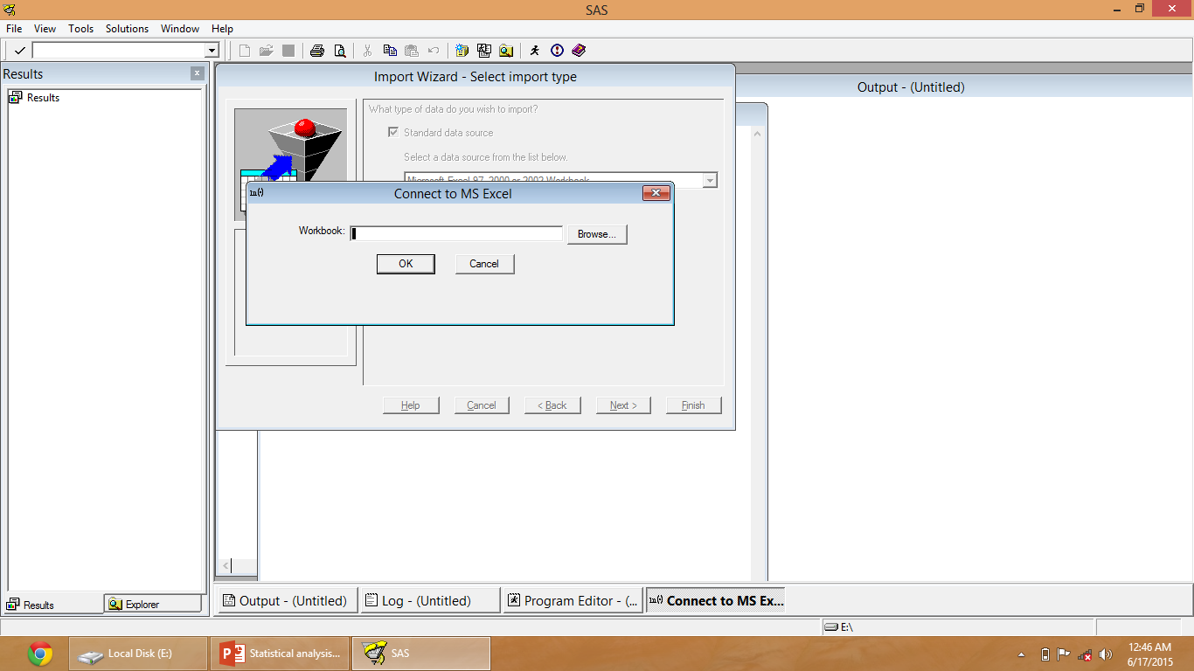

Slide 18
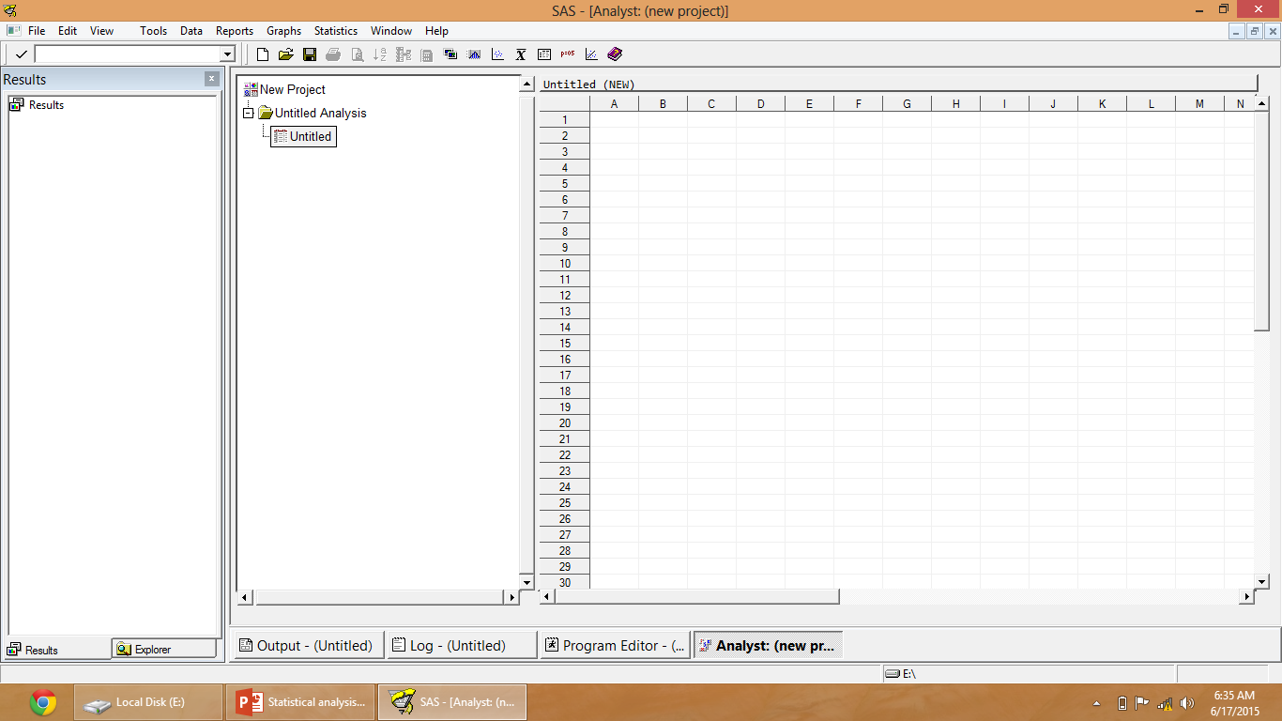

Slide 19
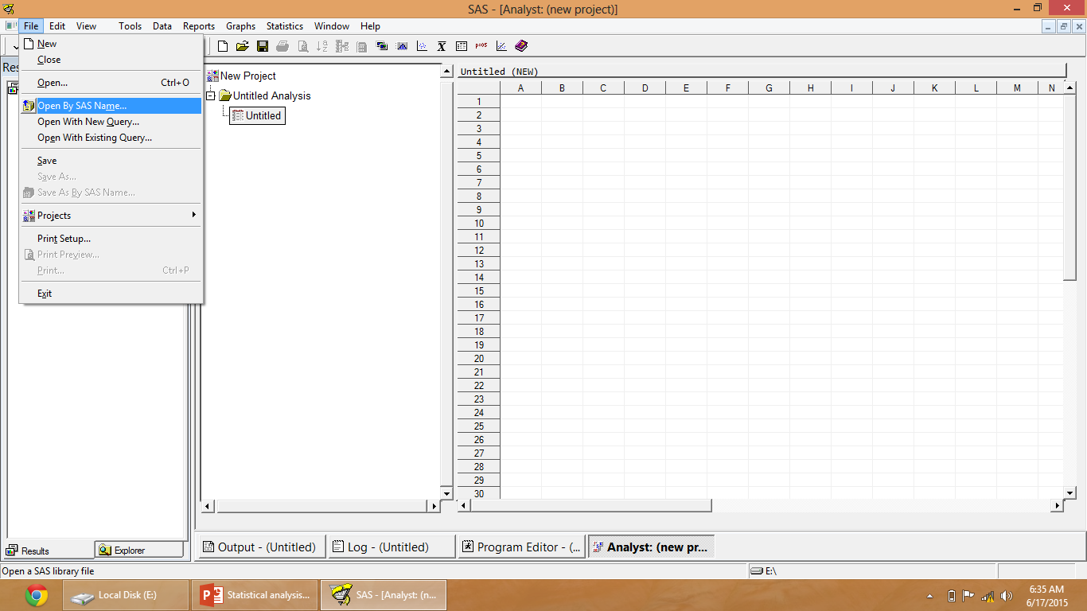

Slide 20
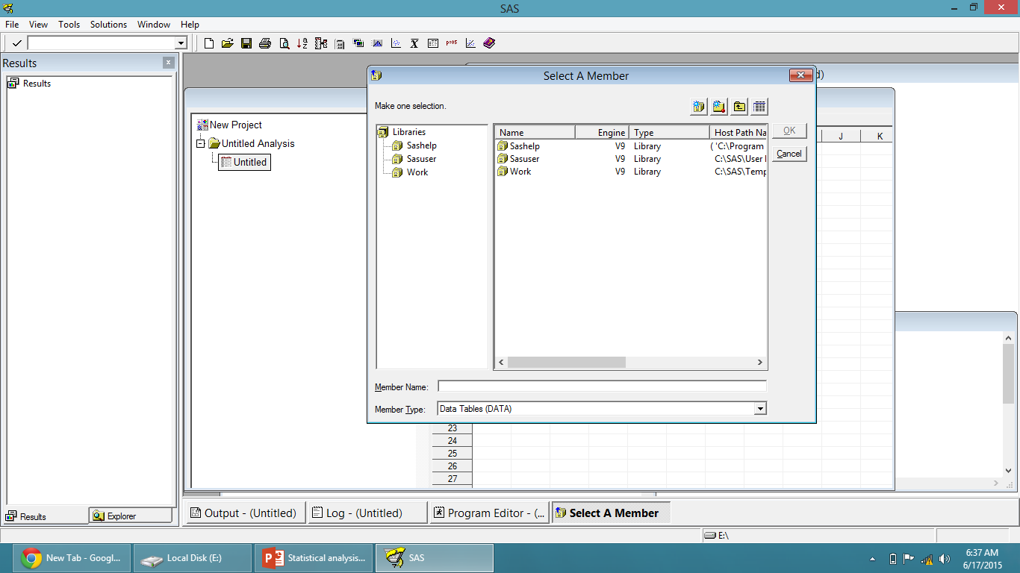

Slide 21
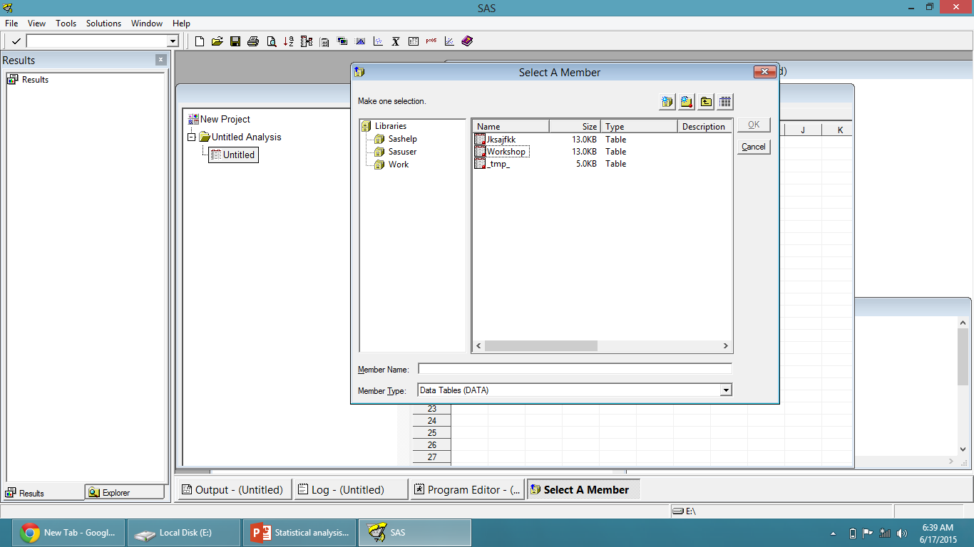

Slide 22
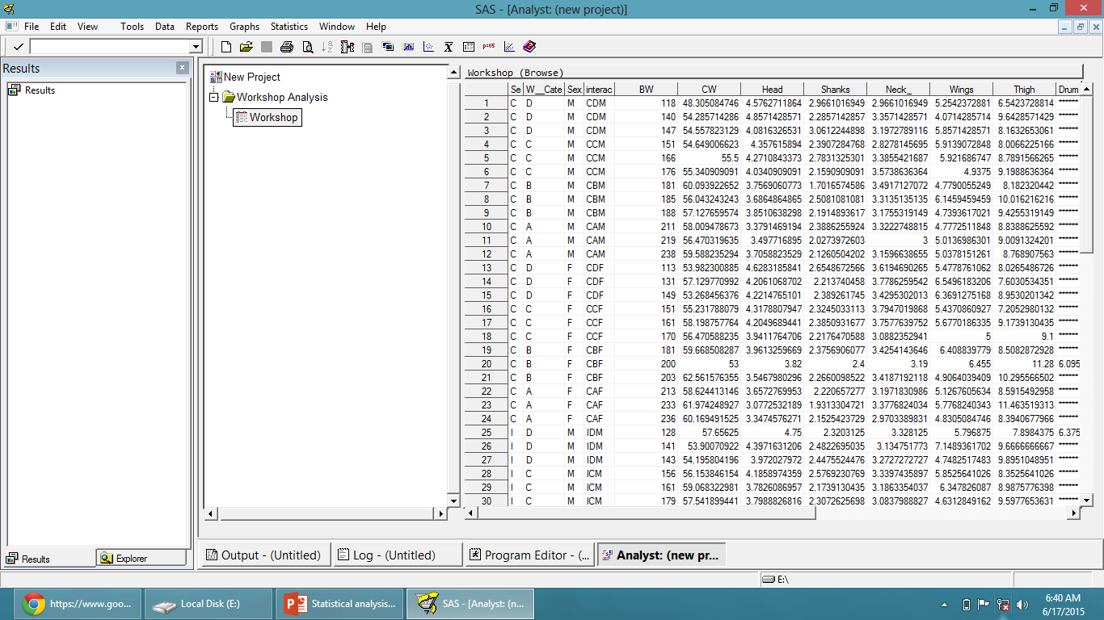

Slide 23
Summary Statistics
t test
One Way ANOVA
Factorial ANOVA

Slide 24
Summary Statistics

Slide 29
T-test

Slide 33
ONE WAY ANOVA

Slide 39
Results
Significant ≤0.05
Non-significant >0.05

Slide 41
reference
SAS Institute Inc. 2004. SAS Online Doc® 9.1.3. Cary, NC: SAS Institute Inc.

